Slide 1

Financial Options for Energy Efficiency Retrofits
(And some personal energy tips!)
Trish Jerman
Office of Regulatory Staff/Energy Office 803-737-8030

Slide 2
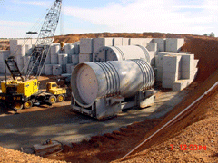

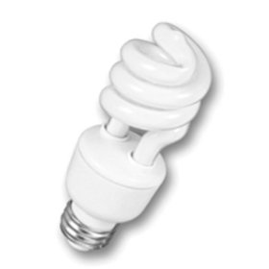
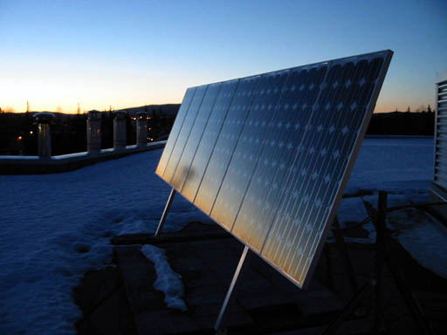
Programs
Transportation Alternatives
Renewable Energy
Energy Efficiency
Energy Planning and Forecasting
Low level Radioactive Waste Issues
Energy Education and Outreach
Notes:
Helping citizens, businesses and public entities save energy and money through greater efficiency and cleaner energy sources

Slide 3

What uses the most energy in your home?
Quiz Time!

Slide 4
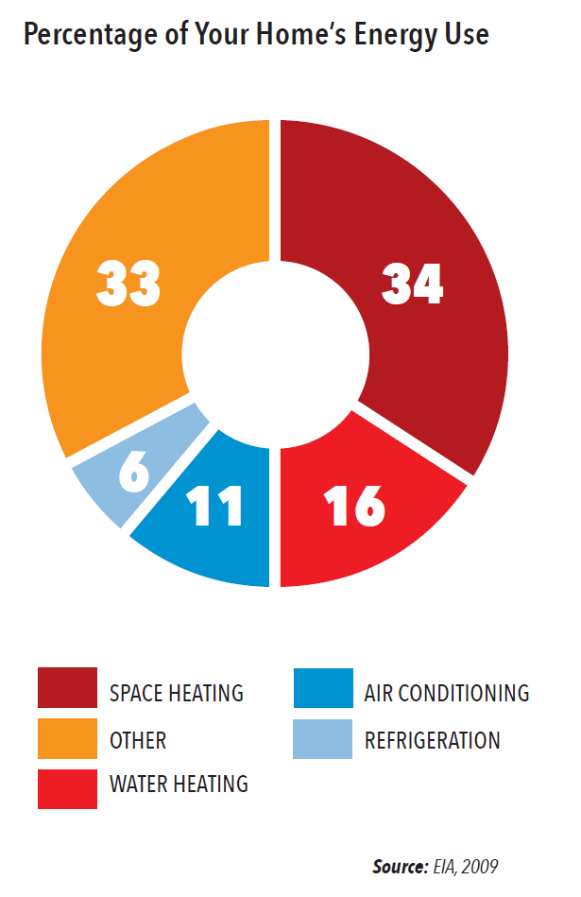

Slide 5
-
SC Electricity Generation by Fuel - 2013
2%
2%
EIA: http://www.eia.gov/state/seds/
Notes:
To give you some background, over half of the electricity generated in South Carolina is via nuclear power, but coal is an important fuel, and natural gas use is increasing. Renewables are a small part of the mix right now, but we expect them to grow.
IN the US, coal accounts for 41% and nuclear for only about 21%
Wood 1.84%, Petroleum 0.11% and Hydro 2.81%. The graph is on energy (kWh) for generation in the state only.

Slide 6
Why Should You Care?
Nearly 40% of total U.S. (non-transportation) energy consumption in 2012 was used in residential and commercial buildings, or about 40 quadrillion Btus. (EIA)
Portion of energy in buildings used inefficiently or unnecessarily:
30 percent (EPA)
Notes:
So take your utility bill and imagine 30% of it going to waste

Slide 7
Spend about $20 billion on energy annually

Slide 8

Red Queen Syndrome
"Now, here, you see, it takes all the running you can do, to keep in the same place. If you want to get somewhere else, you must run at least twice as fast as that!“
Red Queen to Alice, in Lewis Carroll’s Through the Looking Glass

Slide 9


Efficiency First!

Slide 10
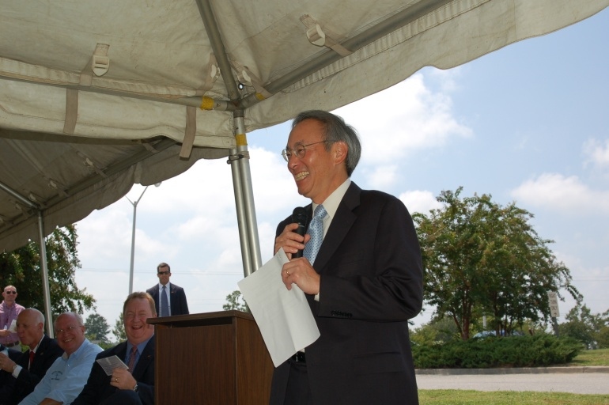
Efficiency First!
“maximizing energy efficiency and decreasing energy use will remain the lowest hanging fruit of the next several decades.”
Former U.S. Energy Secretary Steven Chu
“Efficiency is going to be a big focus going forward. I just don't see the solutions to our biggest energy and environmental challenges without a very big demand-side response. That's why it's important to move this way, way up in our priorities."
Current Energy Secretary Ernest Moniz
Notes:
Steven Chu, quoted in Olson and Fri, eds., “National Academies Summit on America’s Energy Future,” Washington D.C., The National Academies Press, 2008, p. 63.

Slide 11

Vampires! In the Living Room!
Quiz Time!

Slide 12

Living Room/Office
Replace those old lightbulbs with energy-efficient options.
Think the TV is off? Think again!
Use power strips!

Slide 13
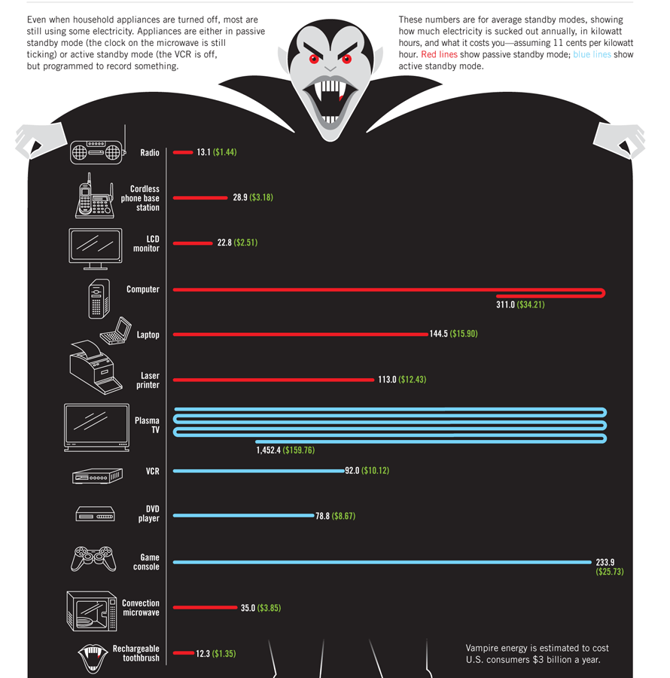
Notes:
Even when appliances are turned off most are still using some electricity. Appliances are either in passive standyby mode (the clock on your microwave or stove is still running) or active standby mode (the VCR is off but programmed to record).
A typical american home has about 40 products continuously drawing power. That amounts to roughly 10% of your energy bill.

Slide 14
Living Room/Office
TRIVIA TIME
True or False: When my cell phone is fully charged it stops using power automatically.
  FALSE
True or False: I have a screen saver on my computer so I’m saving power!
  FALSE
How much money, on average, does it cost to operate a cable box with DVR per year?
  $43.46
Notes:
Q1: Even if you unplug the phone from the charger, if it is still in the outlet, it’s still pulling power.
Q2: It is a common misperception that screen savers reduce a monitor's energy use. Use automatic switching to sleep mode or simply turn it off.
Q3: one of the largest offenders in your home might just be your cable or satellite TV box. Unlike computers and other electronic devices, a set-top cable box with a digital recorder can consume as much as 35 watts of power Even when they’re powered off, these devices consume an average of 17.83 watts. That means that even if you simply left your cable box plugged in for a year and never turned it off, it would add $17.83 to your electrical bill. Make that a cable box with DVR capabilities, which is an increasingly popular option, and your total more than doubles to $43.46.

Slide 15
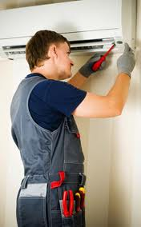
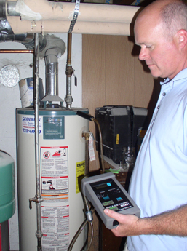
Financial Assistance
ConserFund & ConserFund Plus
Performance Contracting
Energy Efficiency Revolving Loan
USDA grants and loans
Mini-grants

Slide 16
Financial Assistance – ConserFund
ConserFund Loan Program
  For government and non-profit
  Retrofits
    Replacement or modification of lighting, HVAC, building envelope (doors, windows, insulation, roofs); energy control systems
  Renewables & Alternative Transportation
    Fleet conversions (cost of conversion or equivalent)
    Biomass, solar, geothermal if return is acceptable
http://www.energy.sc.gov/incentives/conserfund

Slide 17
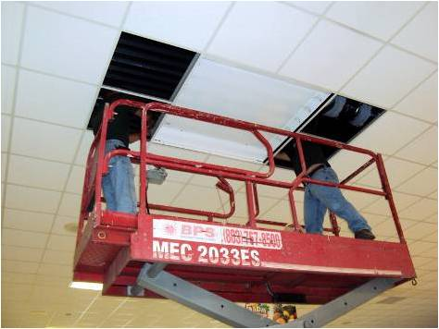
Financial Assistance – ConserFund
2% annual interest rate (reevaluated each June)
100% of eligible project costs
One project or multiple projects up to $500,000 per fiscal year
Maximum term of 10 years.
Payments made annually after a grace period for construction
Notes:
Annual interest rate is a fixed rate set below the Wall Street Journal Prime Rate on July 1 every year (currently two percent through June 2011).
Loans are for 100% of eligible project costs.
Borrowers may finance one project or multiple projects up to $500,000 per fiscal year.
Financing agreements have a maximum term of 10 years.
Payments can be made monthly, quarterly, semi-annually or annually.

Slide 18
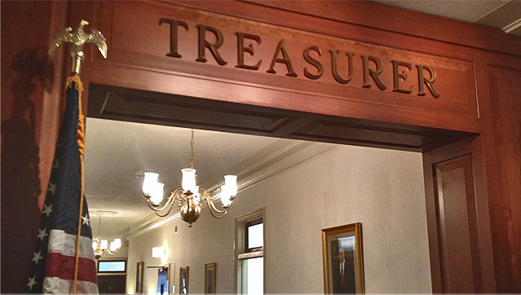
Financial Assistance - ConserFund
Requires technical analysis
Three years of audited financials plus year-to- date
Collateral
  Treasurer’s Intercept
  Bank letter of credit for non-profits

Slide 19
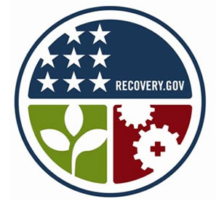
Financial Assistance – ConserFund Plus
ConserFund Plus
  For state government and schools only
  30% grant/70% revolving loan at 2% interest
  ARRA based
    Davis Bacon
    Buy American

Slide 20
Financial Assistance – EERL
Energy Efficiency Revolving Loan (EERL)
  For government, non-profit, commercial, industrial
  Building retrofits, renewables, alternative transportation
  Terms will vary
  ARRA based (Davis Bacon, Buy American )
  Contact:
Edwin Lesley
803-744-0301
elesley@BDCofSC.org

Slide 21

What Works: Georgetown School District
District cut energy consumption by >1 million kBtus from 2004 – 2008
Three pronged approach
  Technology
  Tracking
  Education
Notes:
In the past three years, Georgetown School District has made improvements that reduced energy consumption by over one million kBtus from fiscal year 2004 to fiscal year 2008 and that are projected to produce further reductions in fiscal year 2007(revise). The Energy Management Department upgraded the district’s energy management system, replaced HVAC units, implemented “no cost” measures, and started tracking all utility bills. A three-year usage comparison chart illustrates the results.
The major capital improvement was the replacement of 91 rooftop HVAC units on five of the District’s 17 schools. The new 14 SEER units use 410A refrigerant (which is non-ozone depleting) and variable speed indoor fan motors. In a side-by-side actual runtime comparison with the older 7 SEER units, the new units reduced usage up to 30 percent.
Several in-house projects, implemented at no cost other than staff time, generated annual savings of $93,000. These included removing lights from vending machines and changing the nighttime temperature setbacks. The district also restructured utility rates and identified billing errors.
Georgetown School District’s Energy Manager, Tony Holcomb, has a three-pronged approach to energy management—technology, tracking, and education. He offered the following snapshots of the Energy Management Department’s ongoing program.

Slide 22
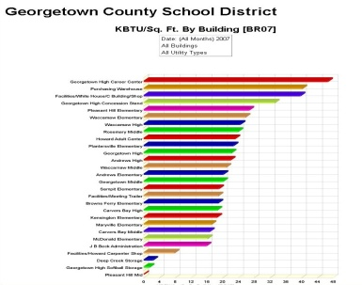
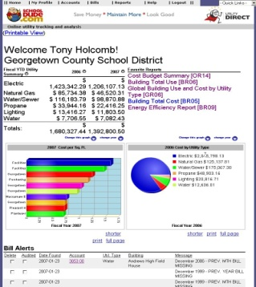
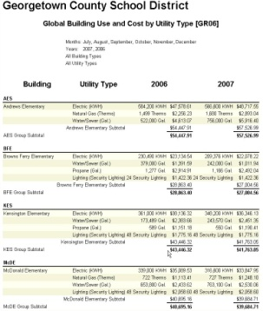
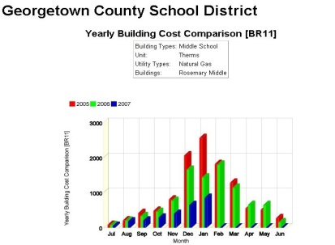
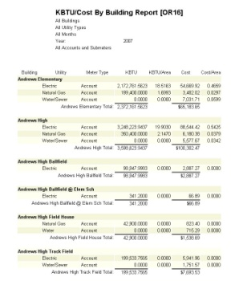
What Works: Georgetown School District
Notes:
Energy Monitoring and Recording
“We use School Dude’s Utility Direct to monitor and analyze all of our utilities. We can now more precisely compare school to school, month to month and even year to year usage, check for billing errors, and compose comprehensive reports and more accurately report usage to the State Energy Office. We can even identify areas where savings are possible by investigating bills that vary in usage and cost above a certain amount to see if there is a water leak, equipment operating after hours, etc.
“Each month, school administrators are sent a report on their utilities. This way they can see their usage in all areas such as electric, natural gas, water, etc., and compare it to other schools. This information is vital in relaying progress or the need for improvements in energy consumption to faculty and staff. It can even encourage friendly competition between schools. They are divided into three different categories: high schools, middle schools, and elementary schools because each grade level has different levels of energy needs

Slide 23

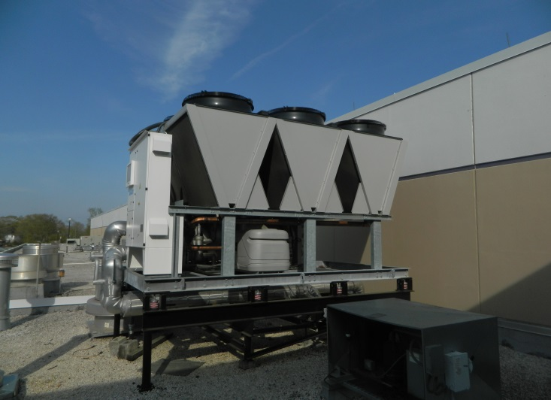
What Works – Lexington SD 4
Replaced chiller, boiler, with additional controls
ConserFund Loan: $386,252 (est. $490,000)
Total Costs (2% interest/10 years): $429,990
Estimated annual savings: $ 52,944
Actual annual savings: $67,815 (26.6%)
Estimated payback: 7.3 years
Likely payback: 5.7 years
Projected lifetime savings: $1.05 million

Slide 24
What Works – Oconee School District
New chiller, direct digital controls
ConserFund Loan: $500,000.00
Total Costs (3% interest/5 years): $545,886
Estimated annual savings: $ 65,000.00
Estimated payback: 7.7 Years
Projected lifetime savings: $1.3 million

Slide 25
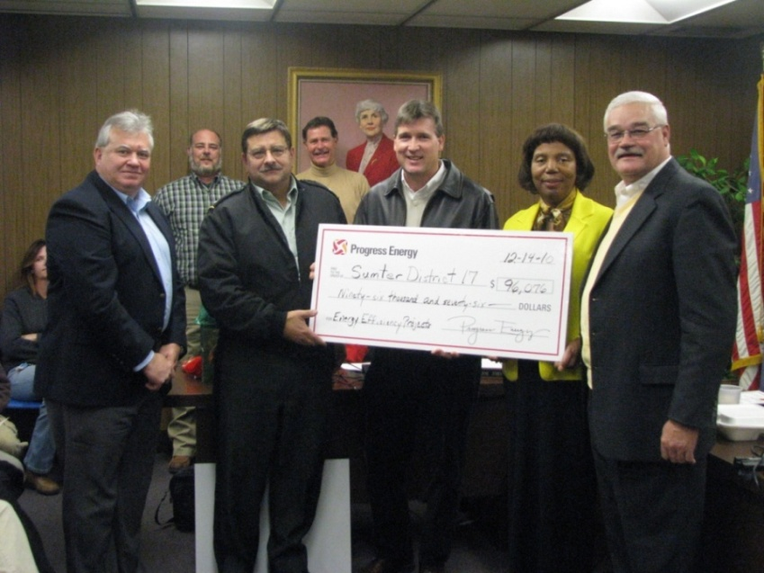
What Works - Sumter School District 17
  ARRA funding of $241,757
  Direct Digital Controls
  Savings – $ 48,826 annually (about 5 yr payback)
  - $976,527 lifetime
  Received $96,076 rebate from Progress Energy’s Energy Efficiency for Business program
Notes:
Sumter School District 17hool District 17 - $241,757

Slide 26
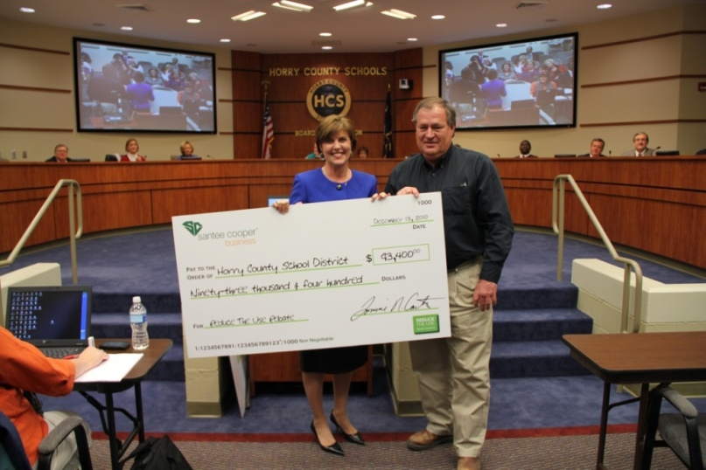
What Works - Horry County School District
  1651 Occupancy Sensors @ $598,438
  Savings - $ 289,000 annually
  - $2,896,000 lifetime
  Received $93,400 rebate from Santee Cooper’s “Reduce The Use – South Carolina” campaign

Slide 27
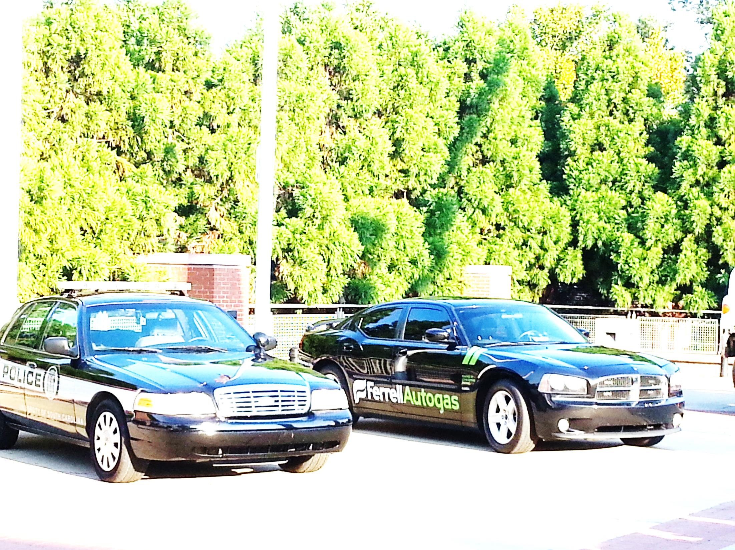
What works: Vehicle Conversions: Propane
Greenville County
  Converted 113 cruisers
  Alliance Autogas & SE Propane Autogas Development Program
  3 refueling stations
  @$100,000 annual fuel savings
Greenwood County
  Converted 37 vehicles
  Propane duel-fuel cruisers
  $5,800 per retrofit
  ARRA grant

Slide 28
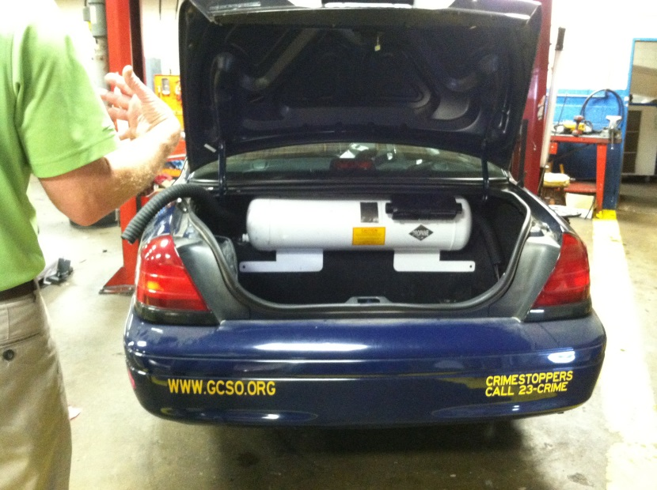
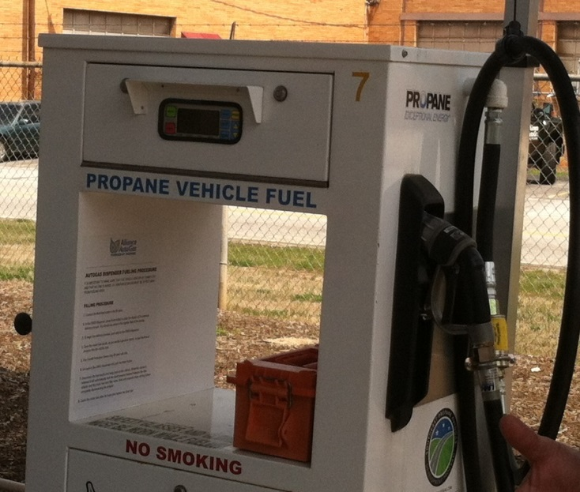
What works: Vehicle Conversions: Propane
Conversion cost @ $5,000
Limited infrastructure investment (@$250,000)
Dedicated and duel-fuel options available
Works well in light/medium-duty vehicles
Liquid, fueling time similar to petroleum

Slide 29


What Works: Vehicle Conversions: CNG
Conversion cost @ $5,000
Large infrastructure investment (@$500,000)
Dedicated and duel-fuel options available
Works in light/medium/heavy-duty vehicles
Fueling can be fast-fill (5 minutes) or time-fill (overnight)

Slide 30
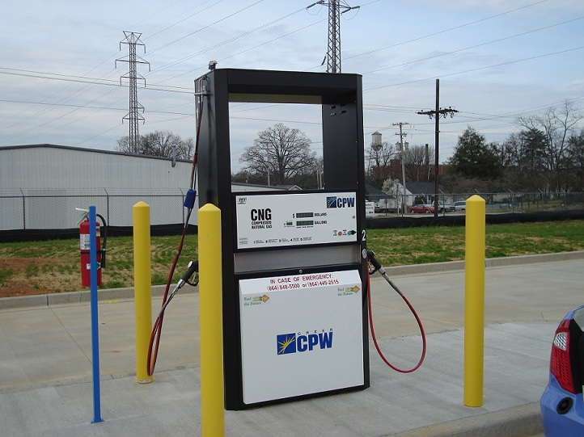
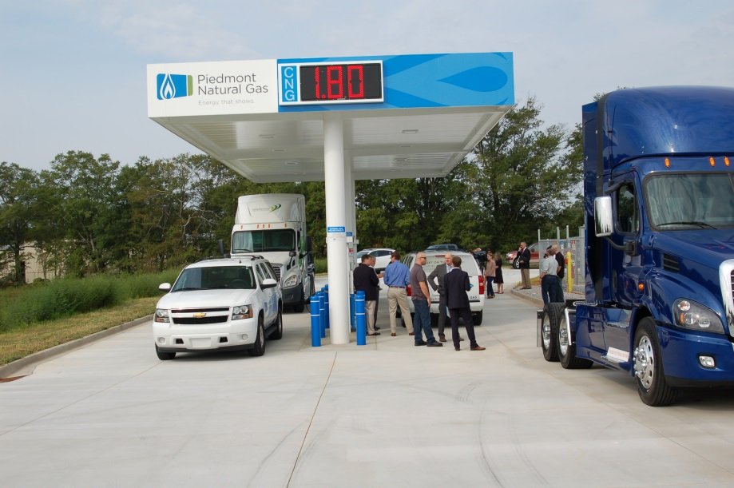
What works: Vehicle Conversions: CNG
Greer Commission of Public Works
Spinx and Spire both have
installed charging stations
open to the public
Notes:
Converted 14 light-duty vehicles
Installed a CNG fast-fill station open to the public ($412,000) saved $80,000 using CPW labor
Encouraging other CNG development in the area (AT&T, Frito Lay, City of Greer)
Loaner program available in January

Slide 31
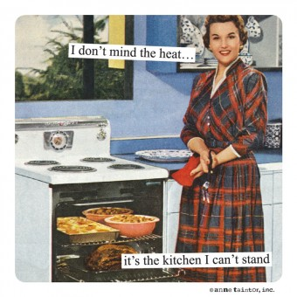
If you can’t stand the heat…
Quiz Time!

Slide 32
Kitchen Trivia time!
What is the most efficient appliance in the kitchen?
  MICROWAVE
What kitchen appliance uses less energy than your oven and can be left on all day?
  CROCK POT
True or False: Opening and closing the refrigerator door multiple times is better than leaving the door open and getting all of your goodies out at once?
  FALSE
Notes:
Q1. What is the most efficient appliance in your kitchen?
The answer: It’s your microwave, believe it or not. That two-minute popcorn machine uses just 1/3 of the wattage your oven at 750–1100 watts on average and can be used for more than just frozen meals, reheating leftovers, and defrosting chicken. In fact, there are entire books dedicated to culinary usage of the microwave. Recipe books such as “A Man, a Can, a Microwave,” have now turned some of your favorite party-pleasing meals and hors d'oeuvres into microwavable treats (think Buffalo wings). As a general rule, shorter cooking time equals fewer watts, and you're unlikely to use a microwave for anything more than 20 minutes at a time, even with these new age recipes.
Q2. What kitchen appliance uses less energy than your oven and can be left on all day?
Answer? If you didn’t guess it, it’s a Crock-Pot or slow cooker. The device that made “Set it and forget it” style cooking popular in the 70s makes incredible beef stews, brisket, and chicken casserole as easy as turning a dial. It also uses much less energy. At 200-250 watts on the high setting, it beats any toaster oven at 1225 watts. Try slow-cooking a tasty 8-lb cured- ham, drizzled with brown sugar for four hours. Pair your vegetables accordingly.
Q3. leaving the door open for a longer period while you remove items from the ‘fridge is better than opening and closing the door multiple times over the course of a few minutes. Each time the door closes, the motor starts to re-cool the interior. By allowing the motor to start only once, you save some energy.

Slide 33
Financial Assistance – Performance Contracting
Energy Savings Performance Contracting
“The use of GUARANTEED savings from the maintenance and operations budgets as capital to make needed upgrades and modernizations to your building environmental systems, financed over a specified period of time.”
-- US Department of Energy

Slide 34
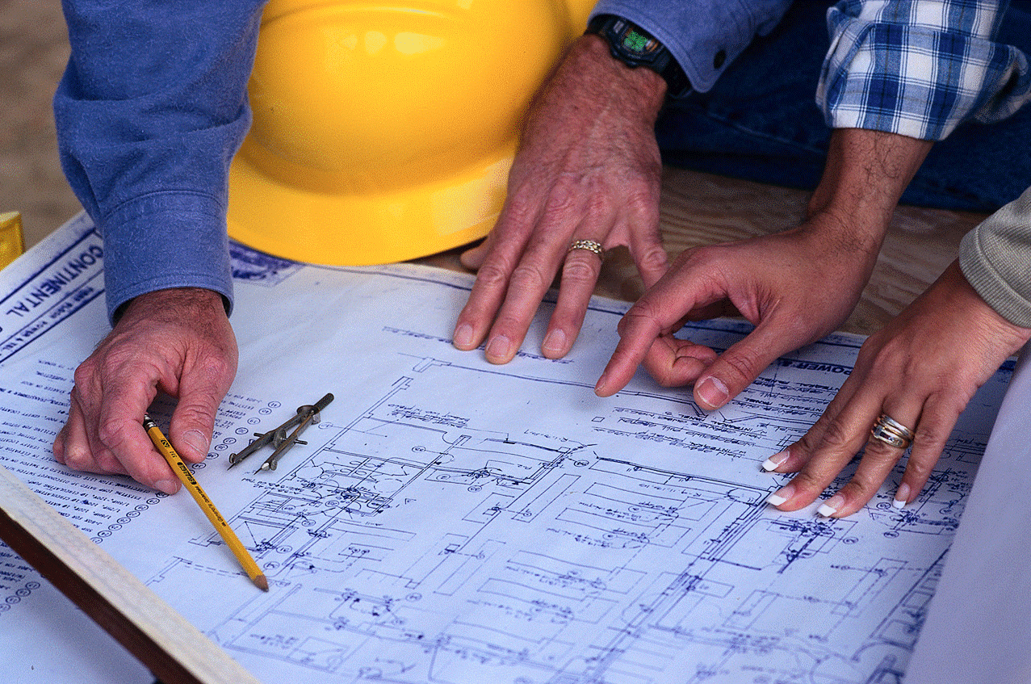
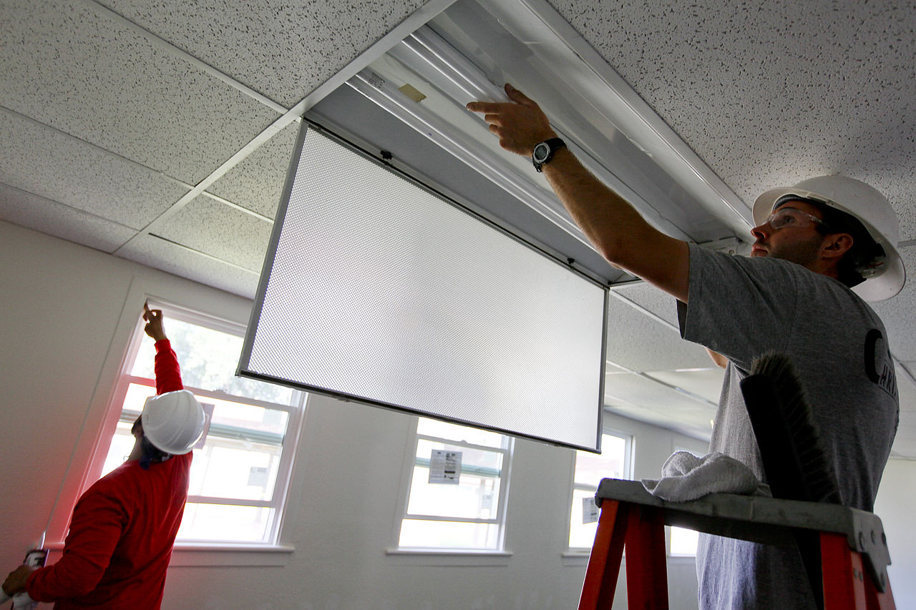
Financial Assistance –
Performance Contracting
If the project is straightforward
  -Project management can be done in-house
  -Financing isn’t a problem
  -The project is small in scope or cost
  -Loan might be the best approach
Notes:
For example, you know your agency needs to change its T12 lighting and ballasts.
For financing, ConserFund is for government agencies, EARL is for commercial and industrial retrofits, SC Saves is available for private and public organizations

Slide 35
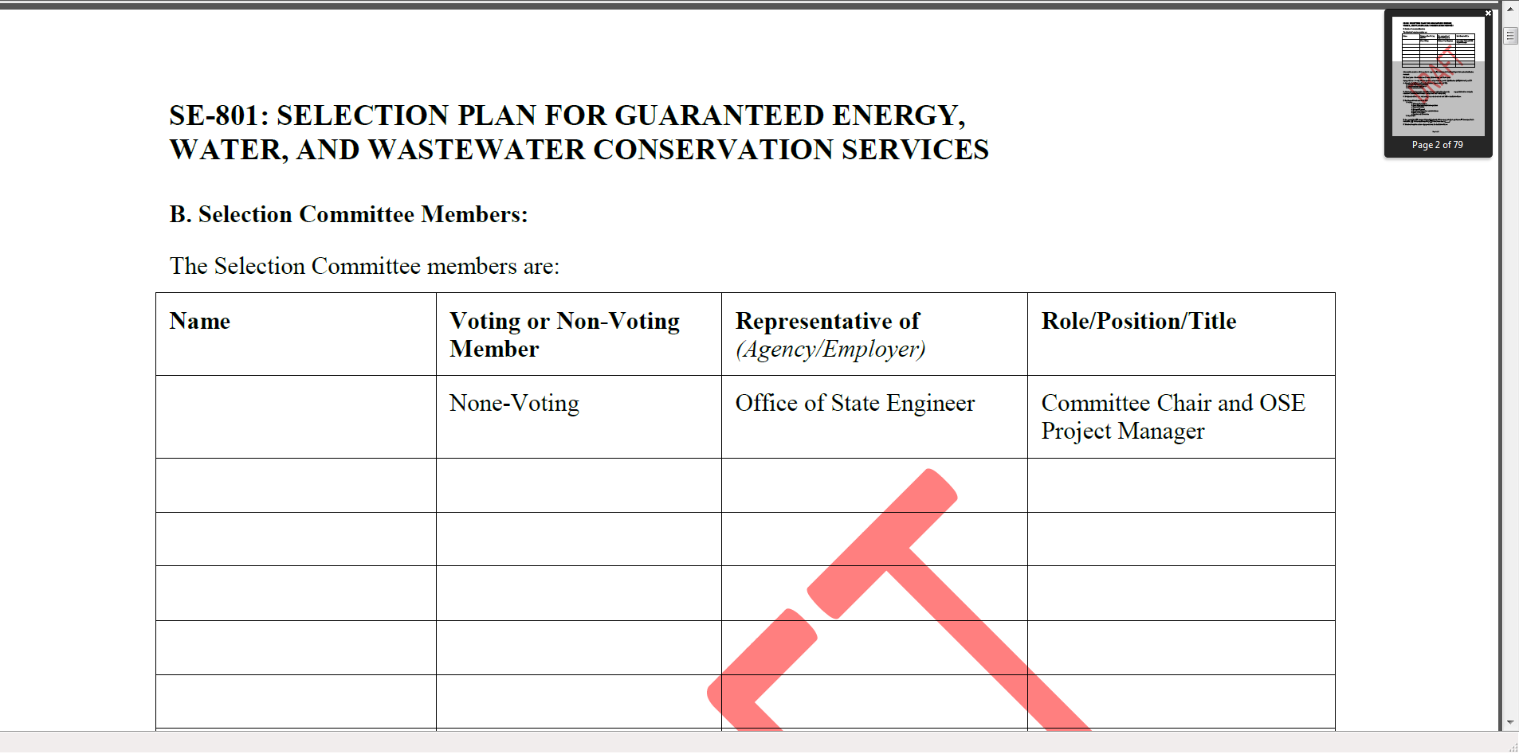
Financial Assistance –
Performance Contracting
If the solution seems complex or unclear
  -You need project management help
  -Financing is an issue
  -Your organization wants to mitigate risk
  -Think about entering into a Performance Contract
  Help available through SCEO
  http://energy.sc.gov/perfcont

Slide 36
Financial Assistance – USDA
Most areas in SC qualify as “rural”
Funding for cost-share grants, loans
For retrofits and renewables
Contact:
  Shannon LeGree
  shannon.legree@sc.usda.gov
  (803) 253-3150

Slide 37



Financial Assistance -- Utility Rebates
Information on web sites – prescriptive/custom
Can pay up to half of the project cost
Get custom rebate approval BEFORE installation
Consider opt in/opt out options
Smart $aver® Incentive Program

Slide 38
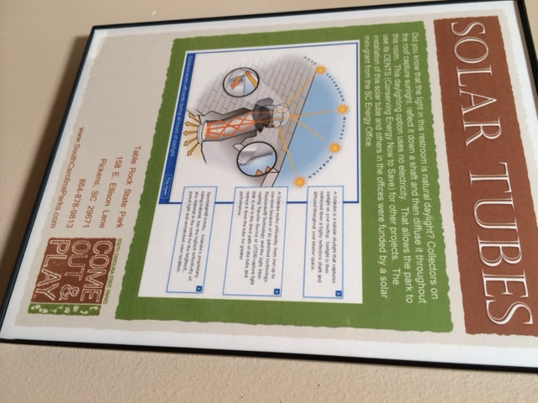
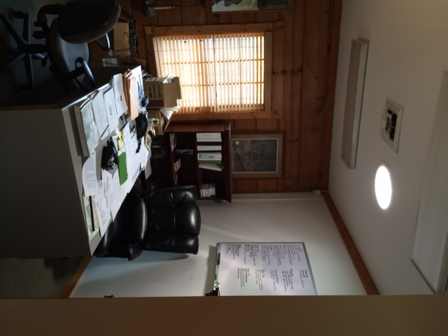
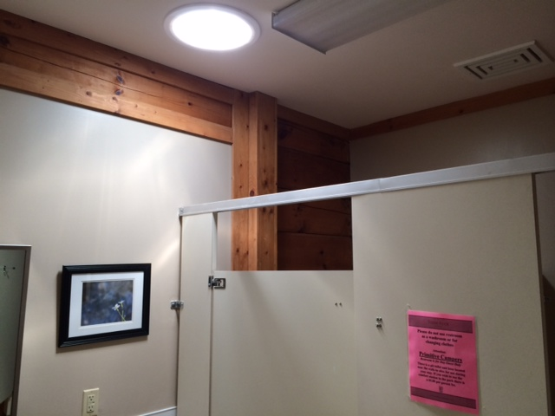
Financial Assistance – SCEO Mini-grants
For state agencies, K-12 schools, public colleges & universities
$5000 (cost share not required)
Can fund lighting, other small projects

Slide 39
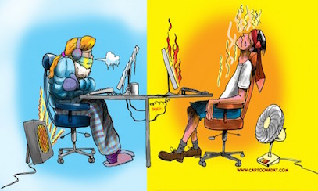
Hot and cold
Quiz Time!

Slide 40
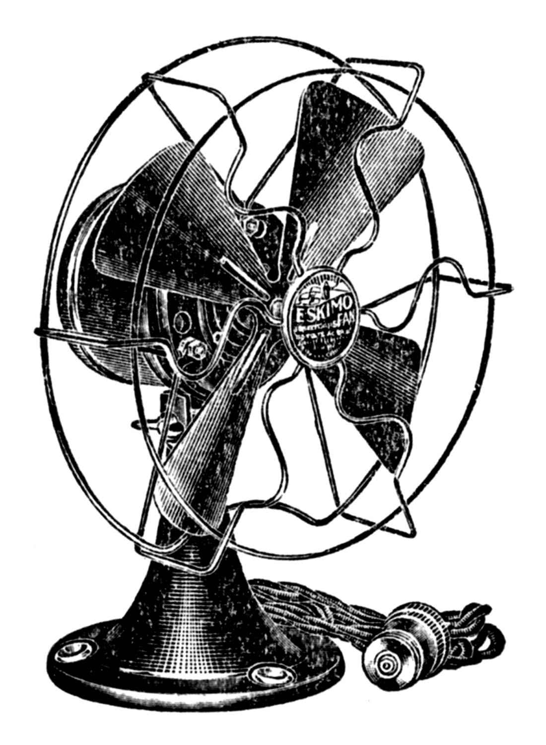
Heating & Cooling
Invest in a programmable thermostat
Hot? Fans help keep the room cooler
Use your windows!
Invest in a more efficient HVAC unit
Remember annual maintenance
Notes:
Using a programmable thermostat, you can adjust the times you turn on the heating or air-conditioning according to a pre-set schedule. Programmable thermostats can store and repeat multiple daily settings (six or more temperature settings a day) that you can manually override without affecting the rest of the daily or weekly program. COULD SAVE YOU UP TO 10% PER YEAR
You can easily save energy in the winter by setting the thermostat to 68°F while you're awake and setting it lower while you're asleep or away from home. By turning your thermostat back 10° to 15° for 8 hours, you can save 5% to 15% a year on your heating bill -- a savings of as much as 1% for each degree if the setback period is eight hours long.
In the summer, you can follow the same strategy with central air conditioning by keeping your house warmer than normal when you are away, and setting the thermostat to 78°F (26°C) only when you are at home and need cooling.
Fans circulate air in the room creating a “wind chill effect” that makes occupants more comfortable. Ceiling fans allow you to raise the thermostat about 4 degrees without impacting comfort. And remember, you can reverse the direction of the blades to push air toward the floor or pull air up from the floor.
WINDOWS can help heat your home in winter and covering your windows with energy efficient coverings to block out the sun in summer can keep your home cooler.

Slide 41
Heating & Cooling
Trivia Time!
True or False: One way air conditioning makes us cooler is by removing moisture from the air.
  TRUE
Air loss through leaky ducts accounts for how much energy waste (percentage)?
  30%!
What are good settings for heating & cooling to save energy?
  68 degrees heating/78 degrees cooling
Notes:
Q1: TRUE! When there is excess humidity in the air our body’s ability to cool itself through perspiration is inhibited. Walk outside on a warm day and look at your HVAC unit, is there water dripping from your p-trap? That’s humidity from the interior of your home being removed by your unit!
Q2:

Slide 42

Solar
On Everyone’s Mind….

Slide 43
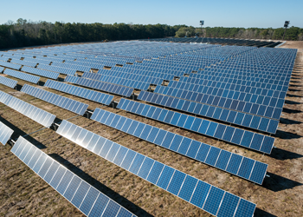
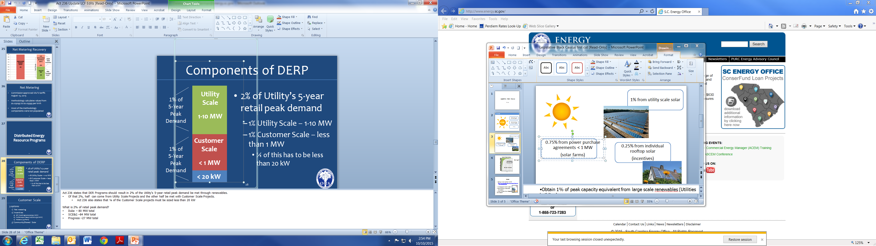

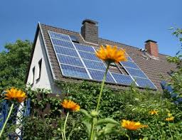
1% from utility scale solar
0.75% from power purchase agreements
(smaller solar farms via RFP)
0.25% from individual rooftop solar
(incentives)
Notes:
Obtain 1% of peak capacity equivalent from large scale renewables (Utilities building) Biggest segment, but one you’ll hear the least about
Obtain another 75% of peak capacity equivalent from facilities <1.0 MW This will affect your constituents, or has affected, as developers search for suitable land to lease for a solar farm. Our office has received many calls about it. If they aren’t sure about someone contacting them, they should call their utility.
Provide incentives to enable customers to purchase or lease solar facilities <20 KW for the equivalent of 0.25% of peak capacity (“rooftop solar” for homes and commercial spaces) This will create a huge demand for solar from constituents, putting some pressure on local government code officials and permitting offices to keep up. May also affect local first responders who have to get up to speed on how to respond to a fire where a solar panel is involved.
Finally, regulated utilities have to develop plan for tax exempt facilities like schools and churches Community solar can be an option, and in the case of SCE&G, there are generous incentives for schools.

Slide 44
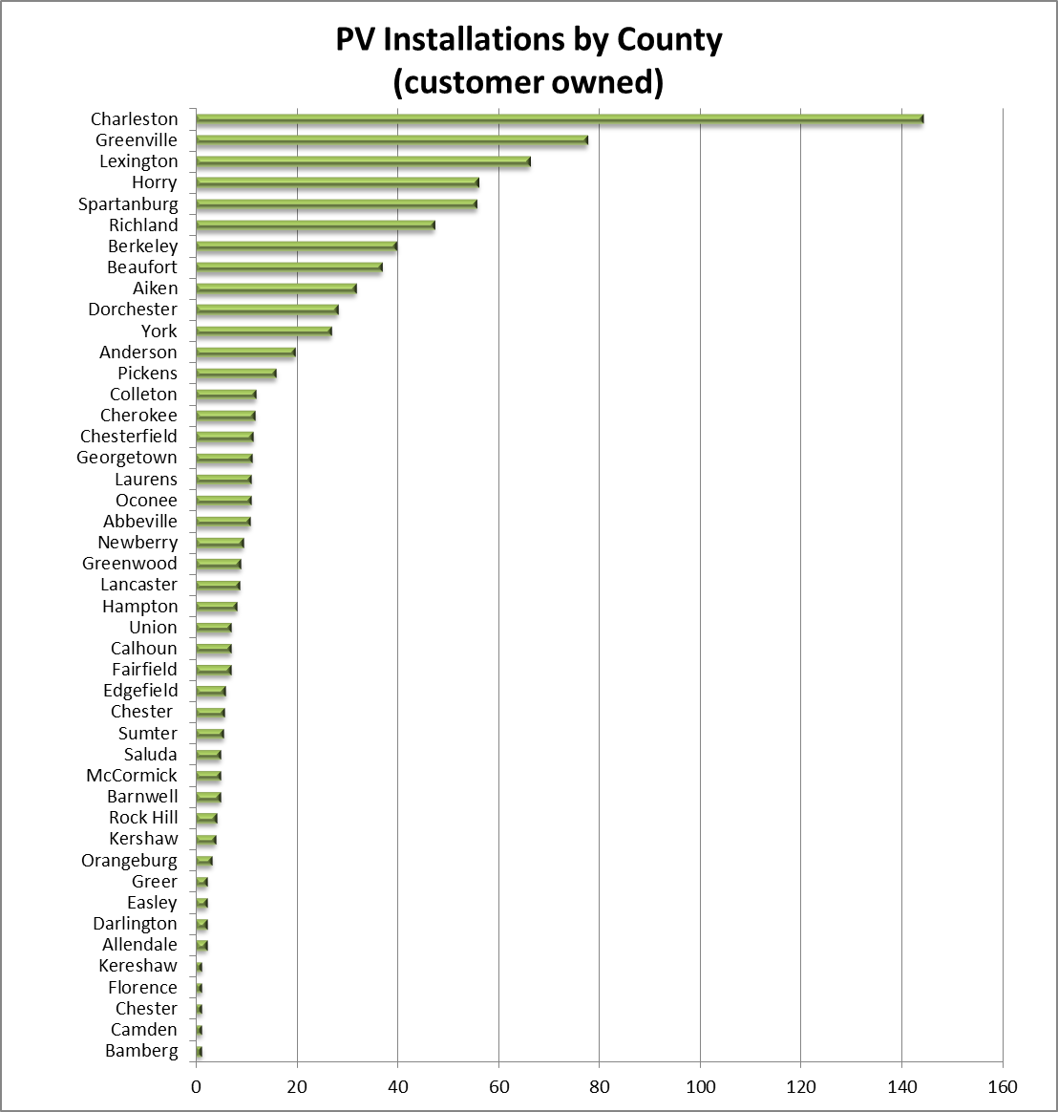

7000 installations by 2020
Notes:
The number of installations has grown from 581 when we conducted this survey last year to 831 this year, an increase of 250. As expected, many of the areas with the highest number of installations are those with high populations as well as coastal areas with good solar. What you have to keep in mind is that if the utilities are going to meet the requirements of the law they estimate that SCE&G and Duke/Duke Progress all together will have to go from under 900 installations to about 7000 in a period of 5 years. This is going to create strains on installers and local government offices.

Slide 45
Options for Public Entities
SCE&G
  $0.22 bill credit for non tax paying entities
  Community solar
Duke/Duke Progress
  $1/Watt rebate
  Community solar

Slide 46

Residential Options
SCE&G
  Net metering, performance incentive
Duke/Duke Progress
  Net metering
  $1/Watt rebate
Others
  Ask!

Slide 47
Additional Resources – Energy Plans
www.energy.sc.gov
Public institutions
    Energy Conservation Planning
  Local Government

Slide 48
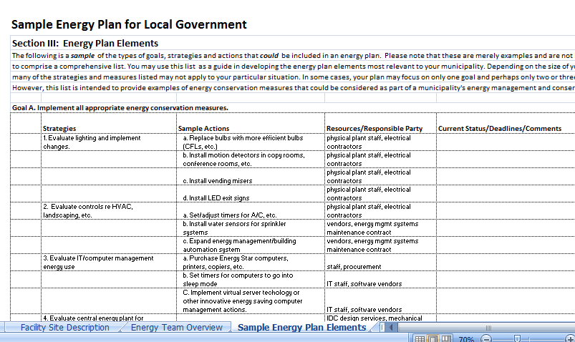

Slide 49
Additional Resources – Association of SC Energy Managers
www.energy.sc.gov
ASCEM
    Twice a year training conferences
    Agency recognition
    Specialized training opportunities

Slide 50

Fleet Conversion
Additional Resources: Transportation s
Palmetto State Clean Fuels Coalition (SCEO)
  Fuel savings calculators
  Fuel providers
  Conversion specialists (CNG/Propane)
  Alternative Fuels Data Center (USDOE)
    Station locator for refueling

Slide 51

QUESTIONS?
Trish Jerman
803-737-8025 tjerman@energy.sc.gov
Jennifer Satterthwaite
803-737-0411 jsatterthwaite@energy.sc.gov

