Slide 1
Improving internal business processes
Kristen Cooper – Treasury Management Consultant
Lauren Patterson – Treasury Management Consultant
Kathy Yath – Ethnography Team Lead
October 20, 2015
SC GFOA

Slide 2
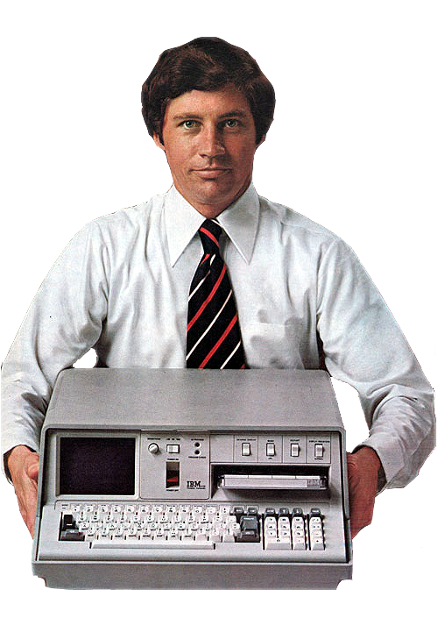
Some things have undergone massive changes over the years…
1978
2015
IBM 5100 portable computer
55 lbs.
.000064 GB
$20,000
Apple iPhone 6
6 oz.
128 GB
$500

Slide 3
“The greatest danger in times of turbulence is not the turbulence – it’s to act with yesterday’s logic”
Peter Drucker
*Peter Ferdinand Drucker was an Austrian-born American management consultant, educator, and author, whose writings contributed to the philosophical and practical foundations of the modern business corporation

Slide 4
Benefits to reviewing business processes
Business Continuity/Disaster Recovery
Improving Transparency
Increased Controls / Checks & Balances
Improved Customer Service to Constituents
Notes:
Business Continuity/Disaster Recovery
Update or create documentation of existing processes
Identify gaps in existing processes & correct before impacted
Improving Transparency
Ensure ability to easily audit “who does what” throughout workflow
Provide User level access to online banking functions; not group or a general name
Move paper based manual processes to an online tool, online decisioning, for easier tracking.
Increased Controls / Checks & Balances
Find gaps in existing processes and correct
Helps prevent potential of internal fraud as well as imposter fraud externally
Improved Customer Service to Constiuents
Find ways to increase efficiency for locating information faster in order to resolve your customer complaints or research needs.
Image vs. Paper
Automated reconcilement
Increase acceptance of electronic forms of payment

Slide 5
State and Local Government examples
A large County reviewed their lockbox processing and eliminated paper storage, improved customer service and reduced their overall cost to process those incoming payments by 30%.
A State agency reviewed their deposit procedures and was able to eliminate almost an hour a day in lost time by making daily deposits to a banking store.
A State Authority was able to utilize an internal Imaging solution for all banking related document imaging -- saving the Authority valuable storage space and time.

Slide 6
Process improvement
Why bother?
4
90
3

Slide 7
Process improvement Why bother?
Best
20%
Average
50%
Bottom
30%
Average days to process an invoice
4
6 16
Invoices payable by discount date
90%
47% 18%
Average cost to process an invoice
$3
$6 $17
Source: Aberdeen Group E-Payables 2012

Slide 8
Process improvement What differentiates top performers?
Average
50%
Top Performing
20%
Accepted routine
Paper
Satisfied with success
Change agents
Less paper
Keeps improving

Slide 9
Process improvement The roadmap
Identify
Document & Analyze
Scope
Average
Review & Evaluate
Redesign
Top performing
Measure
Improve
Operate
Implement
Manage

Slide 10
Process improvement Scope
Select a function to study
Criteria
High cost or resource intensive (labor, time)
High error rates or complaint volumes
Bottlenecks
Heroes
Obtain leadership support
Involve key business partners
Start small
Imagine the possible and set goals

Slide 11
Process improvement Document and analyze
Identify and document the current state
Interview leaders, managers and supervisors
Observe the workers in their environment
Gather data (volumes, time, error rates, cost)
Look for points of pain
Look for exceptions
The Magic Wand

Slide 12
Process improvement Document and analyze
Diagram work process
List of steps
Graphical workflows
Payables Process
Hope opens mail
Inspects invoice and routes to approver
P.O. Issued?
If yes, …….
If no, ……..
………..
File imaged copies
Hope opens mail
Inspects invoice
If no, ……..
P.O.?
If yes, ……..
File copies

Slide 13
Process improvement Document and analyze
Electronic?
4) Prepares batch: Checks processed separately for each respective company
1) Hope manually opens & sorts mail for her invoices (6:30am)
yes
3) To approver/ approvers
2) Receives invoices
no
Hope images
7) Hope prints checks
5) Checks post and creates file 8:30am
8) Process checks
6) Inputs check info
10) Brian approves check register , Hope prints for audit
11) Hope highlights account and invoices numbers on checks
13) Outgoing mail dept. stamps and seals.
14) Copies not imaged go into drawer to be imaged after
9) Print check register
12) Hope folds and stuffs envelopes

Slide 14
Process improvement Document and analyze
Electronic?
4) Prepares batch: Checks processed separately for each respective company
1) Hope manually opens & sorts mail for her invoices (6:30am)
yes
3) To approver/ approvers
2) Receives invoices
no
Hope images
7) Hope prints checks
5) Checks post and creates file 8:30am
8) Process checks
6) Inputs check info
10) Brian approves check register , Hope prints for audit
11) Hope highlights account and invoices numbers on checks
13) Outgoing mail dept. stamps and seals.
14) Copies not imaged go into drawer to be imaged after
9) Print check register
12) Hope folds and stuffs envelopes

Slide 15
Process improvement Document and analyze
Electronic?
4) Prepares batch: Checks processed separately for each respective company
1) Hope manually opens & sorts mail for her invoices (6:30am)
yes
3) To approver/ approvers
2) Receives invoices
no
Hope images
7) Hope prints checks
5) Checks post and creates file 8:30am
8) Process checks
6) Inputs check info
10) Brian approves check register , Hope prints for audit
11) Hope highlights account and invoices numbers on checks
13) Outgoing mail dept. stamps and seals.
14) Copies not imaged go into drawer to be imaged after
9) Print check register
12) Hope folds and stuffs envelopes
= Point of Pain

Slide 16
Process improvement Document and analyze
Analyze and Summarize your findings
Categorize and cluster points of pain
Manual keying Spreadsheets Paper
Identify major themes and impressions
Explore exceptions
Go upstream

Slide 17
Process improvement Redesign
Brainstorm without reservations or boundaries
Relieve the pain
Attack the paper
Consider magic wand suggestions
Challenge the status quo
“Because audit needs it”
Experiment with new process or variations

Slide 18
Process improvement Redesign
Existing
Electronic?
4) Prepares batch: Checks processed separately for each respective company
1) Hope manually opens & sorts mail for her invoices (6:30am)
2) Receives invoices
yes
3) To approver/ approvers
no
7) Hope prints checks
Hope images
5) Checks post and creates file 8:30am
8) Process checks
6) Inputs check info
9) Print check register
10) Brian approves check register , Hope prints for audit
11) Hope highlights account and invoices numbers on checks
12) Hope folds and stuffs envelopes
13) Outgoing mail dept. stamps and seals.
14) Copies not imaged go into drawer to be imaged after
Proposed
Electronic?
1) Hope manually opens & sorts mail for her invoices (6:30am)
yes
3) To approver/ approvers
4) Prepares batch: ACH processed separately for each respective company
2) Receives invoices
no
Hope images
5) ACH post and creates file 8:30am
7) Transmit payment file
6) Brian approves payment file
8) Copies not imaged go into drawer to be imaged after
17

Slide 19
Process improvement Manage and measure
Engage all stakeholders to evaluate proposed changes, but be prepared to challenge the status quo
Revisit goals and project impact
Pilot, measure, monitor, and report
Implement, modify, or abandon
Ongoing monitoring and reporting

Slide 20
Process improvement The roadmap
Identify
Document & Analyze
Scope
Average
Review & Evaluate
Redesign
Top performing
Measure
Improve
Operate
Implement
Manage

Slide 21
Process improvement Resources
Books
Everything I Know About LEAN I Learned in the First Grade by Robert O. Martichenko
Web sites
Search Process improvement, LEAN, workflows, etc.
Wells Fargo Treasury Management Consultant

Slide 22
“It is common sense to take a method and try it. If it fails, admit it frankly and try another. But above all, try something”
Franklin Delano Roosevelt

