Slide 1
Building a Better Budget Document
8:50-9:40 AM
October 20, 2015
John Fishbein, Senior Program Manager, Technical Services Center, GFOA
Phone: 312-578-2268
Email: jfishbein@gfoa.org

Slide 4
#C1: Table of Contents (Mandatory)
The document shall include a table of contents that makes it easier to locate information in the document.
Criteria Location Guide Questions
Is a comprehensive table of contents provided to help the reader locate information in the document?
Are all pages in the document numbered or otherwise identified?
Do the page number references in the budget or electronic table of contents agree with the related page numbers in the budget or electronic submission?
Explanation
Detailed indices preceding individual sections can be helpful, but they are not a substitute for a single comprehensive table of contents. Care should be taken in developing budget or electronic page number references in the table of contents, so they agree with the related page numbers in the budget document or electronic submission. The use of whole numbers as page numbers is easier to follow.
Make sure every page in the budget document is sequentially numbered.

Slide 5
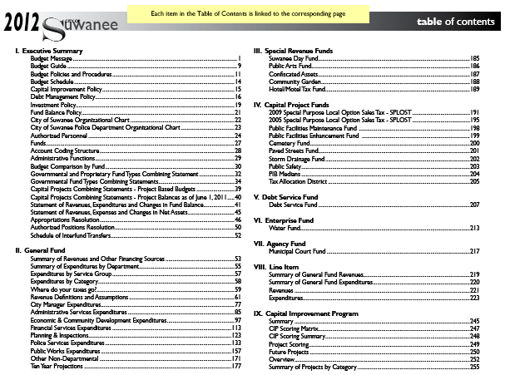
City of Suwanee, GA.

Slide 6
#P1: Strategic Goals and Strategies
The document should include a coherent statement of organization-wide, strategic goals and strategies that address long-term concerns and issues.
Criteria Location Guide Questions
1. Are non-financial policies/goals included?
2. Are these policies/goals included together in the Budget Message or in another section that is separate from the departmental sections?
3. Are other planning processes discussed?
Explanation
This criterion relates to the long-term, entity-wide, strategic goals that provide the context for decisions within the annual budget. Consider including action plans or strategies on how the goals will be achieved.
Look at GFOA best practice on Establishment of Strategic Plans.

Slide 7
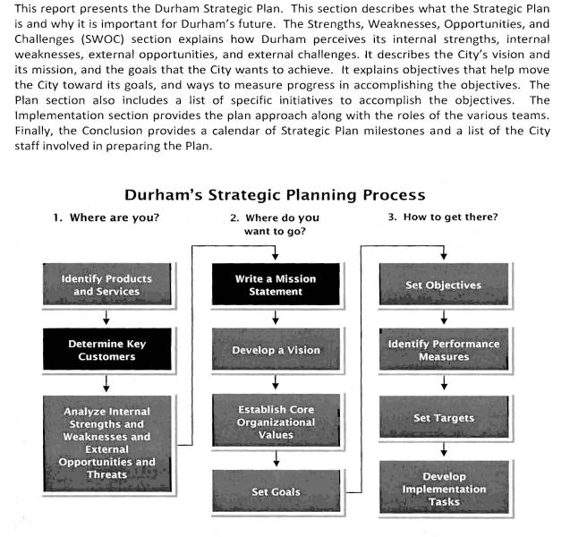
City of Durham, NC.

Slide 8
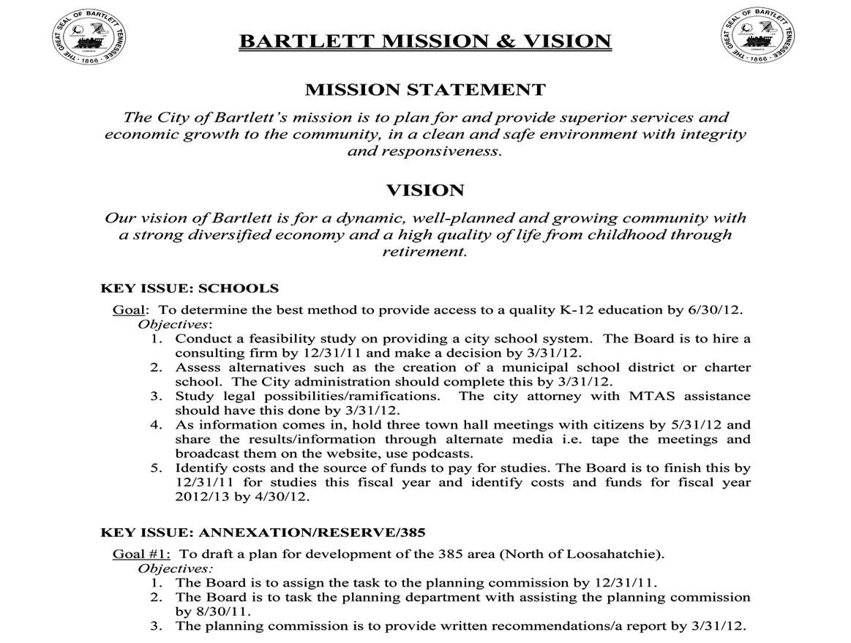
City of Bartlett, TN.

Slide 9
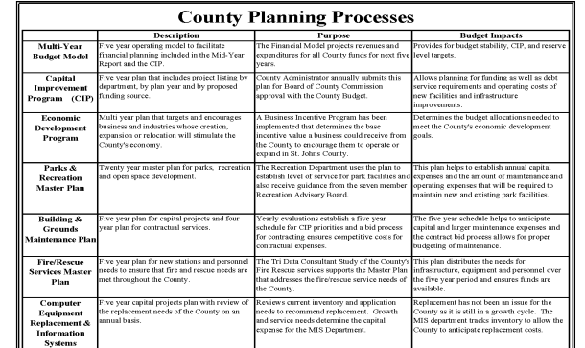
St. Johns County, FL.

Slide 10
#P2: Short-Term Organization-Wide Factors Influencing Decisions
The document should describe the entity’s short-term factors that influence the decisions made in the development of the budget for the upcoming year.
Criteria Location Guide Questions
Are short-term factors addressed?
Does the document discuss how the short-term factors guided the development of the annual budget?
Is a summary of service level changes presented?
Explanation
This criterion requires a discussion of the key factors that guide the development of the upcoming year’s budget. Factors that might be included relate to: salary and benefit guidelines, fees, capital improvements, program enhancements or reductions, tax levels, use of reserves, service level assumptions, unfunded mandates, economic development strategies, inflation assumptions, and demographic assumptions.
Factors should include a mix of operational and financial items.

Slide 11
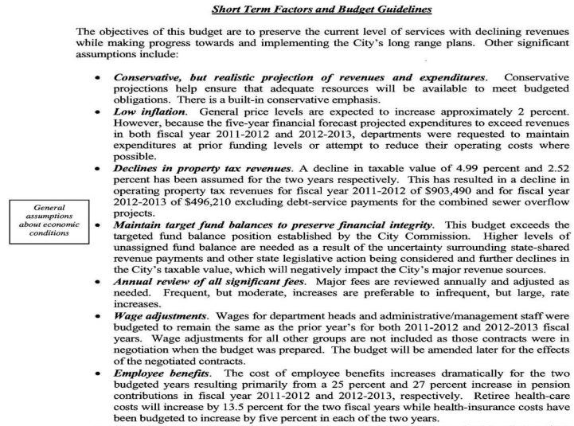
City of Birmingham, MI.

Slide 12
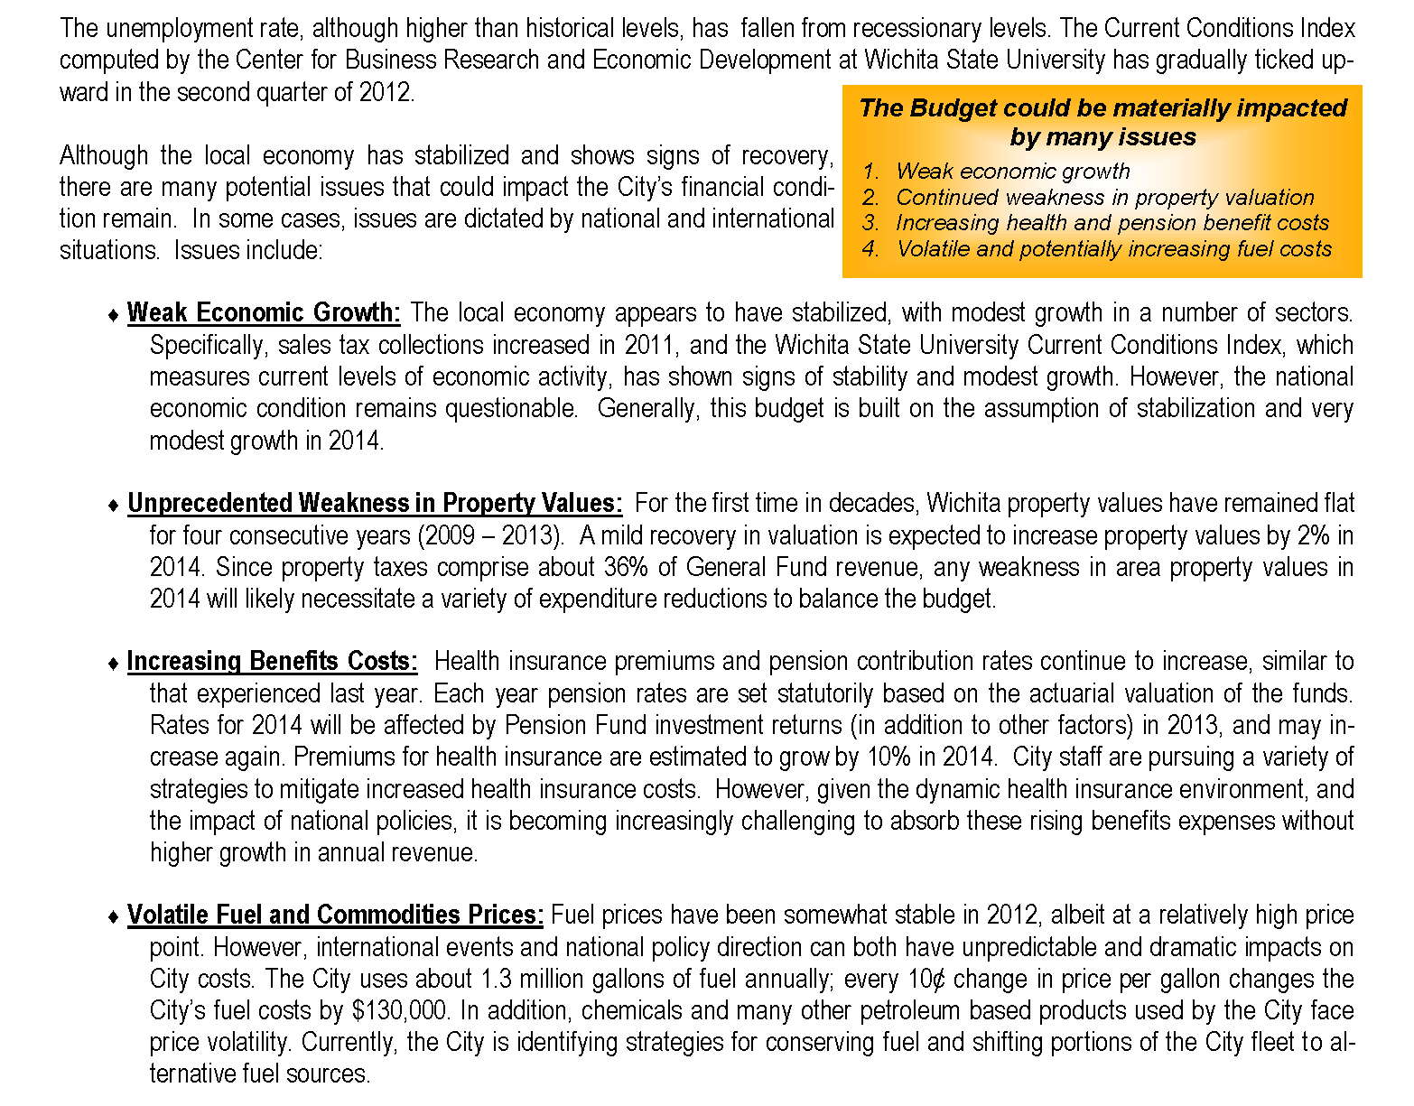
City of Wichita, KS.

Slide 13
#P3: Priorities and Issues (Mandatory)
The document shall include a budget message that articulates priorities and issues for the upcoming year. The message should describe significant changes in priorities from the current year and explain the factors that led to those changes. The message may take one of several forms (e.g., transmittal letter, budget summary section).
Criteria Location Guide Questions
Does the message highlight the principal issues facing the governing body in developing the budget (e.g., policy issues, economic factors, regulatory, and legislative challenges)?
Does the message describe the action to be taken to address these issues?
Does the message explain how the priorities for the budget year differ from the priorities of the current year?
Is the message comprehensive enough to address the entire entity?
Explanation
This criterion requires a summary explanation of key issues and decisions made during the budget process. The budget message also should address the ramifications of these decisions. It is recommended that the total amount of the budget be included in the budget message.
Discuss issues and offer solutions.

Slide 14
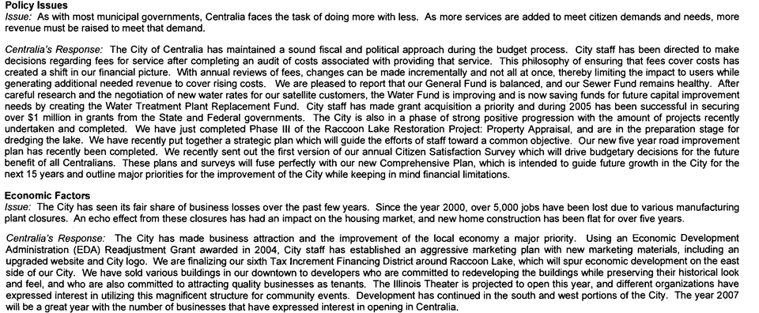
City of Centralia, IL.

Slide 15
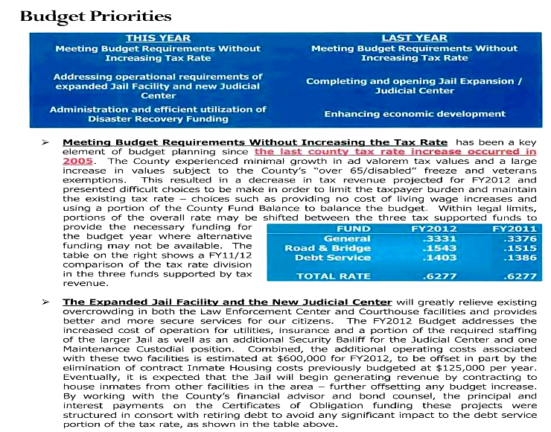
Polk County, TX.

Slide 16
#C2: Budget Overview (Mandatory)
The document should provide an overview of significant budgetary items and trends. An overview should be presented within the budget document either in a separate section (e.g., executive summary) or integrated within the transmittal letter or as a separate budget-in-brief document.
Criteria Location Guide Questions
Is an overview contained in the budget message/transmittal letter, executive summary, or in a separate budget-in-brief document?
Is summary information on significant budgetary items conveyed in an easy to read format?
Is summary information on budgetary trends provided?
Explanation
The intent of this criterion is to help readers quickly understand major budgetary items and trends (revenues, expenditures, and capital). Highlighting, indentation, bullet points, outlines, tables, or graphs may help in communicating this information. If a budget-in-brief is published as a separate document, inclusion of easy to read summary financial information in the main budget document is encouraged.
Present the budget overview in a concise manner.

Slide 17
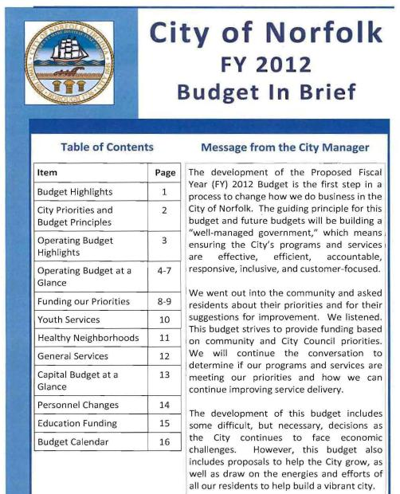
City of Norfolk, VA.

Slide 18
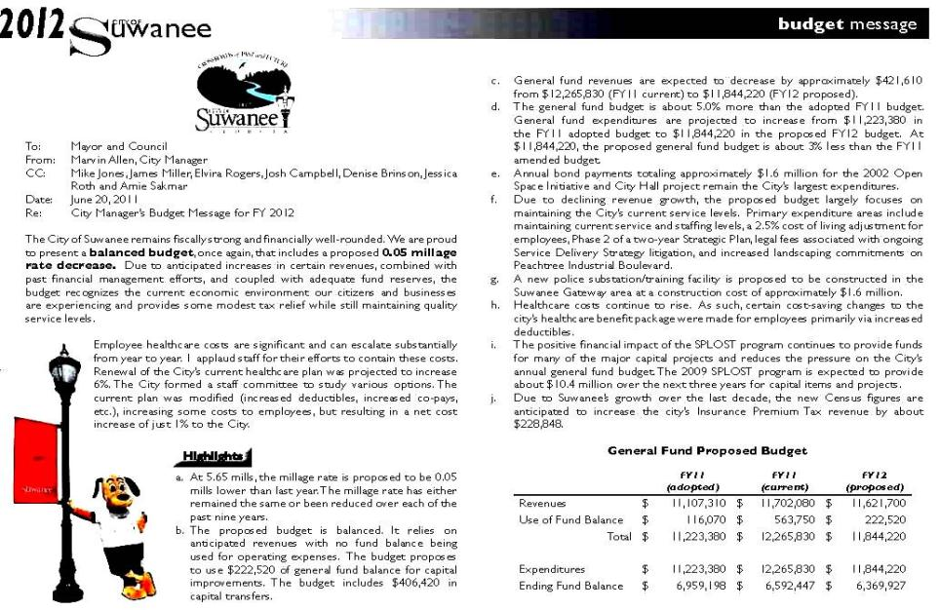
City of Suwane, GA.

Slide 19
#O1: Organization Chart (Mandatory)
The document shall include an organization chart(s) for the entire entity.
Criteria Location Guide Questions
Is an organization chart provided which shows the entire entity?
Explanation
This criterion requires that an organizational chart be presented only for the overall entity. Organizational charts for individual units are not required. When organizational charts are provided for individual units within the entity, those charts should be presented in such a way as to underscore the link between the individual unit and the overall entity.
Make sure the organization chart is legible.

Slide 20
City of Greenbelt, MD.

Slide 21
#F1: Fund Descriptions and Fund Structure
The document should include and describe all funds that are subject to appropriation.
Criteria Location Guide Questions
Is a narrative or graphic overview of the entity’s budgetary fund structure included in the document?
Does the document indicate which funds are appropriated? (Other funds for which financial plans are prepared also may be included in the document.)
Does the document include a description of each individual major fund included within the document?
If additional or fewer funds are included in the audited financial statements, does the document indicate this fact?
Explanation
Showing an entity’s budgetary fund structure is essential for understanding its financial configuration. An overview of the budgeted funds should be included in the document. This overview should include each major fund’s name and either (1) an indication of whether the fund is a governmental, proprietary, or fiduciary fund OR (2) an indication of the fund type of each fund (e.g., general, special revenue, enterprise fund). Any fund whose revenues or expenditures, excluding other financing sources and uses, constitute more than 10% of the revenues or expenditures of the appropriated budget should be considered a major fund for this purpose. The entity needs to identify its major funds.
An‘organization chart’ of the government’s funds is useful.

Slide 22
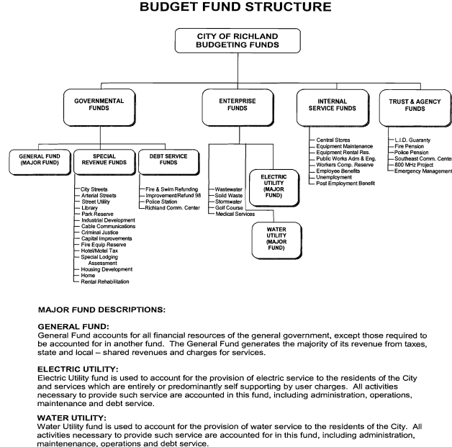
City of Richland, WA.

Slide 23
#O2: Departmental/Fund Relationship
The document should provide narrative, tables, schedules, or matrices to show the relationship between functional units, major funds, and nonmajor funds in the aggregate.
Criteria Location Guide Questions
Is the relationship between the entity’s functional units, major funds, and nonmajor funds in the aggregate explained or illustrated?
Explanation
Since most entities use more than one way of classifying financial and operational information, this criterion requires an explanation or illustration of the relationship between functional units, major funds, and nonmajor funds in the aggregate. A matrix is one way to show this relationship.
The department/fund relationship can be shown through the use of a matrix.

Slide 24
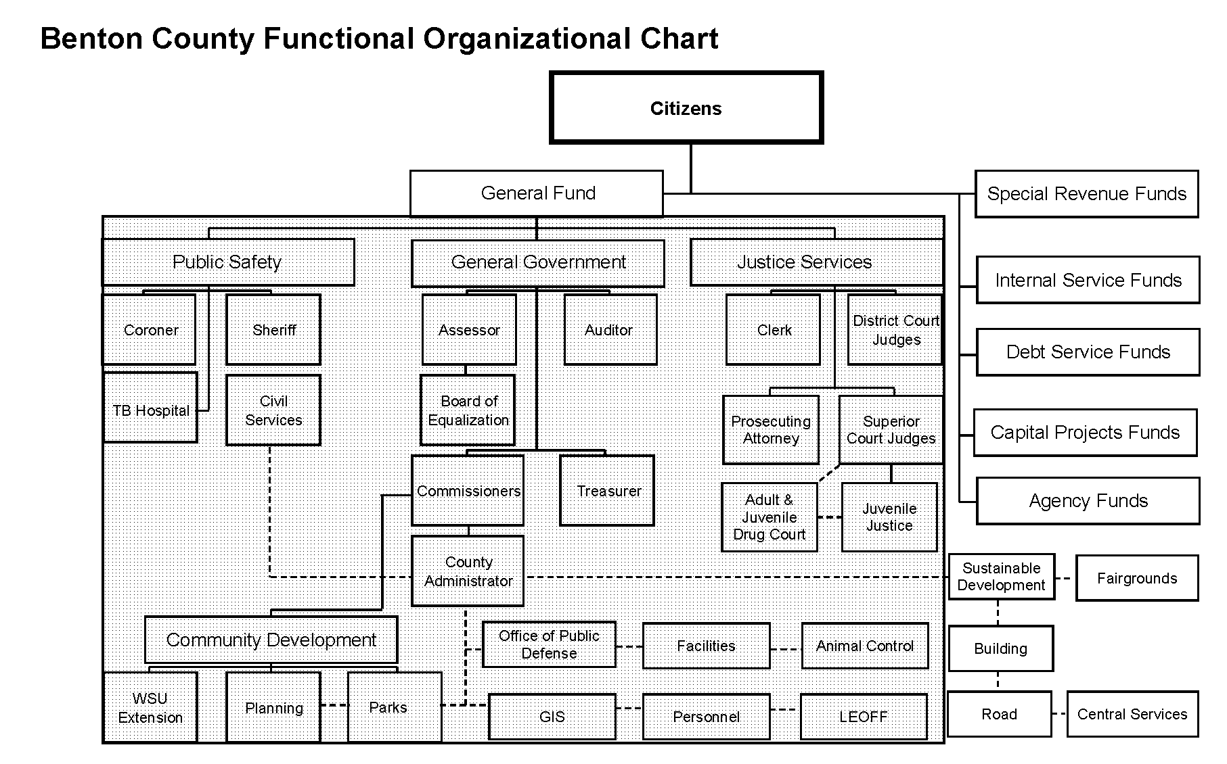
Benton County, WA.

Slide 25
#F2: Basis of Budgeting
The document shall explain the basis of budgeting for all funds, whether cash, modified accrual, or some other statutory basis.
Criteria Location Guide Questions
Is the basis of budgeting defined (eg., modified accrual, cash, or accrual) for all funds included in the document?
If the basis of budgeting is the same as the basis of accounting used in the entity’s audited financial statements, is that fact clearly stated?
If the basis of budgeting is not the same as the basis of accounting used in the entity’s audited financial statements, are the differences described?
Explanation
The document should clearly identify the basis of budgeting (e.g., modified accrual, cash, accrual) employed by the entity for each category of funds represented (governmental, proprietary, and fiduciary). If the basis of budgeting is identical to the basis of accounting used in the audited fund financial statements in the basic financial statements for some or all categories of funds, that fact should be clearly stated. Differences between the basis of budgeting and the basis of accounting should be identified.
For examples of differences between the basis of budgeting and the basis of accounting, refer to GFOA’s best practice, Relationship Between Budgetary and Financial Statement Information.
Make sure exceptions between basis of budgeting and basis of accounting are noted.

Slide 26
City of Bremerton, WA.
Basis of Budgeting
All of the funds are budgeted using the modified accrual basis of accounting. Modified accrual accounting recognizes revenues when they become measurable and available. Measurable means that the dollar value of the revenue is known. Available means that it is collectible within the current period, or soon enough after the end of the current period to pay liabilities of the current period. For this purpose the City considers revenues to be available if they are collected within 30 days of the end of the current fiscal period. Expenditures generally are recorded when a liability is incurred. However, debt service expenditures, as well as expenditures related to compensated absences and claims and judgments, are recorded only when payment is due.
Accounting Basis
The basis of accounting refers to when revenues and expenditures or expenses are recorded in the accounts and reported in the financial statements. The City’s Annual Financial Report shows the status of the City’s finances in conformance with generally accepted accounting principles (GAAP). In most cases this conforms to the way the City prepares its budget. Exceptions are as follows:
Compensated absences liabilities that are expected to be liquidated with expendable available financial resources are accrued as earned by employees (GAAP) as opposed to being expended when paid (Budget Basis).
Principal payments on long-term debt within the Enterprise Funds are applied to the outstanding liability on a GAAP basis, as opposed to being expended on a Budget Basis.
Capital Outlays within the Proprietary Funds are recorded as assets on a GAAP basis and expended on a Budget Basis.

Slide 27
#P4: Financial Policies (Mandatory)
The document should include a coherent statement of entity-wide long-term financial policies.
Criteria Location Guide Questions
Is there a summary of financial policies and goals?
Do the financial policies include the entity’s definition of a balanced budget?
Are all financial policies presented in one place?
Explanation
This criterion requires a discussion of the long-term financial policies. Financial policies that should be included (but not limited to) and formally adopted relate to: (1) financial planning policies, (2) revenue policies, and (3) expenditure policies. The entity should adopt a policy(s) that defines a balanced operating budget, and indicate whether the budget presented is balanced. The entity should adopt a policy(s) that supports a financial planning process that assesses the long-term financial implications of current and proposed operating and capital budgets, budget policies, and cash management and investment policies. The entity should adopt a policy(s) to inventory and assess the condition of all major capital assets. Revenue policies should consist of diversification, fees and charges, and use of one-time and unpredictable revenues. Expenditure policies should consist of debt capacity, issuance, and management, fund balance reserves, and operating/capital budget versus actual monitoring. Refer to GFOA’s best practices on (1) Adoption of Financial Policies, (2) Long-Term Financial Planning, (3) Multi-Year Capital Planning, (4) Establishing Government Charges and Fees, (5) Debt Management, (6) Appropriate Level of Unrestricted Fund Balance in the General Fund, (7) Creating a Comprehensive Risk Management Program, and (8) Revenue Control and Management.
Look at GFOA best practice on Adoption of Financial Polices.

Slide 28
Relative Importance of Financial Policy Types
Essential Policies | Highly Advisable Policies
Fund Balance and Reserves | Accounting & Financial Reporting
Operating Budget | Revenues
Capital Budgeting and Planning | Internal Controls
Debt Management | Expenditures
Long-Range Financial Planning | Purchasing
Investment | Risk Management
 | Economic Development

Slide 29
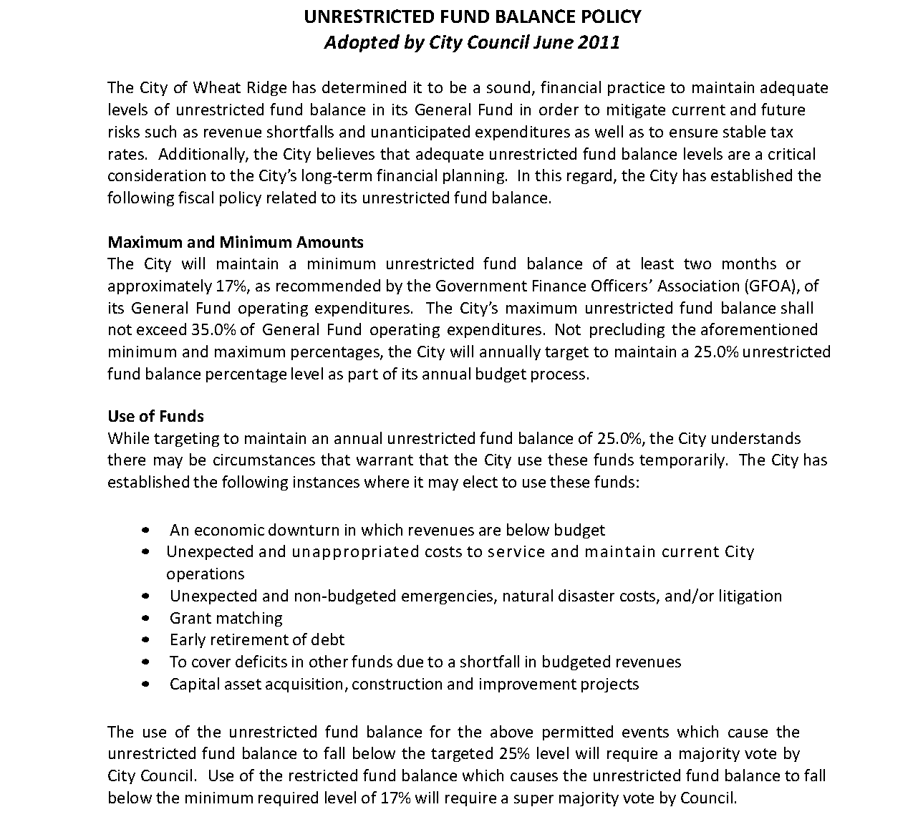
City of Wheat Ridge, CO.

Slide 30
City of Sterling Heights, MI.

Slide 31
#P5: Budget Process (Mandatory)
The document shall describe the process for preparing, reviewing, and adopting the budget for the coming fiscal year. It also should describe the procedures for amending the budget after adoption.
Criteria Location Guide Questions
Is a description of the process used to develop, review, and adopt the budget included in the document?
Is a budget calendar provided to supplement (not replace) the narrative information on the budget process?
Is a discussion of how the budget is amended provided in the budget document available to the public (including the budgetary level of control)?
Explanation
This criterion requires a concise narrative description of the budget process, including an explanation of relevant legal or policy requirements. This description should include the internal process to prepare the budget, the opportunities for public input, and the actual adoption of the budget. A budget calendar should be included (noting both key operating and capital dates), although its format may vary. Inclusion of dates in the narrative description of the budget process will not satisfy this criterion. The process for amending the budget after adoption should be covered. The description of the amendment process should identify the level at which the governing body must approve changes. Refer to GFOA’s best practice on Public Participation in Planning, Budgeting, and Performance Management as a guide on public involvement in the budget process.
Include the public in your budget process.

Slide 32
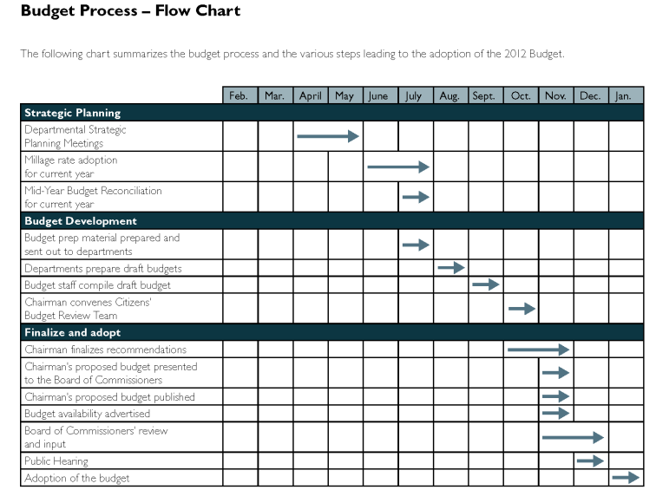
Gwinnett County, GA.

Slide 33
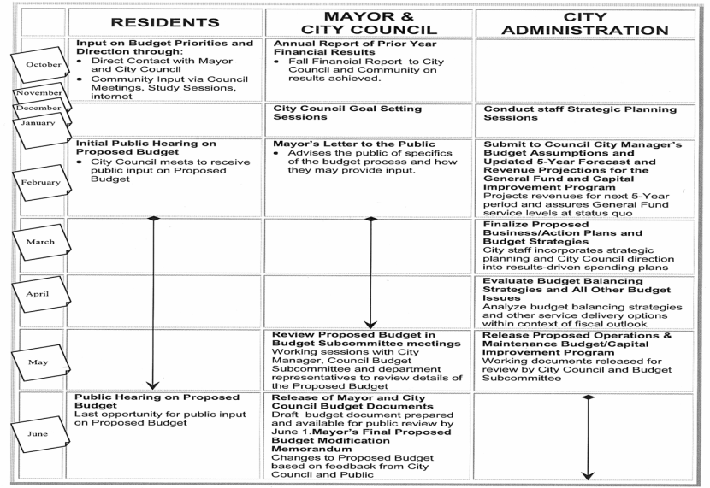
City of Santa Rosa, CA.

Slide 34
#F3: Consolidated Financial Schedule (Mandatory)
The document shall present a summary of major revenues and expenditures, as well as other financing sources and uses, to provide an overview of the total resources budgeted by the organization.
Criteria Location Guide Questions
Does the document include an overview of revenues and other financing sources and expenditures and other financing uses of all appropriated funds?
Are revenues and other financing sources and expenditures and other financing uses presented either (1) together in a single schedule OR (2) in separate but adjacent/sequential schedules OR (3) in a matrix?
Are revenues presented by major type in this schedule (e.g., property taxes, intergovernmental, sales taxes, fees and charges)?
Are expenditures presented by function, organizational unit, or object in this schedule? (For funds other than the main operating fund of the entity, a presentation by fund normally would satisfy this requirement.)
Explanation
This criterion requires a summary of the revenues and other financing sources and expenditures and other financing uses of all appropriated funds in one place in the budget document. Both revenues and other financing sources and expenditures and other financing uses must be presented either (1) together in a single schedule OR (2) in separate but adjacent/sequential schedules OR (3) in a matrix. Merely showing fund totals in a summary schedule is not proficient. Revenues should be presented by type (e.g., property tax, sales tax, fees and charges, intergovernmental) for all appropriated funds in total. A more detailed presentation that also shows revenues by major fund is encouraged, but not required. Expenditures should be presented either by function, organizational unit or object.
Break out revenues by type and expenditures by function, organizational unit, or object.

Slide 35
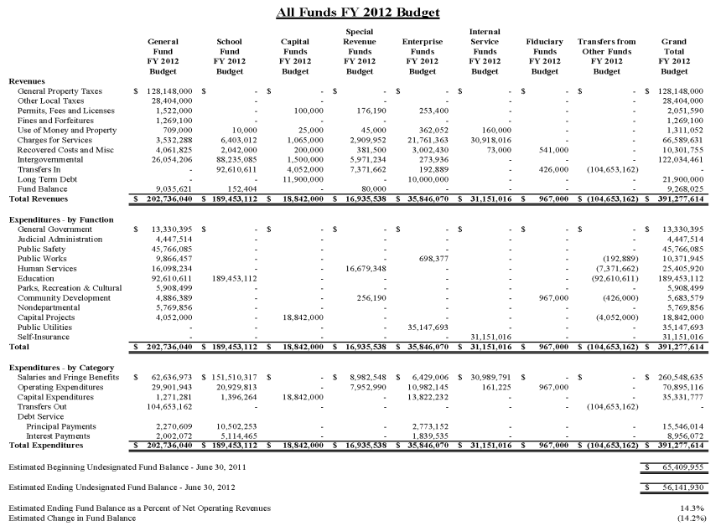
Hanover County, VA.

Slide 36
#F4: Three/(Four) Year Consolidated and Fund Financial Schedules (Mandatory)
The document must include summaries of revenues and other financing sources, and of expenditures and other financing uses for the prior year actual, the current year budget and/or estimated current year actual, and the proposed budget year.
Criteria Location Guide Questions
For annual budgets, are revenues and other financing sources and expenditures and other financing uses for the prior year, the current year, and the budget year presented together on the same schedule(s) or on schedules presented on adjacent/sequential pages?
Is this information presented for the appropriated funds in total?
Is this information also presented for each major fund and for other (i.e. nonmajor) funds in the aggregate?
For biennial budgets, are revenues and other financing sources and expenditures and other financing uses for the prior year, the current year, and both budget years presented together on the same schedule(s) or on separate schedules presented on adjacent/sequential pages?
Explanation
This criterion requires a schedule(s) that includes both revenues and other financing sources and expenditures and other financing uses for at least three budget periods (prior year actual, current year, and budget year). The data for the prior year should be the actual revenues and expenditures.. Information for individual major funds, nonmajor funds in the aggregate, and the entity as a whole may be presented on a single schedule OR on separate schedules. Regardless of the format selected, the information for both revenues and expenditures must be included (1) on the same schedule(s) OR (2) on schedule(s) presented on adjacent/ sequential pages. As in the prior criterion, revenues should be presented by type (e.g., property tax, sales tax, fees and charges, intergovernmental) and expenditures should be presented either by function, organizational unit or object.
Break out revenues by type/expenditures by function, organizational unit, or object for total funds and individual funds.

Slide 37
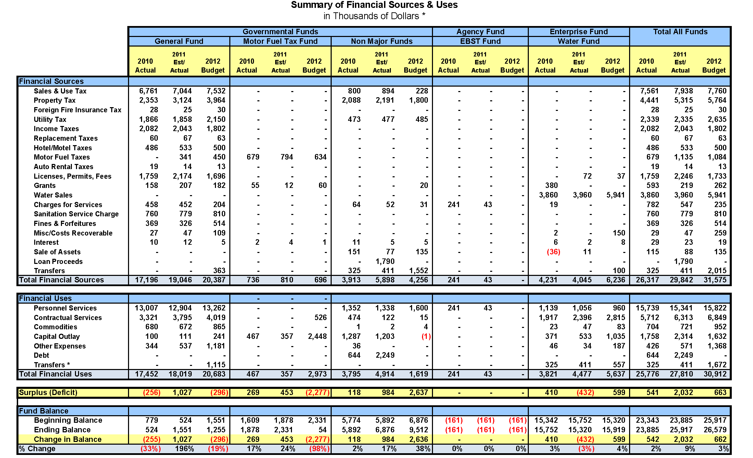
Village of Westmont, IL.

Slide 38
#F5: Fund Balance (Mandatory)
The document shall include projected changes in fund balances, as defined by the entity in the document, for appropriated governmental funds included in the budget presentation (fund equity if no governmental funds are included in the document).
Criteria Location Guide Questions
Does the document include the entity’s definition of “fund balance” (or of “fund equity” if no governmental funds are included in the entity - frequently the noncapital portion of net assets)?
Is the fund balance (equity) information presented for the budget year?
Is there a schedule showing (1) beginning fund balances, (2) increases and decreases in total fund balances (reported separately), and (3) ending fund balances for appropriated governmental funds?
Is this information presented at a minimum for each major fund and for nonmajor governmental funds in the aggregate?
If fund balances of any major fund or the nonmajor funds in the aggregate are anticipated to increase or decline by more than 10%, does the document include a discussion of the causes and/or consequences of these changes in fund balance?
If an entity has no governmental funds, is the change in the fund equity presented for (1) the entity as a whole, (2) the main operating fund, and (3) each significant fund?
For biennial budgets is the change in fund equity presented separately for both years of the biennium?
Explanation
This criterion requires that beginning and ending fund balances, be shown for the budget year, as well as revenues, expenditures, and other financing sources/uses. This information must be provided for each major fund and for the nonmajor governmental funds in the aggregate. The information may be included on the schedule(s) with the three-year data or may be presented on a separate schedule(s). Both the beginning and ending fund balances must be clearly labeled.
Discuss fund balance changes over 10%.

Slide 39
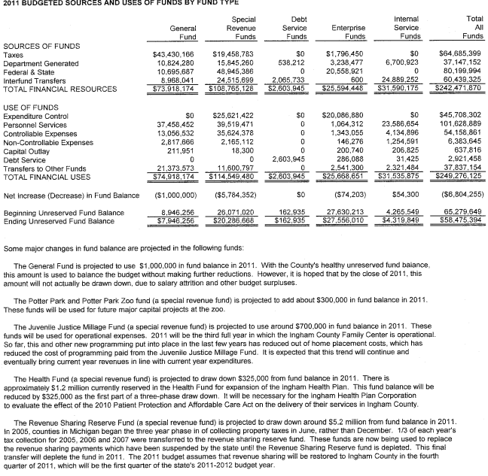
Ingham County, MI.

Slide 40
#F6: Revenues (Mandatory)
The document shall describe major revenue sources, explain the underlying assumptions for the revenue estimates, and discuss significant revenue trends.
Criteria Location Guide Questions
Are individual revenue sources described?
Do the revenue sources that are described represent at least 75 percent of the total revenues of all appropriated funds?
Are the methods used to estimate revenues for the budget year described (e.g., trend analysis, estimates from another government or consulting firm)?
If revenues are projected based on trend information, are both those trends and the underlying assumptions adequately described?
Explanation
This criterion requires that the major revenues of the appropriated funds in the aggregate be identified and described. If an outside source (e.g., another government or consulting firm) provides an estimate of the revenue for the budget year, that fact must be clearly stated. If the entity uses trend analysis to project particular revenue, a discussion of the revenue trend is required in addition to any schedules or graphs depicting the revenue trend. If the projections are based on trend analysis, the discussion must identify factors that affect the trend, such as changes in the local economy, a new housing development, or fee increases. Do not just focus on General Fund revenues. Refer to GFOA’s best practice on (1) Financial Forecasting in the Budget Preparation Process and (2) The Use of Trend Data and Comparative Data for Financial Analysis.
Trend graphs can be useful in revenue analysis.

Slide 41
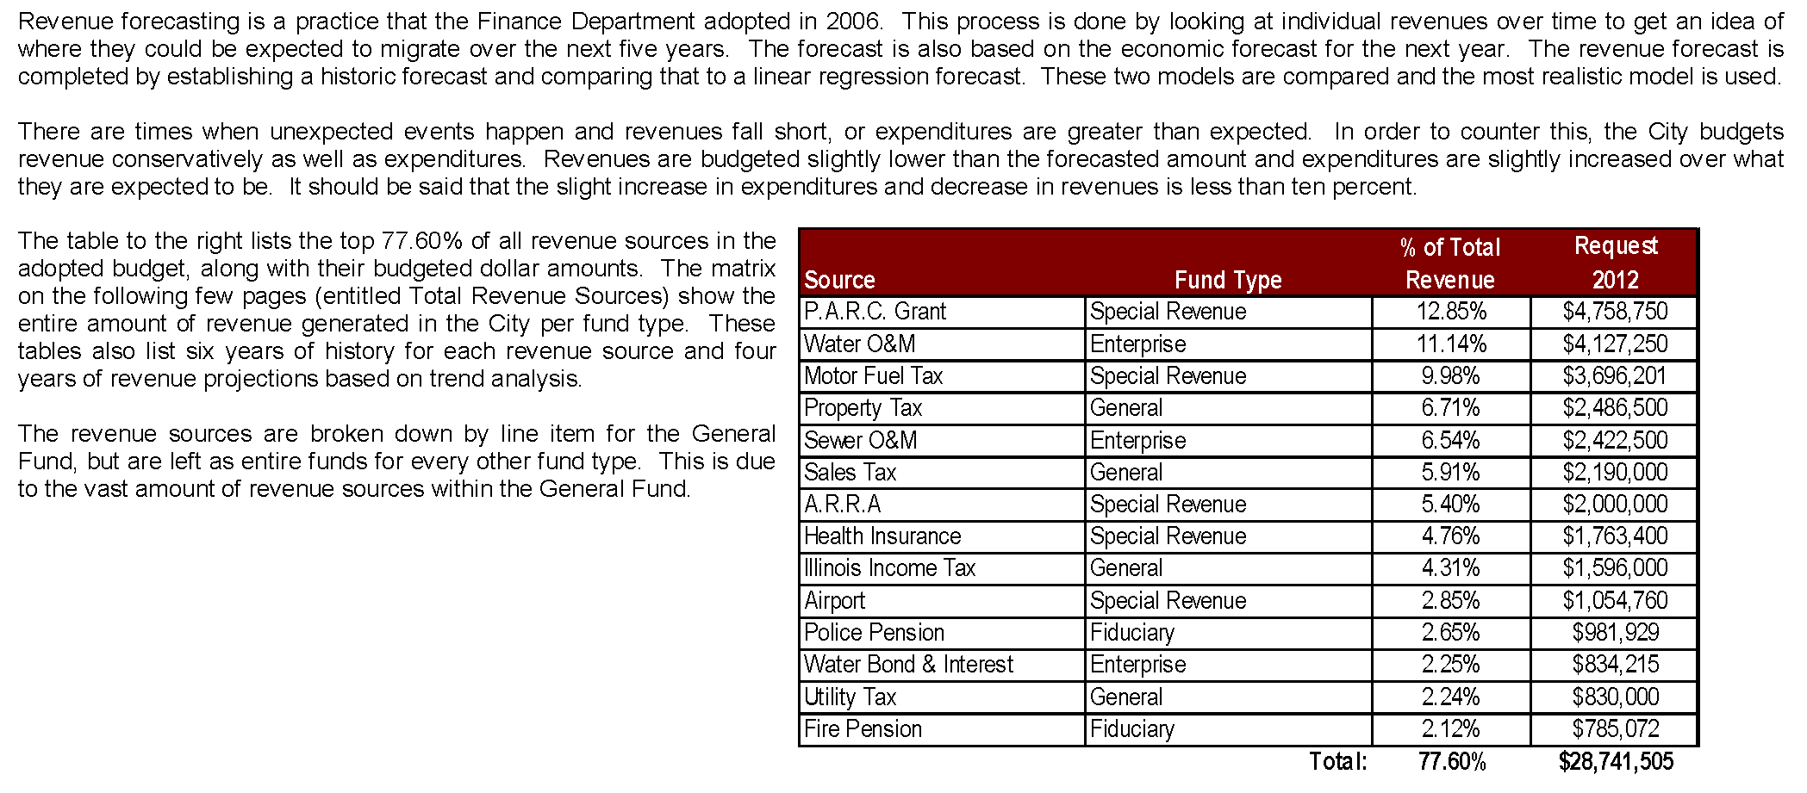
City of Centralia, IL.

Slide 42
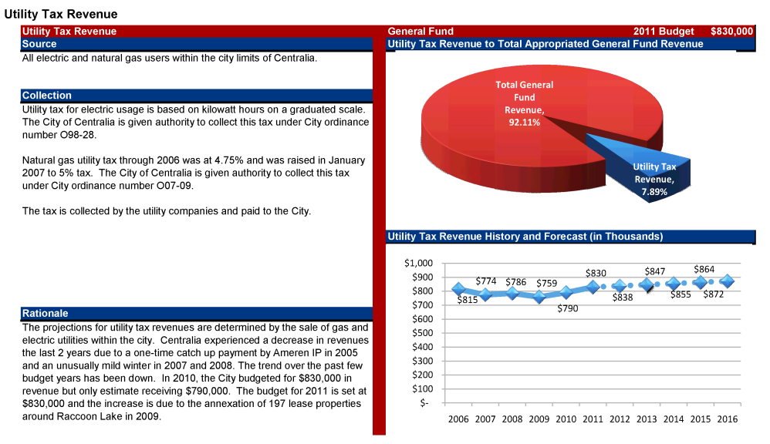
City of Centralia, IL.

Slide 43
#F7: Long-Range Financial Plans
The document should explain long-range financial plans and its affect upon the budget and the budget process.
Criteria Location Guide Questions
Are long-range financial plans identified?
Do your long-range financial plans extend out at least two years beyond the budget year?
Is there a concise explanation or illustration of the linkage between the entity’s long-range financial plans and strategic goals?
Explanation
This criterion requires the identification of long-range financial plans that extend beyond the budget year. The impacts of the long-range financial plan upon the current budget and future years should be noted. Refer to GFOA best practices on (1) Long-Term Financial Planning, (2) Establishment of Strategic Plans, (3) Budgeting for Results and Outcomes, and (4) Multi-Year Capital Planning.
Include long-range financial plans that extend beyond the budget year.

Slide 44
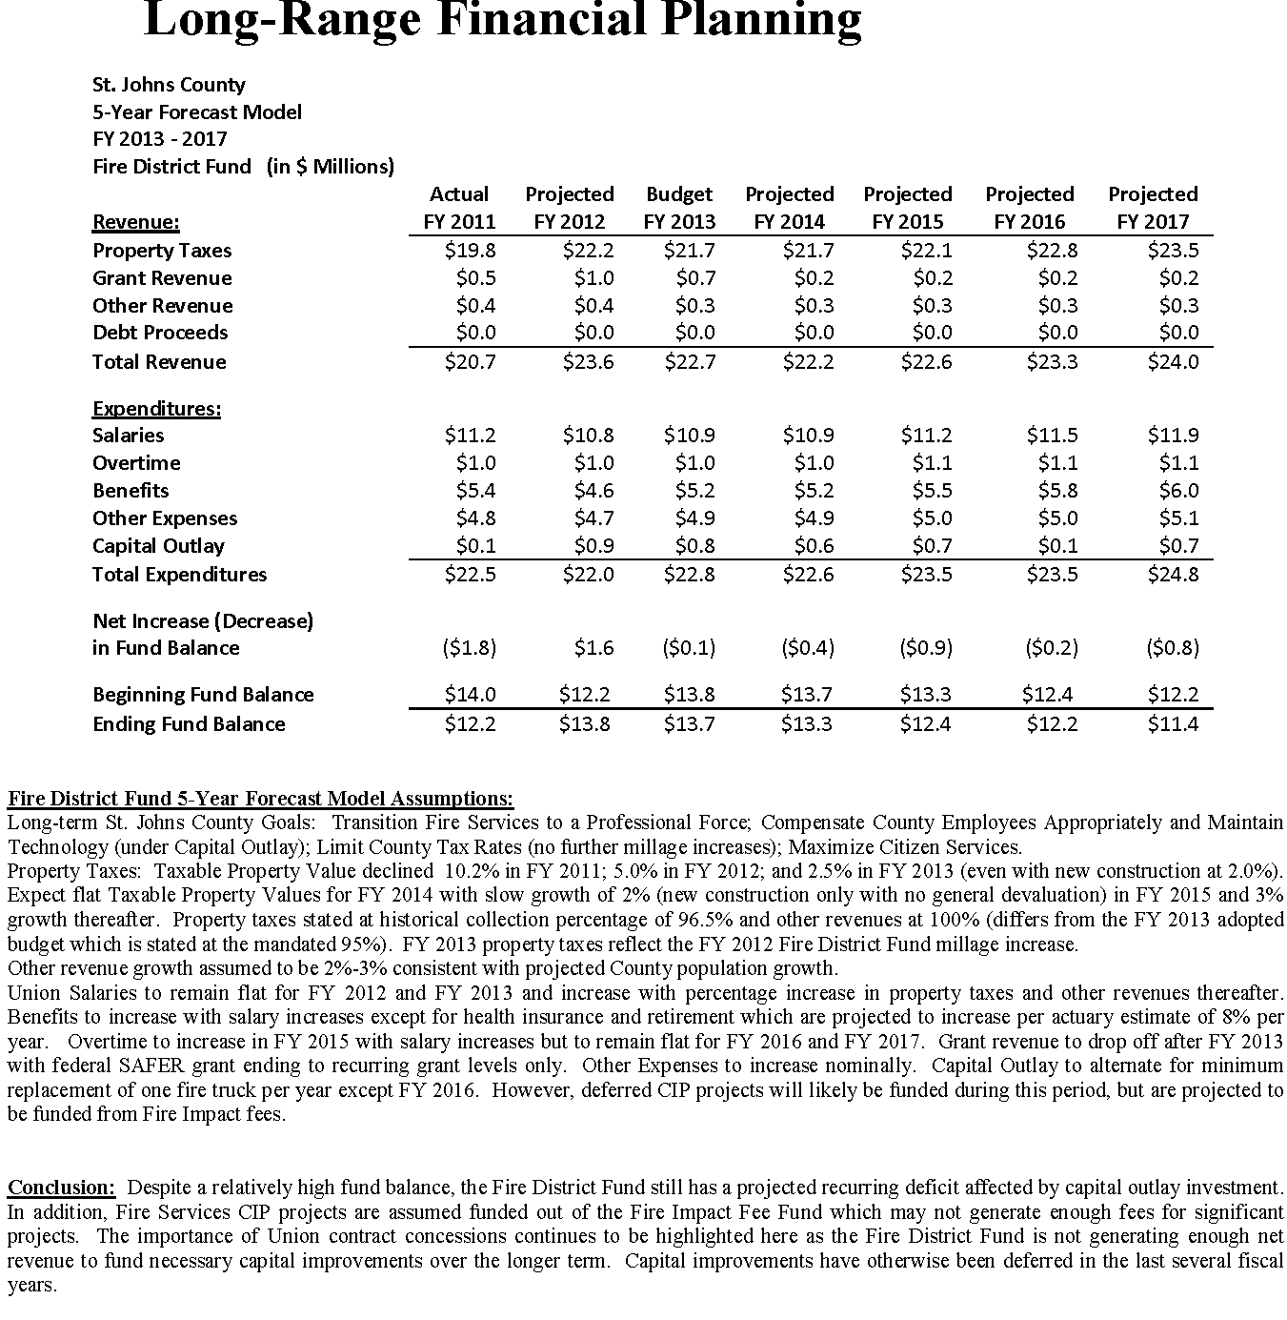
St. Johns County, FL.

Slide 45
#F8: Capital Expenditures (Mandatory)
The document should include budgeted capital expenditures, whether authorized in the operating budget or in a separate capital budget.
Criteria Location Guide Questions
Does the document define “capital expenditures”?
Does the document indicate the total dollar amount of capital expenditures for the budget year (both budget years for biennial budgets)?
Are significant nonrecurring capital expenditures described along with dollar amounts? (Information in a separate CIP document does not satisfy this criterion.)
If the entity has no significant nonrecurring capital expenditures, is that fact clearly stated in the document?
Explanation
This criterion does not mandate any particular definition of “capital expenditures,” only that whatever definition is being used by the entity be disclosed. The entity should indicate the total dollar amount of such expenditures for the budget year. The entity is encouraged, but not required, to provide a summary of capital expenditures by major project, type, fund, or user.
Recurring capital expenditures are those that 1) are included in almost every budget and 2) will have no significant impact on the operating budget. If the entity has any significant, nonrecurring capital expenditures, the document should describe these items (i.e. indicate the project’s purpose and funding sources) and indicate the amount appropriated for the project during the budget year(s). Also, the document should include the amount appropriated for significant, nonrecurring capital expenditures in the budget year. Refer to GFOA recommended practices on (1) Establishing Appropriate Capitalization Thresholds for Tangible Capital Assets, (2) Establishing the Estimated Useful Lives of Capital Assets, (3) Incorporating Capital Project Budget in the Budget Process, and (4) Presentation of the Capital Budget in Operating Budget Document.
Include discussion on major capital projects.

Slide 46
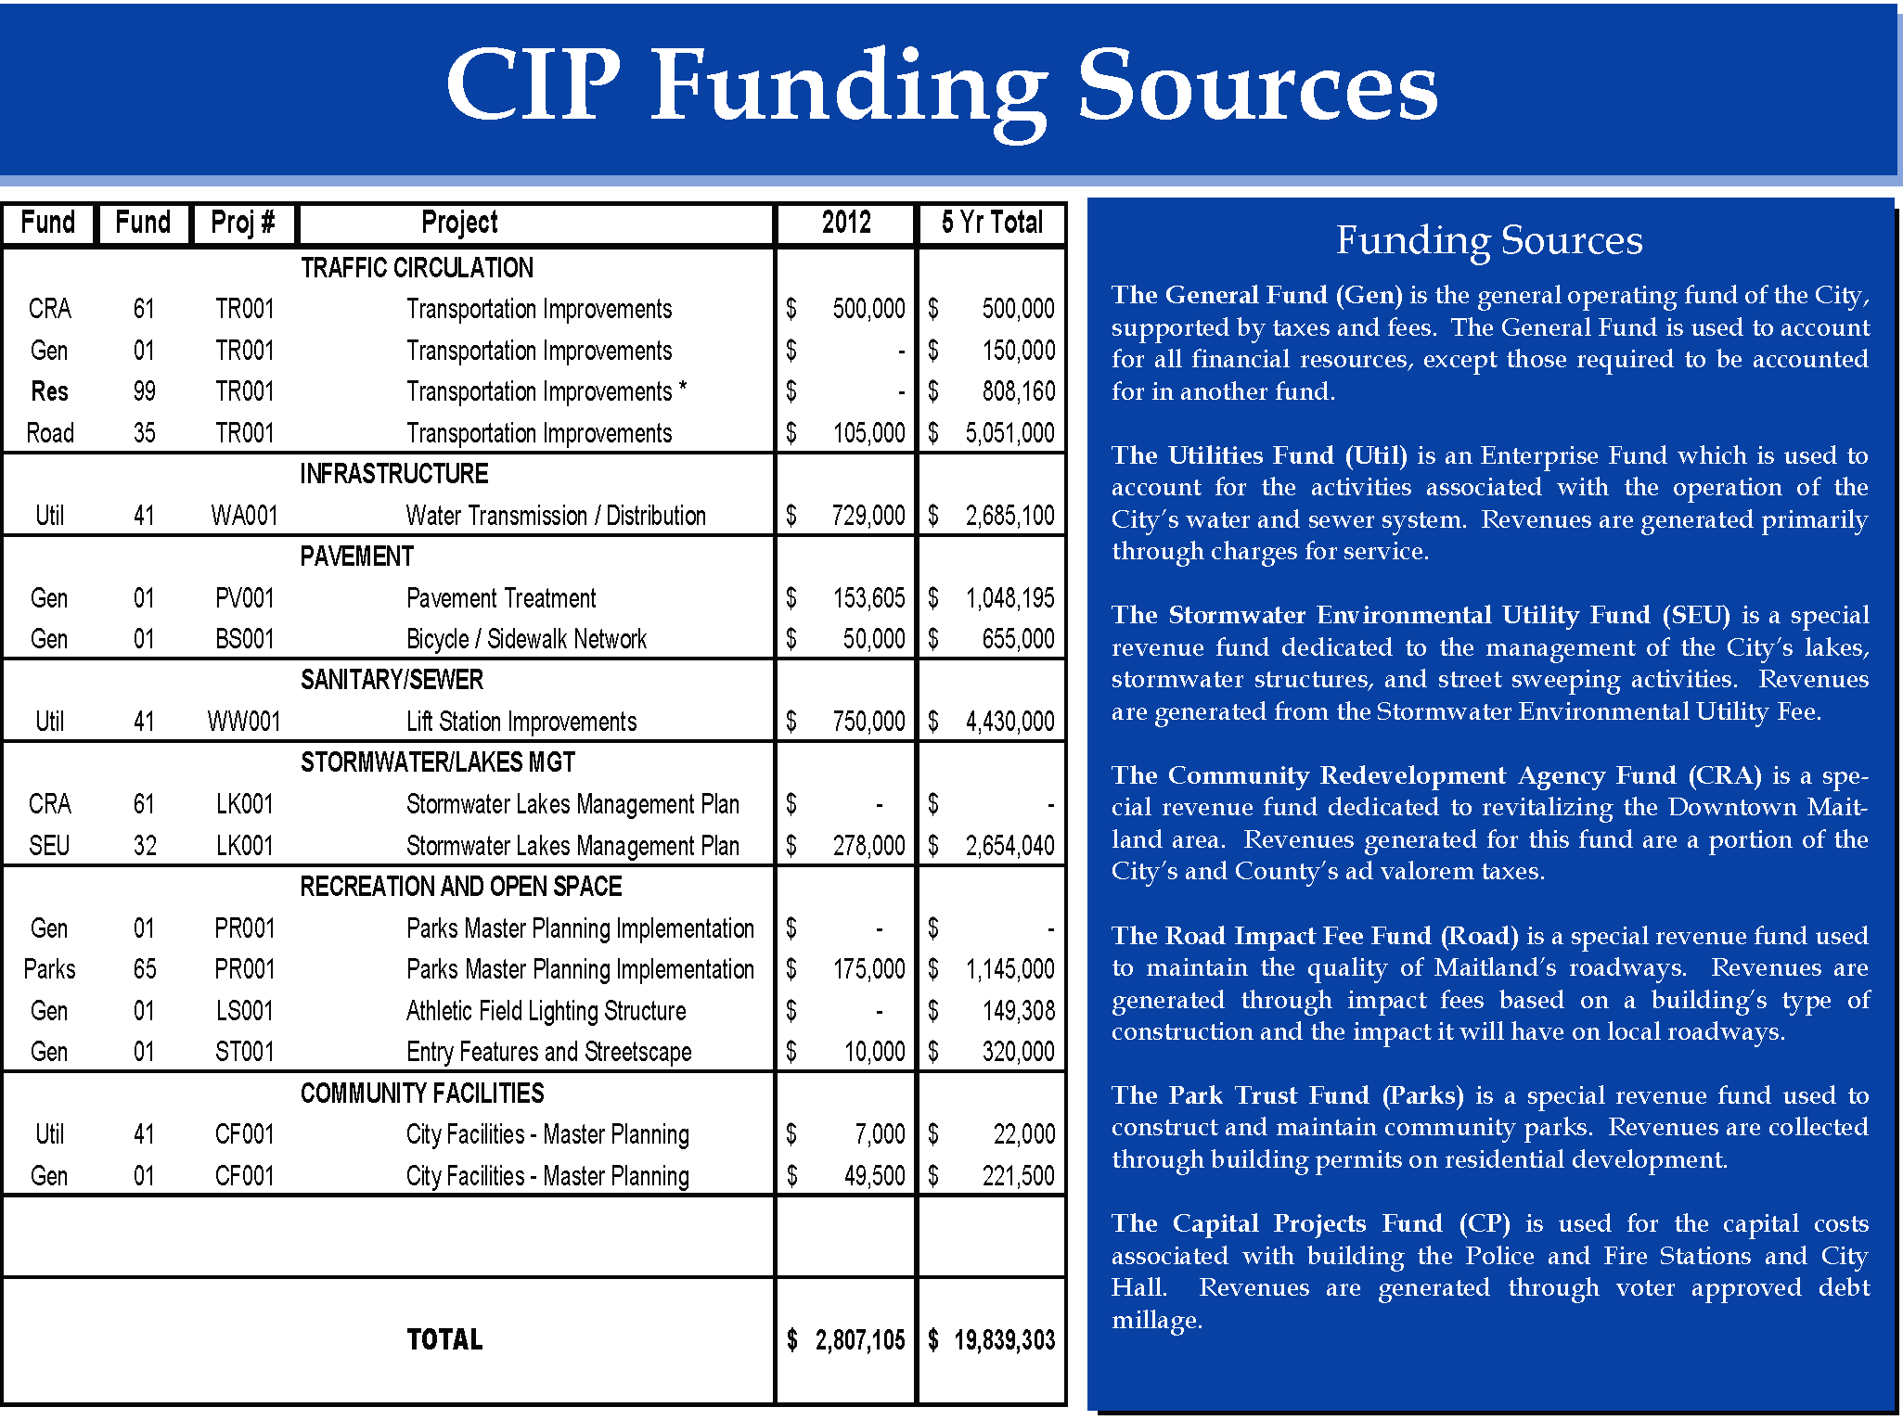
City of Maitland, FL.

Slide 47
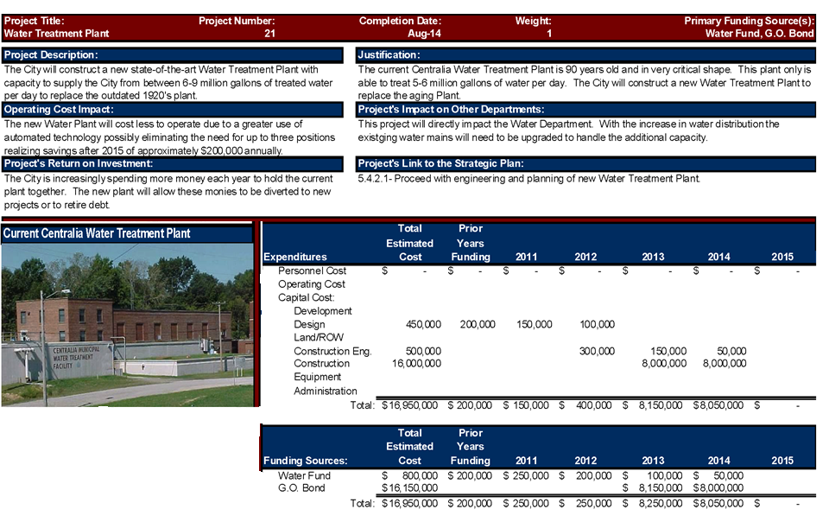
City of Centralia, IL.

Slide 48
#F9: Impact of Capital Investments on Operating Budget
The document should describe if and to what extent significant nonrecurring capital expenditures will affect the entity’s current and future operating budget and the services that the entity provides.
Criteria Location Guide Questions
Are anticipated operating costs associated with significant nonrecurring capital expenditures described and quantified (e.g., additional personnel costs, additional maintenance costs, or additional utility costs)? (Information in a separate CIP document does not satisfy this criterion.)
Are anticipated savings or revenues expected to result from significant nonrecurring capital expenditures described and quantified (e.g., reduced utility costs, lower maintenance costs)?
Explanation
This criterion asks for the identification of specific significant financial impacts upon current and future years that are likely to result from significant nonrecurring capital expenditures (other than the cost of the improvements themselves). The entity may make its own determination of what is “significant.” However, some examples of significant costs are those that (1) would require an increase in the tax rate OR (2) would result in a reduction in spending elsewhere in the budget OR (3) would require additional staff. Additional anticipated revenues and expenditure reductions also should be briefly described and quantified. Concepts like net present value, return on investment, or payback period may be used. Identification of the anticipated non-financial impact of significant nonrecurring capital expenditures on services is encouraged.
Quantify and discuss operating impacts.

Slide 49
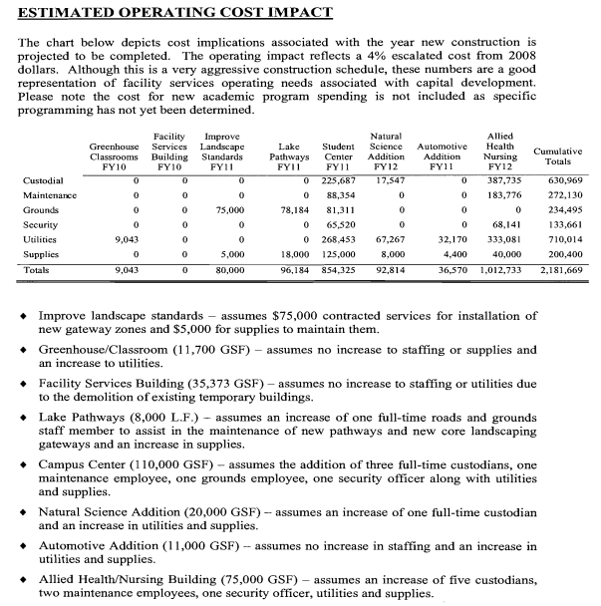
Joliet Junior College, IL.

Slide 50
#F10: Debt (Mandatory) The document shall include financial data on current debt obligations, describe the relationship between current debt levels and legal debt limits, and explain the effects of existing debt levels on current operations.
Criteria Location Guide Questions
Are debt limits described?
Are the amounts of debt limits expressed in terms of total dollars, millage rates or percentages of assessed value?
Are the amounts of debt subject to debt limits identified in the same terms used to describe the debt limits themselves?
Is the amount of principal and interest payments for the budget year (two years for biennial budgets) shown for each major fund (for appropriated funds), for each significant unappropriated fund and for other funds in the aggregate?
Explanation
Entities should describe their legal debt limits. The legal debt limits may be expressed in terms of total dollars, millage rates, or percentages of assessed value.. The document should indicate the impact of debt on the current budget by indicating the total amount of principal and interest payments to be paid during the year for each major appropriated fund and for each significant unappropriated and for other funds in the aggregate (two years for biennial budgets). If the entity has variable rate debt or a balloon payment that could significantly alter debt levels in the future, the entity is encouraged to disclose that fact. A repayment schedule may be presented, but is not required. The entity is encouraged to discuss coverage requirements and actual coverage for revenue backed debt. An entity may wish to discuss debt that it anticipates issuing separately from its discussion of outstanding debt. An entity should consider concisely describing the purpose and type of individual debt obligations.
Debt to maturity schedules breaking out principal and interest can be useful.

Slide 51
City of Ames, IA.

Slide 52
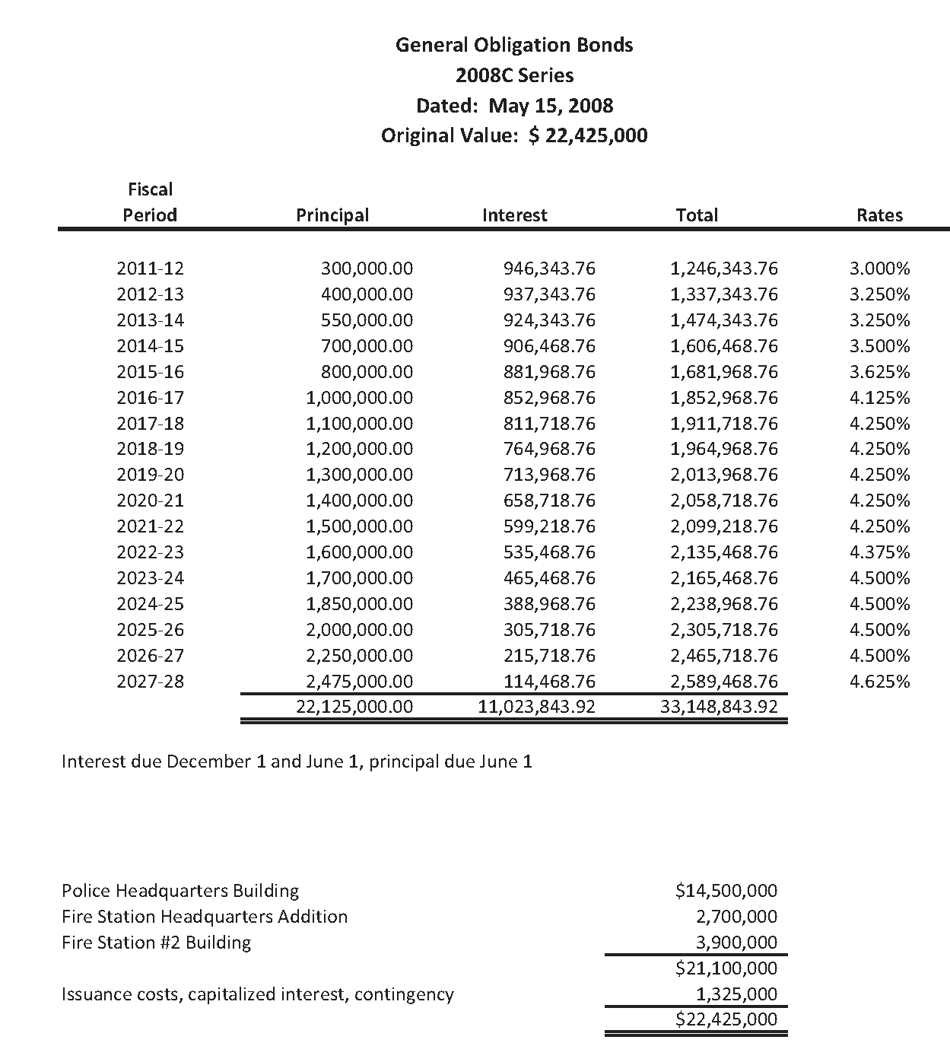
City of Ankeny, IA.

Slide 53
#03: Position Summary Schedule (Mandatory)
A schedule or summary table of personnel or position counts for prior, current and budgeted years shall be provided.
Criteria Location Guide Questions
Is a summary table of position counts provided for the entire entity?
Does the table include the prior year, the current year, and budget year position counts?
Are changes in staffing levels for the budget year explained?
If there are no changes in staffing levels, is that item noted?
Explanation
This criterion requires a presentation of position counts or full time equivalents (FTEs) within the entity. Presentation may be by position and/or by summaries of positions. Position summaries within individual departments may supplement, but not be a substitute for, the position counts on the consolidated schedule. If presented, position counts on the departmental summaries should tie to the consolidated position count schedule for the entity as a whole. Staffing level changes must be explained. If there are no staffing level changes, then that fact must be noted.
Position counts are frequently presented showing individual department totals summing to a grand total.

Slide 54
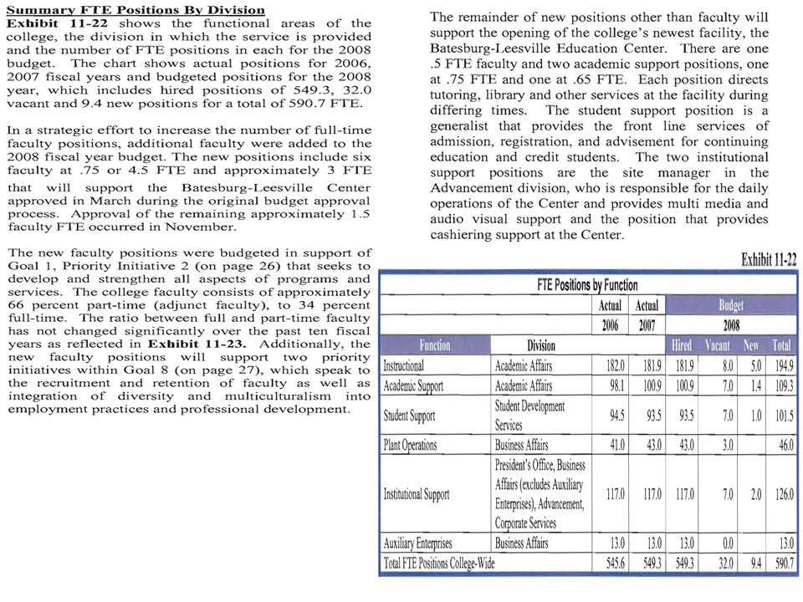
Midlands Technical College, SC.

Slide 55
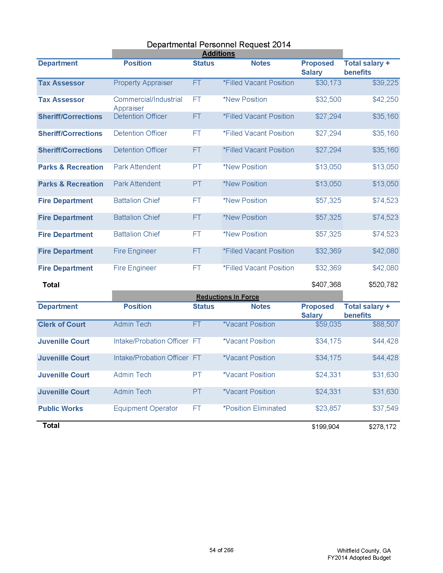
Whitfield County, GA.

Slide 56
#O4: Department Descriptions (Mandatory)
The document shall describe activities, services or functions carried out by organizational units.
Criteria Location Guide Questions
Does the document clearly present the organizational units (e.g., divisions, departments, offices, agencies, or programs)?
Does the document provide descriptions of each organizational unit?
Explanation
This criterion requires a clear presentation of the organizational units within the budget document. A narrative description of the assigned services, functions, and activities of organizational units should be included. The presentation of relevant additional information should be included (e.g., shift in emphasis or responsibilities or major changes in costs).
Refer to GFOA’s best practice on Presentation of the Department Section in the Operating Budget Document.
Discuss major financial or program changes occurring in the different departments.

Slide 57
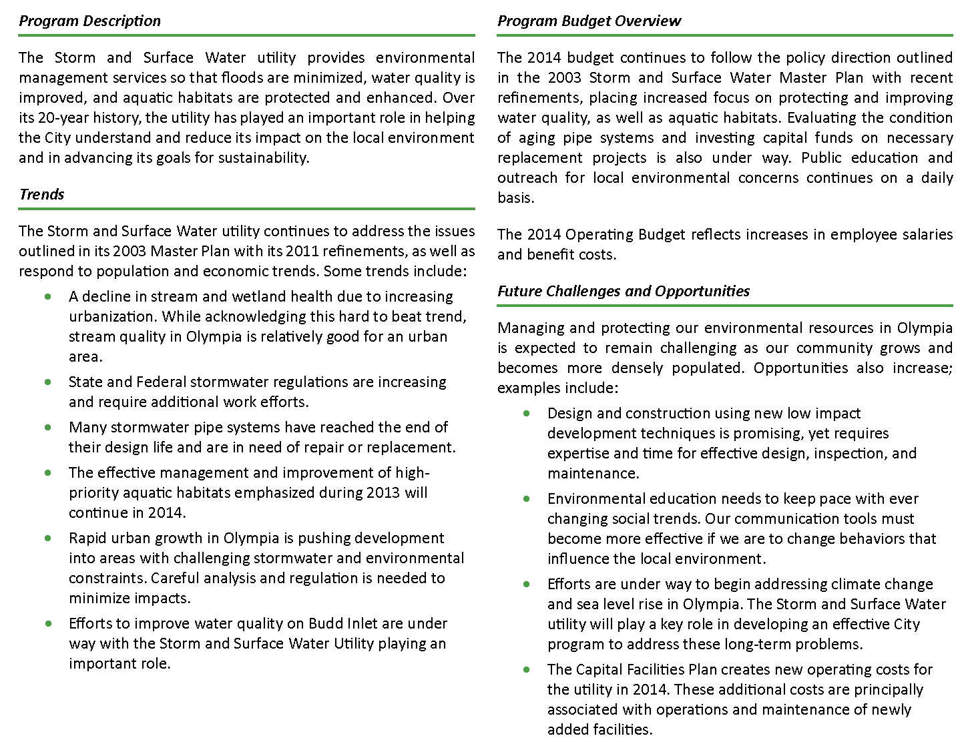
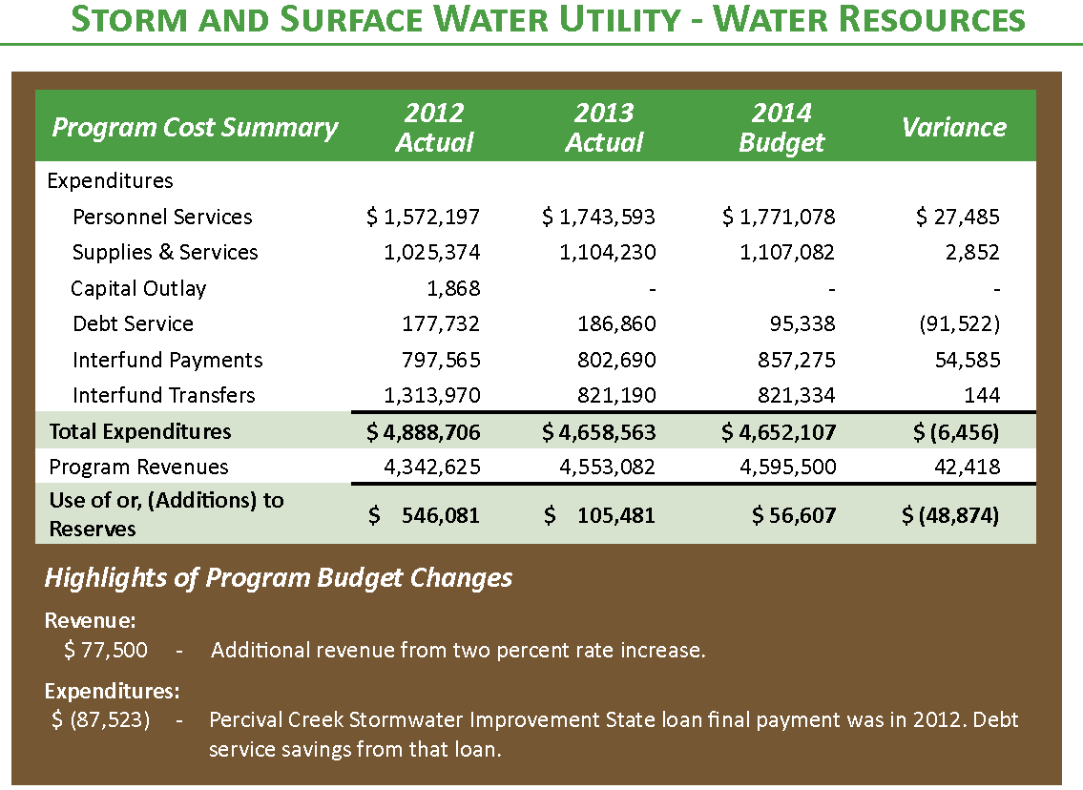
City of Olympia, WA.

Slide 58
#O5: Unit Goals and Objectives
The document should include clearly stated goals and objectives of organizational units (e.g., departments, divisions, offices or programs).
Criteria Location Guide Questions
Are unit goals and objectives identified?
Are unit goals clearly linked to the overall goals of the entity?
Are objectives quantifiable?
Are timeframes on objectives noted?
Explanation
This criterion requires that unit goals and objectives be clearly identified. The relationship of unit goals to the overall goals of the entity should be apparent (perhaps, in the form of a matrix). For purposes of this criterion, goals are long-term and general in nature, while objectives are more short-term oriented and specific. Note when goals and objectives are expected to be accomplished.
Consider a matrix linking department goals to overall entity goals.

Slide 59
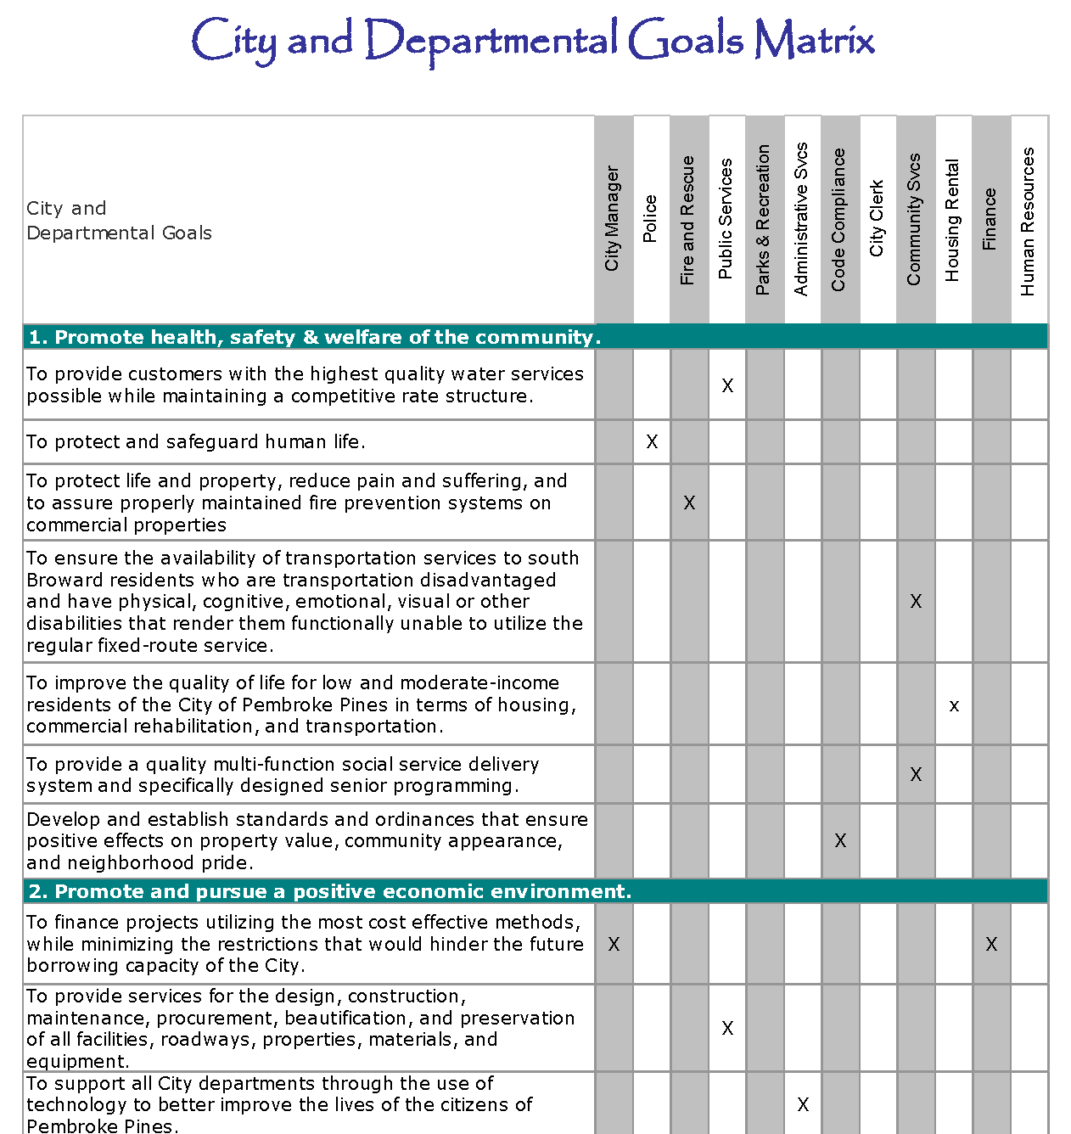
City of Pembroke Pines, FL.

Slide 60
State of West Virginia

Slide 61
#O6: Performance Measures
The document should provide objective measures of progress toward accomplishing the government’s mission as well as goals and objectives for specific units and programs.
Criteria Location Guide Questions
Are performance data for individual departments included in the document?
Are performance data directly related to the stated goals and objectives of the unit?
Do performance measures focus on results and accomplishments (e.g., output measures, efficiency and effectiveness measures) rather than inputs (e.g., dollars spent)?
Explanation
Performance measures should include the outputs of individual units and provide a meaningful way to assess the effectiveness and efficiency of those units. The measures should be related to the mission, goals, and objectives of each unit. Include information for at least three years (the prior year actual, current year estimate or budget, and budget year).
Refer to GFOA’s best practice on Performance Management: Using Performance Measurement for Decision Making - Updated Performance Measures.
Include efficiency and effectiveness measures.

Slide 62
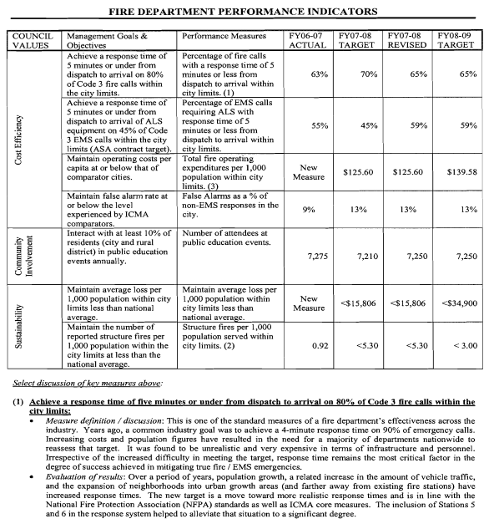
City of Corvallis, OR.

Slide 63
#C3: Statistical/Supplemental Section
The document should include statistical and supplemental data that describe the organization, its community, and population. It should also furnish other pertinent background information related to the services provided.
Criteria Location Guide Questions
Is statistical information that defines the community included in the document (e.g., population, composition of population, land area, and average household income)?
Is supplemental information on the local economy included in the document (e.g., major industries, top taxpayers, employment levels, and comparisons to other local communities)?
Is other pertinent information on the community (e.g., local history, location, public safety, education, culture, recreation, transportation, healthcare, utilities, and governmental structure) included in the document?
Explanation
Background information should be included in the budget in the form of statistical and supplementary data, either in a separate section or throughout the document. The goal is to provide a context for understanding the decisions incorporated into the budget document. The presentation should include factors that will affect current or future levels of service (e.g., population growth, economic strength in the region, or a change in the size of the school age population). Refer to GFOA’s best practice on Statistical/Supplemental Section of the Budget Document for information that should be included as part of this discussion.
Do not just copy the CAFR statistical/supplemental section into the budget document.

Slide 64
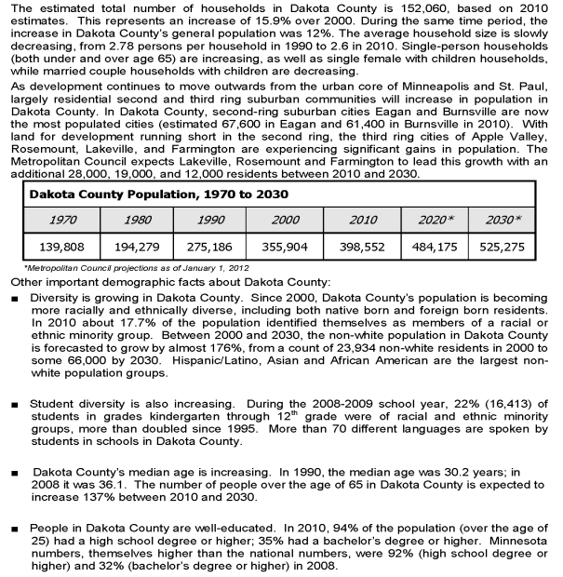
Dakota County, MN.

Slide 65
#C4: Glossary
A glossary should be included for any terminology (including abbreviations and acronyms) that is not readily understandable to a reasonably informed lay reader.
Criteria Location Guide Questions
Is a glossary that defines technical terms related to finance and accounting, as well as non-financial terms related to the entity, included in the document?
Are acronyms or abbreviations used in the document defined in the glossary?
Is the glossary written in non-technical language?
Explanation
The use of technical terms and acronyms ought to be kept to a minimum, to enhance the value of the document to the majority of stakeholders. When technical terms and acronyms are used, they should be clearly and concisely described in the glossary.
Make sure acronyms and non-financial terms are also included.

Slide 66
City of Owensboro, KY.

Slide 67
#C5: Charts and Graphs
Charts and graphs should be used, where appropriate, to highlight financial and statistical information. Narrative interpretation should be provided when the messages conveyed by the graphs are not self-evident.
Criteria Location Guide Questions
Are charts and graphs used in the document to convey essential information (e.g., key policies, trends, choices and impacts)?
Do the graphics supplement the information contained in the narratives?
Explanation
This criterion requires that graphics be used to communicate key information in the budget document. Graphics should enhance the budget presentation, and clarify significant information. The entity determines the most effective format to present graphic information. Graphics may be consolidated or included throughout the document. Normally, narratives should accompany the graphs. Graphs can be used for such topics as revenues, expenditures, fund balances, staffing, economic trends, capital expenditures, service levels, performance measures, or general statistical information. Originality is encouraged, but not at the expense of clarity and consistency. Consider using captions to explain the significance of graphs.
Including captions with graphs can be helpful.

Slide 68
City of Boca Raton, FL.

Slide 69
#C6: Understandability and Usability
The document should be produced and formatted in such a way as to enhance its understanding by the average reader. It should be attractive, consistent, and oriented to the reader's needs.
Criteria Location Guide Questions
Is page formatting consistent?
Are the main sections of the document easily identifiable?
Is the level of detail appropriate?
Are text, tables, and graphs legible?
Are budget numbers in the document accurate and consistent throughout the document?
Explanation
The goal of this criterion is to make sure that the document itself contributes to the effectiveness of the communication to readers. Sequential page numbering throughout the document is encouraged. Budget numbers (both financial and operational) should be accurate and consistent throughout the document. Put similar topics in the same section. For electronic submissions, refer to GFOA’s best practice on Web Site Presentation of Official Financial Documents.
Make sure the document is easy to read.

Slide 70
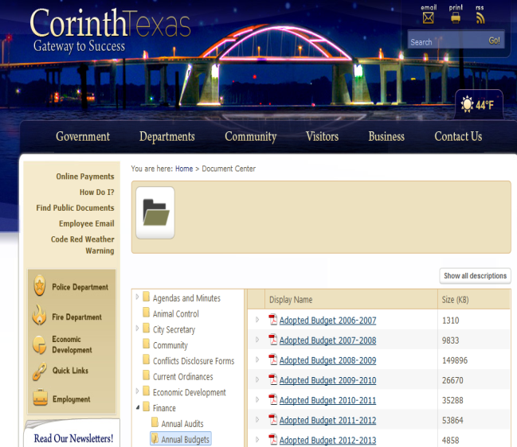
City of Corinth, TX.

