Slide 1
GFOASC 2018 Fall Conference
Preventing and Detecting Fraud
Anne P. Harty, CPA, CGFO
Chief Financial Officer
City of Rock Hill, SC

Slide 2
Outline
Targeted Industries
Internal Controls
Data Analytics
Corruption
Billing Schemes
Expense Reimbursements
Other Treasury/Finance Tools
Case Studies

Slide 3
Targeted Industries

Slide 4
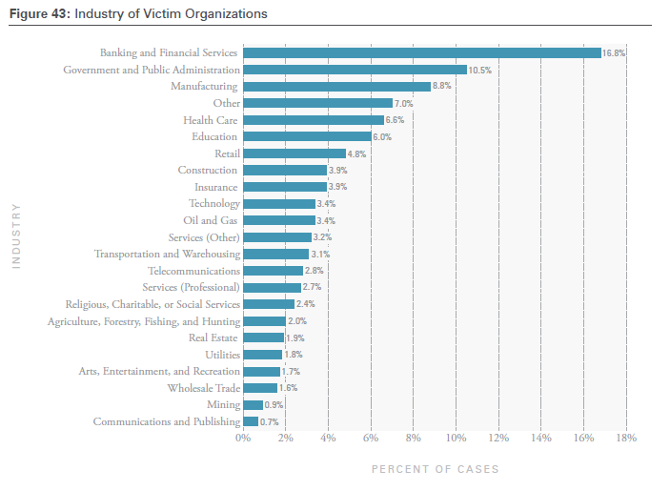
2nd Most Targeted Industry - Government
Median loss for government entities is $133,000

Slide 5
II. Internal Controls

Slide 6
Internal Controls
Importance of Policies and Procedures
Importance of Employee Education
Deterring Bad Behavior
Internal
External
Phishing
Vendor information manipulation
Straight up Fraud
Rating Agencies and Financial Policies

Slide 7
Internal Controls
Separation of Duties
Actions established through policies and procedures that help ensure that management’s directives to mitigate risks
Identify and document your business processes
Identify areas of weakness
Segregate those duties, or identify alternative checks and balances

Slide 8
Internal Controls
We all know basic Internal Controls:
Separation of Duties (authorization, recording, reconciling, custody)
Surprise Audits
Timely Reconciliations
Timely Financial Reports
Secure Computer Access
Central Collections
Separate Cash Drawers
And more

Slide 9
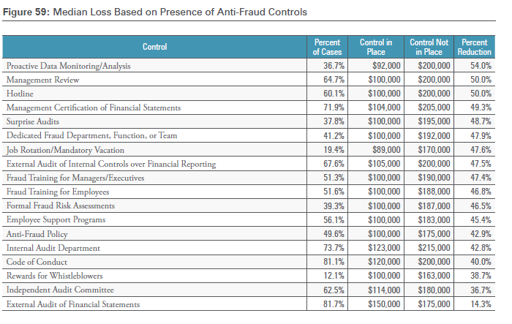
Most Effective Anti-fraud Control

Slide 10
III. Data Analytics

Slide 11
Data Analytics
Data analytics – processes to obtain and evaluate data to extract useful information and answer strategic questions
Answer questions through use of analytical software
As simple as Excel
Filter
Sort
As complex as you want to make it
IT Department
Consultants and Experts

Slide 12
Data Analytics
More and more companies are mining their data to create a competitive advantage and garner customer loyalty by tailoring the customer’s experience to the customer

Slide 13
Why Data Analytics?
Data analytic techniques are efficient and effective
Data sets are massive in size and often proprietary in format
With Data Analytics you are analyzing 100%, not just a sample

Slide 14
What are we looking for?
Irregular activity or patterns
Prevention of waste
Duplicate payments of invoices
Fictitious Vendors
Matches between employees and vendors
Improper approval processes
Circumvention of approval process
Coercion
Gaps in numbering

Slide 15
What are we looking for?
Paying for items never received
Paying a legitimate vendor for personal items
Payroll –
Fictitious overtime
Fictitious employees
Unauthorized raises
Terminated employees still being paid or receiving benefits (such as insurance)

Slide 16
What types of data files are we analyzing?
Vendor lists
Accounts payable records
Invoices
Purchase orders
Checks and ACH transactions
Numbers of transactions
Transactions by amount, by vendor, by week, by month, by year

Slide 17
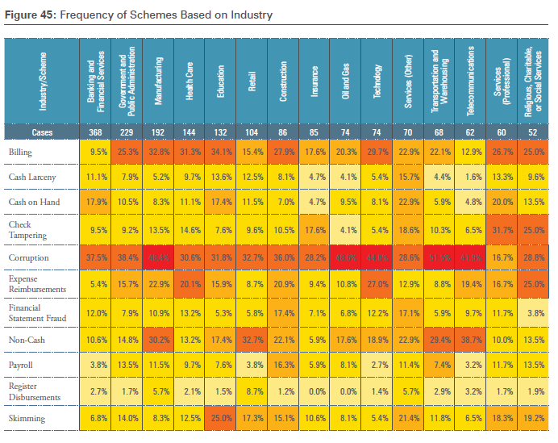
Types of Cases

Slide 18
Corruption
An employee misuses his or her influence in a business transaction in a way that violates his or her duty to the employer in order to gain a direct or indirect benefit
In most businesses, the most common form of corruption is the payment of kickbacks related to purchases

Slide 19
Red Flags For Corruption
Off-book fraud, so very hard to detect
Payments often do not go through the organization’s accounting records
Payments often paid in cash
Look for “behavioral” red flags
Rapidly increasing purchases from one vendor
Excessive purchases of goods and services
Too close of a relationship with a vendor

Slide 20
Data Analytics For Corruption
Compare order quantity to optimal reorder quantity
Compare purchase volumes/prices from like vendors
Compare quantities ordered and received
Check for inferior goods (# of returns by vendor)

Slide 21
Billing Schemes
Fraudster creates false support for a fraudulent purchase, causing the organization to pay for goods or services that are nonexistent, overpriced or unnecessary
Invoicing via fake vendor
Invoicing via an existing vendor
False invoicing for non-accomplice vendors
Pay-and-return schemes
Personal purchases with organization’s funds

Slide 22
Red Flags/Data Analytics For Billing Schemes
Vendor attribute analysis
Trending of vendor activity

Slide 23
Vendor Attribute Analysis – Matching

Slide 24
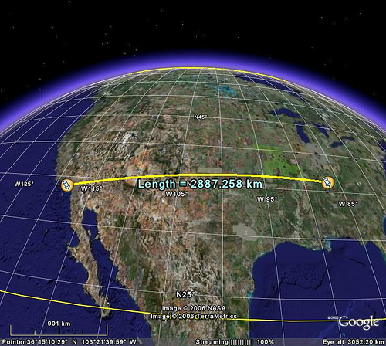
Geocoding
Vendor authorized by “DLC”
Notes:
This Slide has animation
Because Syntec did not match any name databases and its address is a postal contractor, this vendor was added to a red flag listing. Further, when employee and vendor addresses were geocoded and cross-referenced, it was found the authorizer of payments to Syntec lived only 965 feet from the postal contractor.

Slide 25
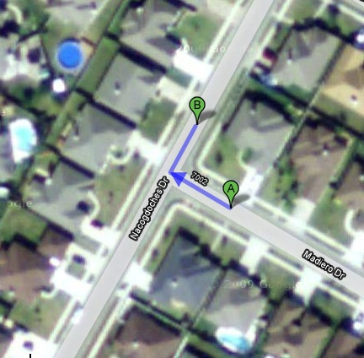
A Picture Is Worth 1,000 Words….
AP Manager
Vinny’s Salvage Yard
Notes:
25

Slide 26
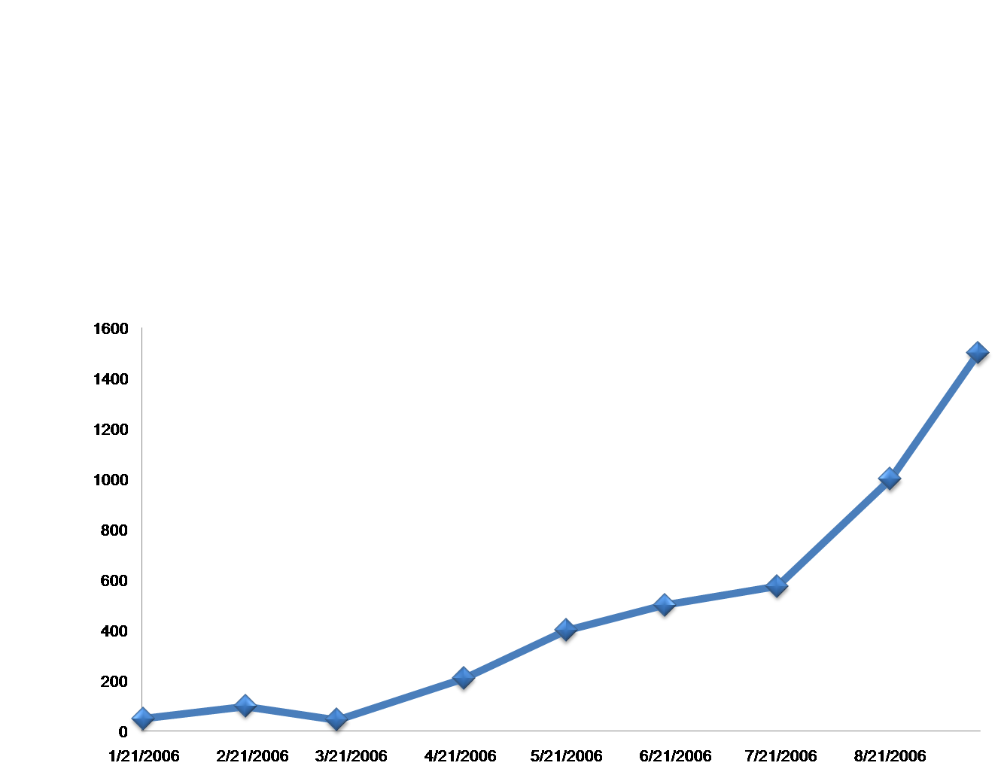
Vendor Trending Analysis
Getting Greedy
Acceleration as confidence builds
Test phase
Notes:
26

Slide 27
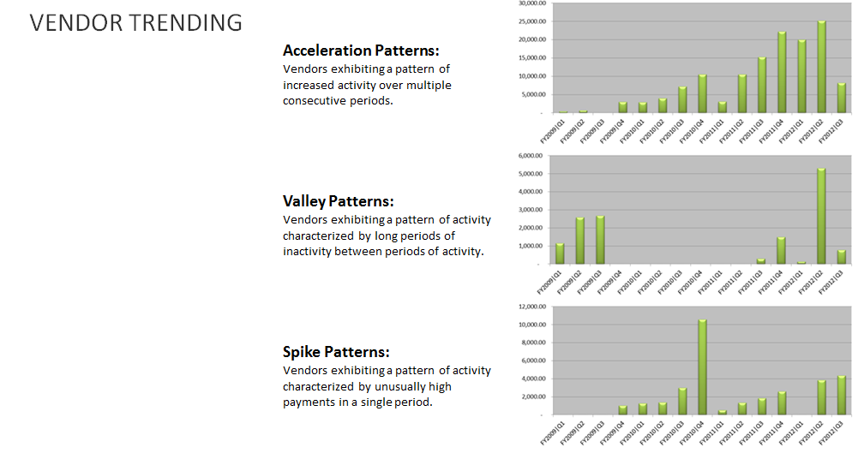
Time Series Analysis
Possible fictitious vendor
Possible abuse of dormant legitimate vendor
Possible abuse of active legitimate vendor
Notes:
These are common patterns worth looking into. The top one is just another type of view of an acceleration pattern.
The middle one shows valleys. This could be indicative of a dormant or inactive vendor account being compromised.
Spikes are another pattern worth investigating if you don’t know the reason. Sometimes a spike can be indicative of an active vendor account being compromised.

Slide 28
Expense Reimbursement/P-cards
Any scheme in which an employee makes a claim for reimbursement or fictitious or inflated business expenses
Employee files fraudulent expense report, claiming personal travel, nonexistent meals, etc.
Employee purchases personal items and submits and invoice to employer for payment
Employee purchases goods/services for inappropriate uses and charges to employer for payment

Slide 29
Red Flags For Expense Reimbursement/P-cards Schemes
Expenses exceed what was budgeted or prior years totals
Expenses claimed on days employee did not work
Purchases that do not appear to be business related
Minimal or non existent support for requests
Altered receipts
Unusual or excessive reimbursements to one employee
Submitted receipts are consecutively numbered
Expenses in round dollar amounts
Expenses just below receipt submission threshold

Slide 30
Data Analytics For Expense Reimbursement/P-card Schemes
Identify transactions on weekends, holidays or while employee is on vacation
Identify split transactions in which a large purchase are split into smaller transactions just under approval threshold
Identify unusually high or frequent expense reimbursement/p-card usage
Identify expenses in round dollar amounts

Slide 31
IV. Other Treasury/Finance Tools

Slide 32
Positive Pay
Matching government data file of checks written to the financial institution records as checks are processed

Slide 33
Invoice Approval
Have an on-line invoice approval process
Match approvers to authorization levels
Verify that the invoice approver matches the authorization for the amount or general ledger department/division
Did the same employee authorize and approve the invoice?

Slide 34
Receipting/Cash Collections
Compare transactions by employee
Compare number of void or credit transactions by employee
Match customer name to employee’s names
Trend void transactions by day of the week, match to employee schedules

Slide 35
Insurance
Match employee workers compensation claims to work schedules, liability claims, previous workers compensation claims
Compare employee spouses/dependents covered on health insurance to beneficiaries in retirement system data

Slide 36
Payroll
Compare W-2 totals to Human Resources files
Sort by amount paid –trend over years
Calculate pay increase percentages for employees over time
Direct Deposit only - check data for duplicate direct deposit checking account numbers for more than one employee
Match employee badges, to email addresses, to the employee file

Slide 37
Ensuring Internal Controls Work
Management support and commitment
Adoption of policies and procedures
Clearly communicate responsibilities
List of duties for each person
Organizational Flow Chart
Monitoring
Test your controls
Hold employees accountable

Slide 38
Case Studies

Slide 39
Anne P. Harty, CPA, CGFO
anne.harty@cityofrockhill.com
803-329-8764

