Slide 1
Do I have to tell them that?
Bond disclosure and you
Michael E. Kozlarek
October 2018
SC GFOA

Slide 3
In the beginning there were bonds . . .

Slide 4
Bond: fancy word for loan
Classified by security
General obligation (full faith and credit)
Revenue bonds (pledgeable stream)
Lease-Purchase (technically not bonds)

Slide 5
Bond: fancy word for loan
Classified by offering
Public offering – the universe
Limited public offering – a (very small) world
Private placement – a wee little village of one

Slide 6
Sharing is caring (but why?)
Because we have to (legal)
How else would you get a rating?
Better liquidity
Greater market access
Greater market demand
Decreased market volatility

Slide 7
10b-5 (Initial Disclosure)
Section 10(b) - SEC Act of 1934
Unlawful
1. to defraud,
2. to make any untrue statement of material fact or to omit to state a material fact necessary in order to make the statements made, in the light of the circumstances under which they were made, not misleading, or
3. to defraud or deceive.

Slide 8
It’s Official . . . boogie woogie woogie
POS – no, not a reference to the car you drove in high school
OS
No untrue statements / no material omissions
provide investors – information material to the financial condition and debt offering
Material???
“substantial likelihood that a reasonable investor would have considered the information important when making an investment decision.”
“total mix” of information

Slide 11
15c2-12 (Continuing Disclosure)
(1) Principal and interest payment delinquencies;
(2) Non-payment related defaults, if material;
(3) Unscheduled draws on debt service reserves reflecting financial difficulties;
(4) Unscheduled draws on credit enhancements reflecting financial difficulties;
(5) Substitution of credit or liquidity providers, or their failure to perform;

Slide 12
15c2-12
(6) Adverse tax opinions, the issuance by the Internal Revenue Service of proposed or final determinations of taxability, Notices of Proposed Issue (IRS Form 5701-TEB) or other material notices or determinations with respect to the tax status of the security, or other material events affecting the tax status of the security;
(7) Modifications to rights of security holders, if material;
(8) Bond calls, if material, and tender offers;
(9) Defeasances;
(10) Release, substitution, or sale of property securing repayment of the securities, if material;

Slide 13
15c2-12
(11) Rating changes;
(12) Bankruptcy, insolvency, receivership or similar event of the obligated person;
(13) The consummation of a merger, consolidation, or acquisition involving an obligated person or the sale of all or substantially all of the assets of the obligated person, other than in the ordinary course of business, the entry into a definitive agreement to undertake such an action or the termination of a definitive agreement relating to any such actions, other than pursuant to its terms, if material;
(14) Appointment of a successor or additional trustee or the change of name of a trustee, if material.

Slide 14
15c2-12 – new (and improved?)
[15] Incurrence of a financial obligation of the issuer or obligated person, if material, or agreement to covenants, events of default, remedies, priority rights, or other similar terms of a financial obligation of the issuer or obligated person, any of which affect security holders, if material; and
[16] Default, event of acceleration, termination event, modification of terms, or other similar events under the terms of the financial obligation of the issuer or obligated person, any of which reflect financial difficulties.

Slide 16
Continuing Disclosure Failures
More frequent / complete financial information from corporations
“Culture” of non-compliance
Absence of uniform disclosure protocols
Lack of publicly available information
→MCDC Initiative
71 issuer settlements
72 underwriter settlements (96% muni market share)
$18MM in fines

Slide 17
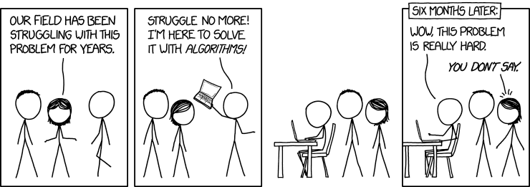

Slide 18
Enforcement
Fail to file 15c2-12 → “mayor” becomes your filing
“[Municipal issuers] act through . . . public officials. So when we find material misstatements or omissions by public officials in connection with municipal securities, we can, should, and will take action to hold the appropriate public officials accountable.”
– SEC Commissioner Daniel Gallagher on May 10, 2013.

Slide 21
Yes, you really have to!
Do I have to tell them that?
Michael E. Kozlarek
michael@kozlareklaw.com

