Slide 1
Employee vs. Independent Contractor Dilemma and Due Diligence Considerations
Presented by: Ronnie Head, CPA
Senior Assistant Comptroller General
State of South Carolina

Slide 2
Dilemma and Considerations
Impact
What’s the difference?
Tax treatment and due dates
Adequate due diligence and documentation considerations
ACA considerations

Slide 3
2017 Minnesota Timberwolves
Video display crewmembers paid as independent contractors
Crewmembers decide to form a union, but could not do so as they were not deemed employees
International Alliance of Theatrical State Employers filed a petition with the National Labor Relations Board seeking to represent workers to form a union
Board Decided 2-1 these workers were misclassified

Slide 4
Uber
2018- Federal District Court in Pennsylvania- Are Uber drivers independent contractors?
Judge Baylson- decided case under 6 factors with 4 factors leaning in favor of Independent Contractor status
2015- California- The California Labor Commission ruled a worker was an Employee

Slide 5
Concussion Lawsuits
NFL- April 2016- Third Circuit court decision – Billions paid to retired players
NFL players employees?
WWE Wrestlers- most recently WWE Cleared in a concussion lawsuit which also addressed worker misclassification

Slide 6
Impact of Misclassification

Slide 7
Impact of Misclassification*
Studies find 10-30% misclassification rate
State and Federal Gov’ts lose billions in revenues annually
Workplace law protections – FMLA, FLSA
Unemployment insurance protections
Workers Compensation insurance protections
FICA Impact
Hurts others who follow the rules
Intentional- Payroll Fraud

Slide 8
What’s the Difference?

Slide 9
Major Treatment Differences
Employees
Withhold Federal, State, and local taxes
Withhold Social Security and Medicare taxes
Provide an employer match on Social Security and Medicare taxes
Calculate and remit unemployment taxes
Remit these taxes to Fed’s/State
Department of labor overtime considerations
ACA considerations
Furnish W-2 and 1095 forms
Worker’s Compensation insurance
Independent Contractors
Payment based upon approved invoices
Furnish 1099 if applicable
Responsible for paying and remitting own taxes including self-employment taxes
May deduct business expenses
May be subject to backup withholding

Slide 10
U.S. Department of Labor

Slide 11
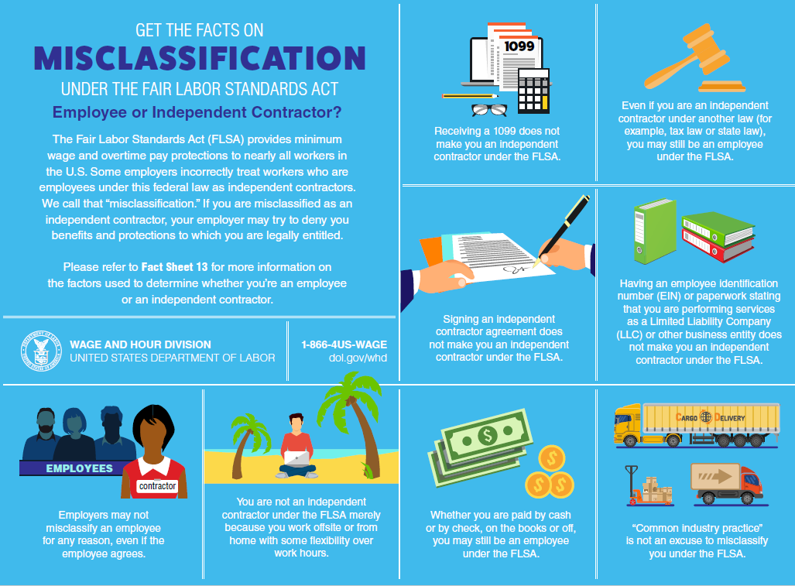

Slide 12
Wage and Hour Division of DOL
Employer-Employee relationship tested by “economic reality” rather than “technical concepts”:
U.S. Supreme Court- no single rule or test for making the determination…total activity or situation which controls. Factors include:
Extent to which the services rendered are an integral part of the principal’s business
Permanency of the relationship
Amount of the alleged contractor’s investment in facilities and equipment
Nature and degree of control by the principal

Slide 13
Wage and Hour Division of DOL (continued)
Alleged contractor’s opportunities for profit and loss
Amount of initiative, judgment, or foresight in open market competition with others required for the success of the claimed independent contractor
Degree of independent business organization and operation
DOL and IRS have a MOU- Agreement of parties with respect to a joint initiative to improve compliance with laws and regulations
Information sharing and other collaboration

Slide 14
U.S. DOL Misclassification News Releases
https://www.dol.gov/whd/media/press/whdprssToc.asp?topic=MIS#CurrentTopic
9/11/2018- San Diego Area- US DOL reclassified 17 workers as employees resulting in a $61k payment (minimum wage, overtime, accurate payroll records)
9/11/2018- Mississippi- Paid $15k in back wages to 12 employees – minimum wage and OT violations due to miss-classified employees. Also child labor violations…
4/30/2018- Michigan- US DOL reclassified 17 workers as employees- $137k (back wages)
6/20/2017- San Francisco- FLSA violation of misclassifying 743 workers- Company paid $3.4 million in unpaid overtime and Company entered into an enhanced compliance agreement
5/9/2013- Kentucky- 196 workers misclassified- $1.075M in back wages and liquidated damages paid

Slide 15
IRS Publication 15-A
General Rule- if you have the right to control or direct only the result of the work and not the means and methods of accomplishing the result- independent contractor

Slide 16
IRS Publication 15-A
3 Main Categories in making the determination
Behavioral Control
Financial Control
Relationship of the parties
This is a question of fact- in resolving the issue of whether a worker is an employee, all of the facts and circumstances must be considered, and no one factor is dispositive.

Slide 17
IRS Publication 15-A
Behavioral Control
Right to direct or control how a worker does the work
For example, extensive instructions suggest you are an employee
How, when, or where to do the work
What tools and equipment to use
What assistants to hire to help
Where to purchase supplies and services
Training- Provided about required procedures and methods- suggests you are an employee

Slide 18
IRS Publication 15-A
Financial Control
Significant investment- if a significant investment in your work, you may be an independent contractor
Expenses- If you are not reimbursed for some or all business expenses, then you may be an independent contractor
Opportunity for profit or loss- If you can realize a profit or incur a loss, this suggests that you are in business for yourself and that you may be an independent contractor

Slide 19
IRS Publication 15-A
Relationship of the Parties
Employee Benefits- If you receive benefits, such as insurance, pension, or paid leave- indication of an employee
Written contracts?
Work performed as a key aspect of operations?

Slide 20
IRS Publication 15-A- Special Categories
Statutory Employees
Statue defines some workers as employees if they fall within any one of 4 categories and meet 3 Social Security and Medicare taxes conditions
W-2 must be furnished with box checked “Statutory employee” in box 13
Don’t withhold federal income tax from the wages of statutory employees
Certain FUTA requirements

Slide 21
IRS Publication 15-A- Special Categories (continued)
Statutory Nonemployees
3 Categories of statutory nonemployees
Direct Sellers
Licensed real estate agents
Companion sitters

Slide 22
IRS Publication 15-A- Examples
Jerry Jones enters into an agreement with Wilma to supervise remodeling of her house
Wilma pays suppliers directly
Wilma carries liability and workers compensation insurance
Wilma pays an hourly rate and exercises almost constant supervision
Jerry assumes no responsibility to complete work and incurs no contractual liability
Jerry is an Independent Contractor or an Employee?

Slide 23
IRS Publication 15-A- Examples
Steve, a computer programmer, laid off from Megabyte, Inc.
Megabyte agrees to pay Steve a flat amount to complete a one-time project with no guarantees of any minimum payment for hours spent on the program
Megabyte provides no instructions beyond the spec’s of the product itself
Steve receives no benefits from Megabyte
Steve works from home and isn’t expected to attend meetings
Steve is an Independent Contractor or an Employee?

Slide 24
Other Considerations
Both an employee and an independent contractor?
If misclassified, IRS Form 8919- https://www.irs.gov/pub/irs-pdf/f8919.pdf
Form is included with IRS Form 1040 which basically raises the question to the IRS
Consideration of employees and outsourced employees- could be same individual. Consider overtime requirements…
Awareness that an issue could exist- research

Slide 25
Simpson v Commissioner (1975)
Simpson was an insurance agent for Farmers Insurance (“FI”), amongst other companies and claimed he was an Employee of FI
Simpson paid for and maintained an office and supplies, he employed his own secretary and fixed terms and conditions of her employment,
FI did not exercise control over Simpson and Simpson’s pay was substantially in the form of Commissions
Simpson’s District Manager with FI never provided leads or dictated the methods by which Simpson Sold insurance
Tax Court Decision was???

Slide 26
Hampton Software Development LLC v. Commissioner (2018)
Owners of Orchard Park Apartments retained Mr. Herndon to be the property manager and handyperson for the complex
Owners had the right to control or direct what work Mr. Herndon was to perform and provided certain tasks and responsibilities
Mr. Herndon had to follow guidelines for rejecting or accepting applications to rent from prospective tenants.
Mr. Herndon had to request approval before incurring an expense for work that exceeded certain dollar amounts, and he routinely used a credit card in the name of the owners
Owners did not closely supervise Mr. Herndon or did not supervise him at all in his performance of routine general maintenance work or minor tasks

Slide 27
Hampton Software Development LLC v. Commissioner (2018) (continued)
Owner paid a flat $2,000 per month for Mr. Herndon’s service
No formal vacation time was provided as well as no health insurance
Owner treated Mr. Herndon as an independent contractor, but failed to issue a form 1099 for taxable year 2009
Issue of worker relationship then brought to the attention of the IRS
Tax Court decision?

Slide 28
Hampton Software Development LLC v. Commissioner (2018) (continued)
IRS determined Mr. Herndon was an employee
Owner directed Mr. Herndon to undertake ~8 specific duties
Owner had the right to control or direct what work Mr. Herndon was to perform at the complex and how he was to do that work
Owner gave instructions as to what to do or what not to do and when
Prioritized his work – tax court finds that the degree-of-control factor weighs in favor of finding that Mr. Herndon was an employee

Slide 29
Hampton Software Development LLC v. Commissioner (2018) (continued)
Other factors in the tax court decision
Investment in facilities- owner provided the facilities and most of the tools and equipment used by Mr. Herndon
Opportunity for profit and loss- Mr. Herndon had no opportunity for profit or risk of loss
Owner had the right to discharge Mr. Herndon at any time
Permanency of the relationship between owner and Mr. Herndon
Owner did not qualify for Sec 530 relief due to not (a) failure to provide a 1099 for the taxable years in question

Slide 30
Tax Treatment and Due Dates- Employees
Employers must obtain an IRS Form W-4
Employers must withhold federal, state, and FICA taxes on employees
Employers must match FICA and pay unemployment tax/workers comp insurance
Employers must deposit withheld and employer match amounts (“Trust Fund Taxes”) by certain deadlines-
The State is typically over the $100,000 mark, therefore, the next day deposit rule applies
See IRS Publication 15 for a discussion on determining when specific Trust Fund Taxes are due
Perform E-verify procedures

Slide 31
Tax Treatment and Due Dates- Employees (continued)
Employers must complete a quarterly 941 and an annual 940 statement
Employers must furnish employees with a Form W-2 by 1/31 of each calendar year
Employers must furnish a form 1095, if applicable, by 1/31 of each calendar year
Employers must file this information with the IRS and applicable agencies by 1/31 of each calendar year for the proceeding year

Slide 32
Tax Treatment and Due Dates- Independent Contractors
Obtain an IRS Form W-9 for persons not treated as employees
Determine if required to furnish an IRS Form 1099. Payments not required are as follows:
Generally, payments to a corporation (including a limited liability company that is treated as a C or S Corp)
Payments for merchandise, telegrams, telephone, freight, storage, and similar items
Payments made to tax-exempt organizations, the United States, a state, the District of Columbia, a U.S. possession, or a foreign government
Payments less than $600
Other payments as listed within the instructions for the form 1099

Slide 33
Tax Treatment and Due Dates- Independent Contractors (continued)
If required:
1099-Misc must be furnished
Due date of 2/15 unless information included in box 7 (due by 1/31)
File IRS Form 1096 by 2/28 unless box 7 (due by 1/31)

Slide 34
Due Diligence and Documentation Considerations
Most relationships are “slam dunk!”
If questionable, consider all of the facts and circumstances surrounding the intended relationship
Review publication 15-A
Review court cases
Obtain research guidance (BNA/CCH/other research)
Obtain legal counsel opinion
Ask the IRS- if you want the IRS to determine whether or not a worker is an employee, file Form SS-8 with the IRS

Slide 35
Due Diligence and Documentation Considerations (continued)
Once a determination has been made:
DOCUMENT and MAINTAIN your decision
If a determination has been made for an independent contractor – ensure you have a DOCUMENTED reasonable basis for making this determination
Failure to have a documented reasonable basis forfeits your rights to the relief provision
Relief Provision- If you have a documented reasonable basis, you may be relieved from having to pay employment taxes for that worker. To get this relief, you must file all required federal information returns on a basis consistent with your treatment of the worker. (Section 530 Relief)

Slide 36
Due Diligence and Documentation Considerations (continued)
IRS Voluntary Classification Settlement Program
Employers currently treating workers as independent contractors and want to voluntarily reclassify their workers as employees for future tax periods may be eligible to participate in the VCSP is certain requirements are met. For more information, go to IRS.gov/VCSP
IRS Form 8952 https://www.irs.gov/pub/irs-pdf/f8952.pdf

Slide 37
Due Diligence and Documentation Considerations (continued)
Section 530 Relief (Publication 1976)- Must meet 3 requirements
Reasonable Basis- relied on a reasonable basis
Substantive Consistency- Treated similar workers the same
Reporting Consistency- must have filed Form 1099-Misc for each worker unless the worker earned less than $600. Relief is not available for any year you did not file the required forms.

Slide 38
ACA Considerations
Determination decision also impacts ACA
If a worker is misclassified all of the provisions of the ACA may apply, and an employer may incur ACA related penalties such as:
Failure to offer minimum value and affordable health coverage
Failure to furnish a 1095 and file a 1094
Basically adds another layer of complexity to this determination

Slide 39
IRS Video
Proper Worker Classification
https://www.irsvideos.gov/Business/Employers/ProperWorkerClassification

Slide 40
Questions?

