Slide 1
The Government Finance Officers Association of South Carolina
October 9, 2018
Courtney M. Laster, General Counsel
Ryanne Caldwell, Senior Investigator

Slide 2
The Ethics Act of 1991
The Ethics, Government Accountability, and Campaign Reform Act of 1991.
Individuals Covered by Ethics Act:
Public officials (now includes members of the General Assembly per 2016 Act. No. 282)
Public members
Public employees
Lobbyists/Lobbyist’s Principals
Subjects Covered by Ethics Act:
Rules of Conduct (8-13-700→8-13-795)
Financial Disclosures (8-13-1110→8-13-1180)
Campaign Practices (8-13-1300→8-13-1374)
Lobbyists/Lobbyist’s Principals (2-17-5→2-17-150)

Slide 3
Commission Composition
8 Commissioners
5 year terms
4 appointed by the Governor (no more than 2 from political party)
2 selected by the Senate (1 from majority party, 1 from largest minority party)
2 selected by HOR (1 from majority party, 1 from largest minority party)
Current Commissioners: Brian Barnwell, Victor Li, Donald Gist, Don Jackson, Childs Cantey Thrasher, Brandolyn Pinkston, Sam Erwin, and Ashleigh Wilson.

Slide 4
Advisory Opinions
May be requested by any person to whom the Act could reasonably be expected to apply. Regs. 52-301(A).
Informal Advisory Opinions. A non-binding opinion of Commission staff. Regs. 52-203; 52-302.
Formal Advisory Opinions. Written binding opinion of the Commission. Regs. 52-203; 52-303.
Must be in writing and relate prospectively to a real or hypothetical set of facts or circumstances. Regs. 52-301(A). An opinion request requiring consideration of past conduct may be referred to the appropriate supervisory office and an investigation of any potential violation may be conducted. Regs. 52-301(C).
Commission will not issue an advisory opinion to a third party about another person without authorization from the affected party. Regs. 52-301(B).
Advisory Opinions may be confidential by request. Regs. 52-301(D).
House and Senate Advisory Opinions.

Slide 5
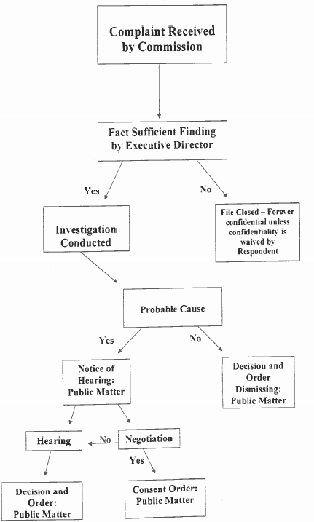
Complaint Process

Slide 6
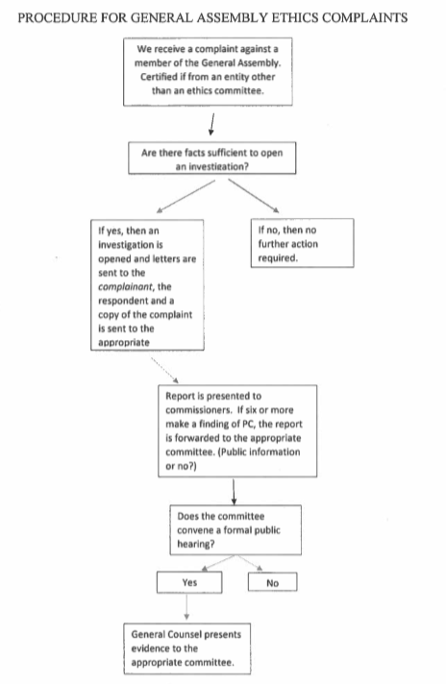
Complaint Process-General Assembly

Slide 7
Confidentiality
S.C. Code Ann. Regs. 52-718
(A) No person associated with a complaint…shall mention the existence of the proceedings or disclose any information pertaining thereto except to persons directly involved including witness and potential witnesses, and then only to the extent necessary for investigation and disposition of the complaint. Witnesses and potential witnesses shall be bound by these confidentiality provisions.
(B) The Respondent may waive the confidentiality of the proceeding in writing filed with the Commission.
No partial waivers. 8-13-320(10)(g)(ii).

Slide 8
§ 8-13-700
Use of Official Position/Office for Financial Gain; Disclosure of Potential Conflict of Interest

Slide 9
Use of Official Position/Office for Financial Gain; Disclosure of Potential Conflict of Interest §8-13-700(A)
No public servant may knowingly use his official position to obtain an economic interest (8-13-100(11)) for:
himself
a family member (8-13-100(15))
an individual with whom he is associated (8-13-100(21))
a business with which he is associated (8-13-100(4))
This prohibition does not extend to incidental use of public materials, personnel, or equipment, subject to or available for the public servant’s use that does not result in additional public expense.
Incidental not defined. Example—telephone use, copier use with reimbursement, etc.
Economic Interest--large class exception.

Slide 10
Use of Official Position/Office for Financial Gain; Disclosure of Potential Conflict of Interest §8-13-700(B)
No public servant may make, participate in making, or in any way attempt to use his position to influence a governmental decision in which he, a family member, or an individual/business with whom associated has an economic interest.

Slide 11
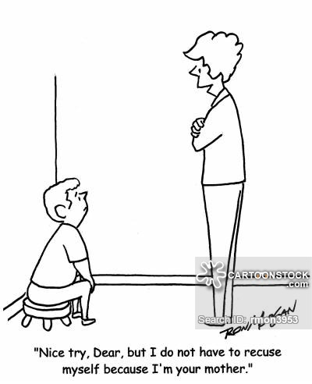
Use of Official Position/Office for Financial Gain; Disclosure of Potential Conflict of Interest §8-13-700(B)

Slide 12
Use of Official Position/Office for Financial Gain; Disclosure of Potential Conflict of Interest §8-13-700(B)
When confronted with an action or decision in discharge of official duties that would affect the economic interest of himself, a family member, or an individual/business with whom associated, the public servant shall:
Prepare a written statement describing conflict of interest;
If he is a public employee, provide the statement to his superior, if any, who shall assign the matter to another employee who does not have a potential conflict of interest. If he has no immediate supervisor, he shall take the action prescribed by the State Ethics Commission;
Recusal includes formal actions and informal actions (ie, participating in discussions).

Slide 13
Anti-Bribery Provision § 8-13-705
A person may not give and a public servant may not receive anything of value (8-13-100(1)) with the intent to influence.
Anything of value does not mean:
Printed informational or promotional material under $10;
Personalized plaque or trophy with a value under $150;
Educational material of nominal value directly related to the public servant’s official responsibilities;
Honorary degree;
Promotional or marketing items offered to general public on same terms;
Campaign contributions.
Intent matters. Christmas gifts, awards, neutral third party decision-makers.

Slide 14
Anti-Nepotism Provision § 8-13-750
No public servant may cause the employment, appointment, promotion, transfer, or advancement of a family member to a state or local office or position in which the public servant supervises or manages.
Direct supervision or management.
Intervening links in chain of command.
Public servant may not participate in an action relating to the discipline of the public servant’s family member.
Family member is the spouse, parent, brother, sister, child, mother-in-law, father-in-law, son-in-law, daughter-in-law, brother-in-law, sister-in-law, grandparent, grandchild or a member of the individual’s immediate family. § 8-13-100(15).
Recusal provisions of § 8-13-700(B) apply. Report to appropriate supervisor if a public employee.

Slide 15
Post-Employment Restrictions § 8-13-755
Former public servant may not, for a period of one year after terminating service/employment:
Lobby or represent clients before the government entity in a matter in which he directly and substantially participated; or
Accept employment:
From a person regulated by the entity; and
Involves a matter in which he directly and substantially participated.

Slide 16
Post-Employment Restrictions § 8-13-760
Public servant participating directly in procurement may not resign and accept employment
with a person contracting with the governmental body
if the contract falls or would fall under the public servant’s official responsibilities.
"Procurement" means buying, purchasing, renting, leasing, or otherwise acquiring any supplies, services, information technology, or construction. It also includes all functions that pertain to the obtaining of any supply, service, or construction, including description of requirements, selection, and solicitation of sources, preparation and award of contracts, and all phases of contract administration. Section 11-35-310(24).

Slide 17
Economic Interest in Gov’t Contracts § 8-13-775
Public servant may not have an economic interest in a contract with the State/political subdivision if public servant is authorized to perform an official function relating to the contract.
Writing or preparing contract specifications, acceptance of bids, award of the contract, or other action on the preparation or award of the contract.
Ok if no official function + public notice + competitive bids.

Slide 18
Other Rules of Conduct
May not accept an honorarium for speaking engagements in official capacity. May accept payment for actual expenses. 8-13-715.
May not accept additional money for assistance given while performing official duties. 8-13-720.
May not represent another person before one’s governmental entity. 8-13-740.

Slide 19
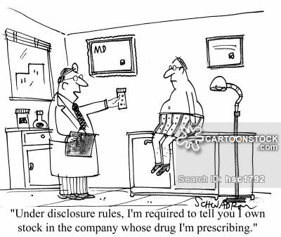
Statements of Economic Interests §8-13-1110, et seq

Slide 20
Statements of Economic Interests §8-13-1110, et seq
To be filed upon entering official responsibilities, then annually on or before March 30.
What to Disclose?
Source, type, and amount of income, not to include tax refunds, of substantial monetary value received from a governmental entity by the filer or a member of the filer’s immediate family during the reporting period;
Associations with lobbyists;
Real property information if public improvements > $200 are known to filer or if sale, lease, or rental is to government;
Public speaking engagements information;
Certain information regarding businesses and stock ownership;
Name and address of associated individual or business that contracts with the employing governmental entity, as well as compensation paid to the public servant by that individual/business.
Gifts, including transportation, lodging, food, or entertainment received from certain persons.

Slide 21
Statements of Economic Interests §8-13-1110, et seq
NEW→ listing of
private source and type of any income received in the previous year by the filer or a member of his immediate family.
Certain items excluded. 8-13-1120(A)(10)

Slide 22
Campaign Finance Overview
Campaign Bank Accounts. All campaign expenses must be drawn from campaign account. Limited to one checking and one savings. Must include candidate’s name.
Duty to File. Triggered by receipt or expenditure of $500 or more. If candidate does not raise or expend $500, must file campaign disclosure 15 days prior to election.
Quarterly Disclosures. Due January 10, April 10, July 10, and October 10.
Individual Contribution Limits. $3500 for statewide candidates. $1000 for local candidates. Personal contributions to own campaign unlimited.
Political Party Contribution Limits. $50K for statewide. $5K for local.
Anonymous contributions prohibited. Send to Children’s Trust Fund within 7 days.
Committees. Krawcheck

Slide 23
Use of Gov’t Personnel/Facilities for Campaign Purposes § 8-13-765
No person may use gov’t personnel, equipment, materials, or an office building in an election campaign. Provisions of this subsection do not apply to a public official’s use of an official residence.
Gov’t may rent or provide public facilities for political/campaign purposes if provided to all equally.
Gov’t personnel, where not otherwise prohibited, not prohibited from participating in election campaigns on own time.
SEC AO2001-004. Public employee cannot use his office, to include office materials, equipment and personnel. Members of staff may participate on their own time.

Slide 24
Use of Public Resources to Influence Elections Prohibited § 8-13-1346
A person may not use or authorize the use of public funds, property, or time to influence the outcome of an election.
SEC AO2018-003; 2018-004. Factors to determine “influence the outcome of an election/ballot measure”
Gov’t entity affected by ballot measure may prepare informational materials, conduct public meetings, or respond to news media or citizens’ inquiries; however, a gov’t entity may not use public funds, property, or time in an attempt to influence the outcome of a ballot measure.
SEC AO2018-003; 2018-004. Discusses what constitutes “informational materials.”

Slide 25
Penalties
8-13-150. Late Filing Penalties for Statements of Economic Interests and Campaign Disclosure Reports
$100 if not filed within five days of deadline
Once Commission provides notice by certified mail:
$10 for 10 days, then
$100 a day until filer comes into compliance or $5,000 accrues (takes approximately 48 days) following notice via certified mail.

Slide 26
Additional Penalties
Oral or written warning or reprimand;
Civil penalty of no more than $2,000 for each violation;
Forfeiture of gifts, receipts, or profits, or the value thereof, obtained in violation of the Act; and
Administrative Fees/Costs.

Slide 27
Questions?

