Slide 1
Best Practices in Budgeting Government Finance Officers Association of South Carolina
October 14, 2019
gfoa.org
@GFOA
© 2019 Government Finance Officers Association

Slide 2
Instructor
John Fishbein
Senior Program Manager
Technical Services Center
Government Finance Officers Association (GFOA)
Phone: 312-578-2268
Email: jfishbein@gfoa.org
2

Slide 3
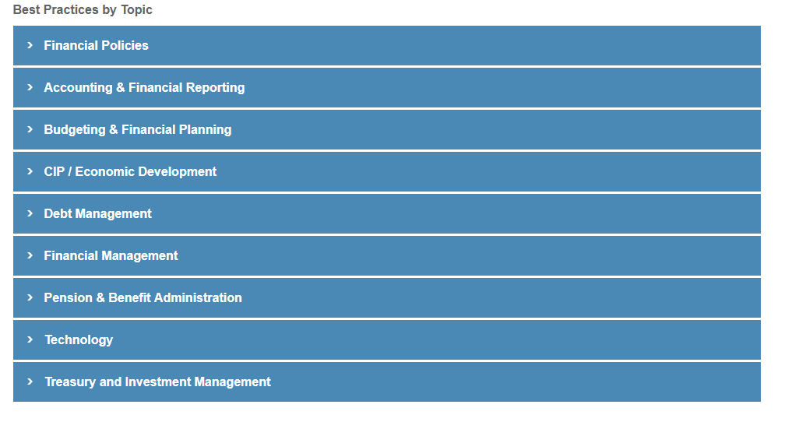
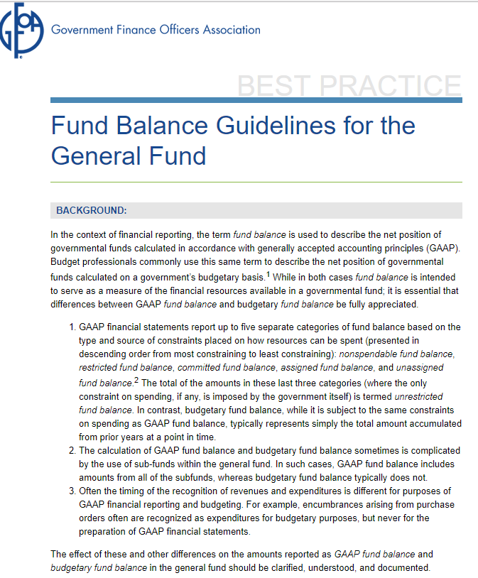
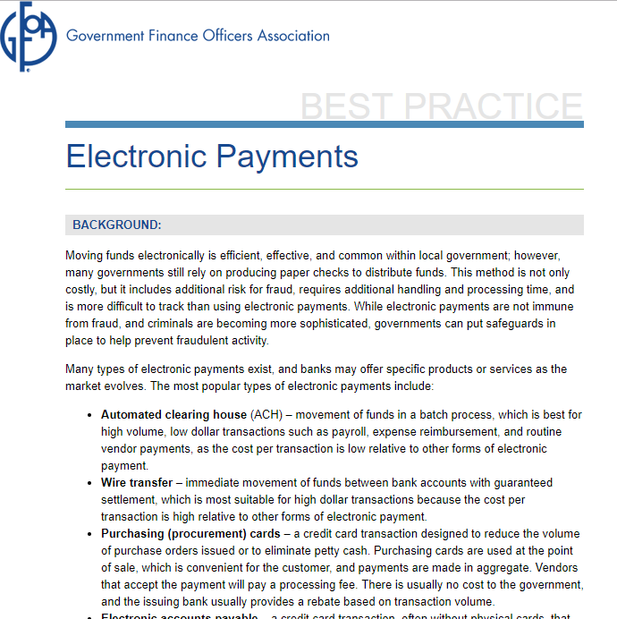
Links
http://www.gfoa.org/best-practices

Slide 4
Links
Budget Awards home page
http://www.gfoa.org/budgetaward
4

Slide 5
1. Adopting Financial Policies
Strong reasons for formal adoption:
Institutionalizes good financial mgt practices
Clarifies strategic intent for financial mgt
Defines boundaries and framework for actions
Supports good bond ratings
Promotes long-term, strategic thinking
Manages risk to financial condition
Complies with established public management best practices
5
Notes:
5
5
5

Slide 6
1. Adopting Financial Policies
Scope – Basic categories
General fund reserves
Reserves in other funds
Grants
Debt
Investment
Economic development
Accounting and financial reporting
Risk management and internal controls
6
Notes:
6
6
6

Slide 7
1. Adopting Financial Policies
Scope – Basic categories
Procurement
Long-term financial planning
Structurally balanced budget
Capital
Revenues
Expenditures
Operating budget
7
Notes:
7
7
7

Slide 8
1. Adopting Financial Policies
Development
Define problem to be addressed
Draft policy – legal requirements, public comments, peer governments
Review with governing body
Governing body formally adopts
Implement
8
Notes:
8
8
8

Slide 9
1. Adopting Financial Policies
Design
Must be in written form
Expressed in understandable manner to the intended audience
Available to stakeholders in more than one medium and accessible by multiple means
Address all relevant issues and risks in a concise fashion
9
Notes:
9
9
9

Slide 10
1. Adopting Financial Policies
Presentation
Same section of the budget
Original and revision dates on each policy
Review
Monitored, reviewed and updated in a systematic way
If not being followed, analyze reasons
10
Notes:
10
10
10

Slide 11
Napa Sanitation District, CA.
11

Slide 12
2. Determining the Appropriate Level of Unrestricted Fund Balance in the General Fund
Focus on unrestricted fund balance (GAAP)
Committed fund balance
Assigned fund balance
Unassigned fund balance
Minimum level of unrestricted fund balance
Two months of regular revenues or regular expenditures
12
Notes:
12
12
12

Slide 13
2. Determining the Appropriate Level of Unrestricted Fund Balance in the General Fund
Factors to be considered in context of long-term forecasting
Revenue predictability, expenditure volatility
Perceived exposure to one-time outlays
Availability of other resources or potential drain by other funds
Impact upon bond rating, cost of borrowing
Commitments and assignments
13
Notes:
13
13
13

Slide 14
2. Determining the Appropriate Level of Unrestricted Fund Balance in the General Fund
Policy components
Time period and contingencies for its use
How expenditure levels will be adjusted to match any new economic realities
Time period over which it will be replenished and the means by which to do so
14
Notes:
14
14
14

Slide 15
2. Determining the Appropriate Level of Unrestricted Fund Balance in the General Fund
Factors influencing the replenishment time horizon
Budgetary reasons behind the fund balance targets
Recovering from an extreme event
Political continuity
Financial planning time horizons
Long-term forecasts and economic conditions
External financing expectations
15
Notes:
15
15
15

Slide 16
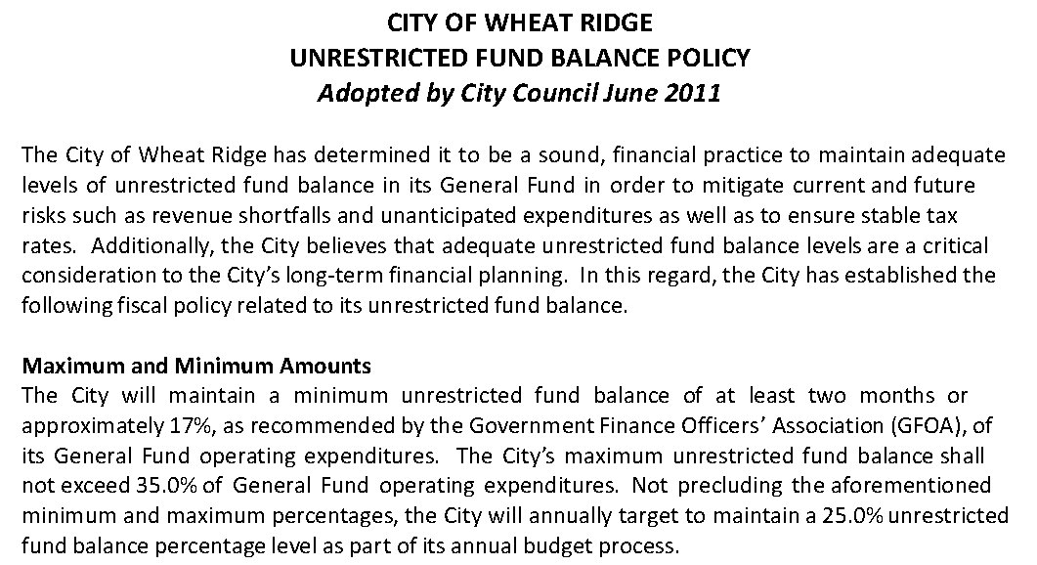
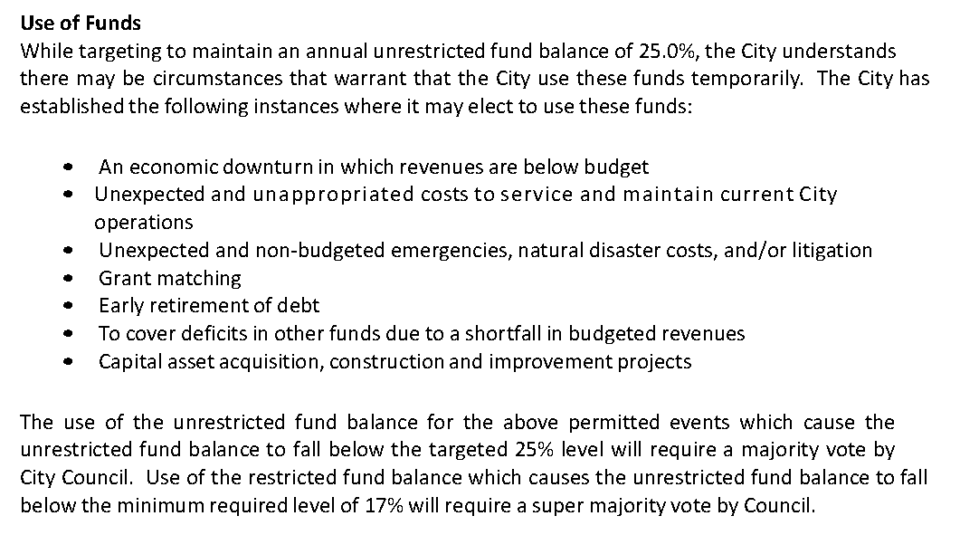
City of Wheat Ridge, CO.
16

Slide 17
3. Determining the Appropriate Levels of Working Capital in Enterprise Funds
Use working capital as the measure of available margin or buffer in enterprise funds.
Defined as current assets minus current liabilities
Recommendations:
Establish appropriate allowance for uncollectibles.
Ensure inventories and prepaids included in current assets are realistic one-year estimates.
Target of no be less than forty-five (45) days worth of annual operating expenses.
17
Notes:
17
17
17

Slide 18
3. Determining the Appropriate Levels of Working Capital in Enterprise Funds
Considerations and factors for setting a working capital target:
Support from general government
Transfers out
Cash cycles
Customer concentration
Demand for services
Control over rates and revenues.
18
Notes:
18
18
18

Slide 19
3. Determining the Appropriate Levels of Working Capital in Enterprise Funds
Considerations and factors for setting a working capital target:
Asset age and condition
Volatility of expenses
Control over expenses
Management plans for working capital
Separate targets for operating & capital needs.
Debt position
19
Notes:
19
19
19

Slide 20
4. Establishing Government Charges and Fees
Adopt formal policy (public)
Factors to be taken into account in pricing
Intent to recover full cost?
Circumstances where more or less than 100% recovery permitted
Rationale for not recovering full cost
Full cost should be calculated to provide a basis for setting fees or charges
Review and update regularly
20
Notes:
20
20
20

Slide 21
WaterOne, KS.
As a part of the budget process, the Board set water rates that will go into effect on January 1, 2016.
The planned water rate adjustment is 2.5% based on a cost of service analysis. This represents an impact of $1/month for the typical residential customer. The main cost drivers that make an increase in 2016 necessary are investments in infrastructure replacement, labor expenses, security enhancements, and a gradual decline in indoor water use.
The 2016 rate is consistent with WaterOne’s approach to avoid rate volatility by creating incremental rate adjustments. Stable, predictable rates are preferred by customers and promote the growth of the local economy.
21
Notes:
Water One, Kansas is very diligent about avoiding rate volatility. Their budget stresses this point. As Mike mentioned in the prior slide, many governments use inflation rates as a guide to fee or tax increases.

Slide 22
Pinellas County, FL

Slide 23
5. Establishing an Effective Grants Policy
Provides staff guidance to staff in order to maximize the benefits and minimize the risks of receiving grants.
Identifies formal steps to take prior to applying for or accepting a grant.
Policy should include, at a minimum, the following:
Grants identification and application
Strategic alignment
Funding analysis
Evaluation prior to renewal or grant continuation
Administrative and operational support
23
Notes:
23
23

Slide 24
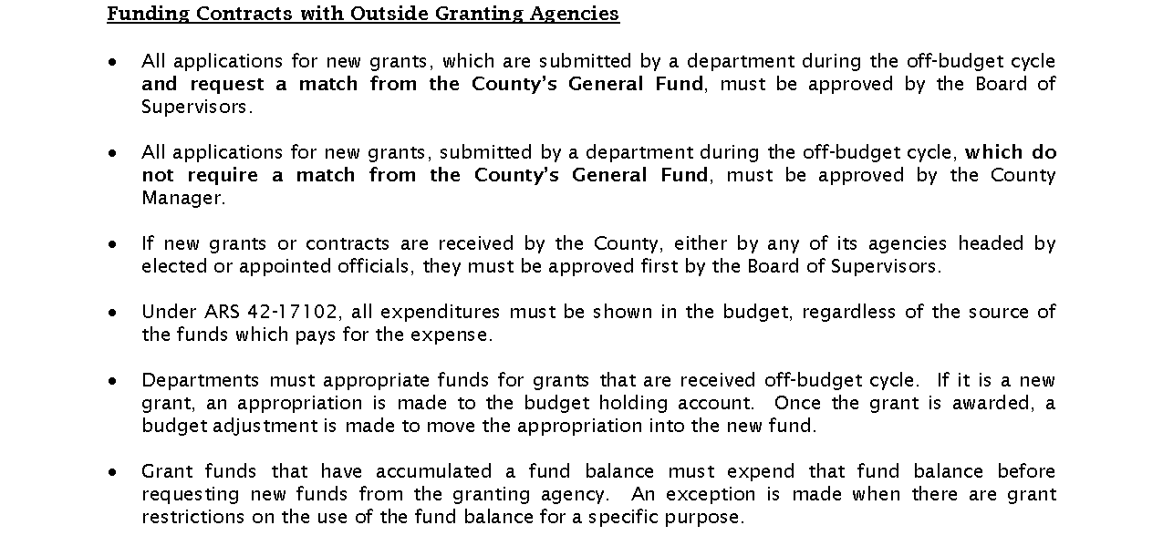
Coconino County, AZ.
24

Slide 25
6. Creating a Comprehensive Risk Management Program
Identify potential events that may affect the government adversely
Protect and minimize risks to the government’s property, services and employees
Grown in importance due to:
Legal, political, medical liabilities
Increased use of technology
Higher litigation costs
Following 5 steps should be included in an effective risk management program:
25
Notes:
25
25

Slide 26
6. Creating a Comprehensive Risk Management Program
Risk identification
Physical environment (disasters & infrastructure)
Legal environment (laws and legal precedents)
Operational environment (day-to-day activities within the organization, workforce demographics)
Political environment
Social/community environment
Economic environment
Internal environment (the attitude of individuals towards risk)
26
Notes:
26
26

Slide 27
6. Creating a Comprehensive Risk Management Program
Risk evaluation
Frequency and severity
Risk treatment
Loss prevention and control (training, workshops, etc)
Risk transfer (financial, contractual, etc)
Risk retention (self insures)
Risk avoidance
Risk management implementation
Risk management review
27
Notes:
27
27

Slide 28
7. Achieving a Structurally Balanced Budget
Clarify distinction between satisfying a statutory definition and a true structurally balanced budget.
Define parameters for achieving and maintaining structural balance whereby recurring revenues equal recurring expenditures in the adopted budget.
Identify key items, including:
Recurring and non-recurring revenues
Recurring and non-recurring expenditures
Reserves
Adopt a formal, written policy calling for structural balance of the budget.
Require the budget presentation to clearly identify how recurring revenues are aligned with or not aligned with recurring expenditures.
28
Notes:
28
28

Slide 29
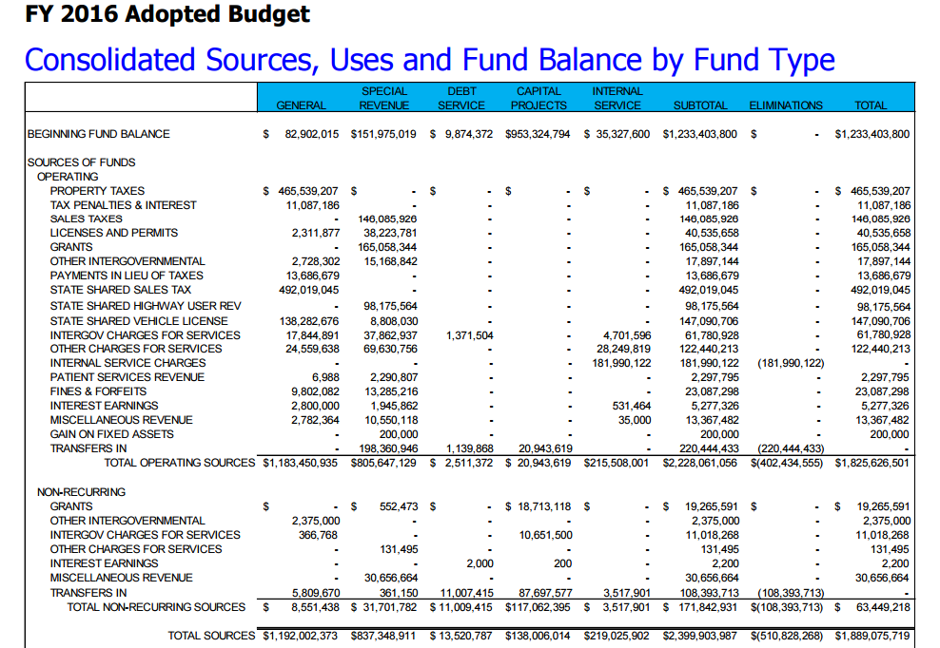
Maricopa County, AZ
29
Notes:
29
29
The city of Abilene, Texas notes that retirements and management succession is a major issue. The issue is identified and one step in solving this problem is offered.

Slide 30
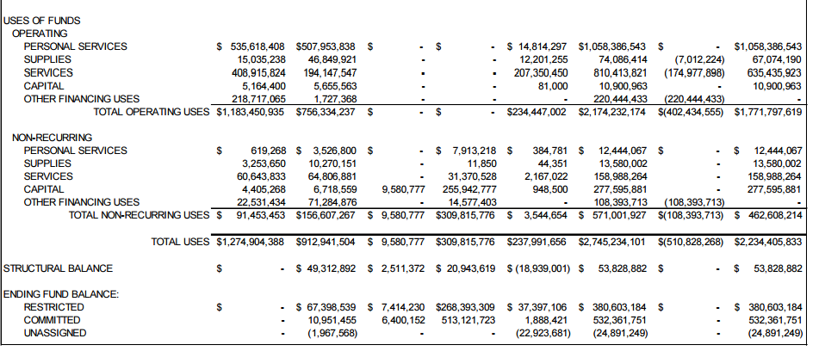
Maricopa County, AZ
30
Notes:
30
30
The city of Abilene, Texas notes that retirements and management succession is a major issue. The issue is identified and one step in solving this problem is offered.

Slide 31
8. Business Preparedness and Continuity Guidelines
Develop, test, and maintain a plan to continue basic business operations.
Assess unique risks.
Strategy should mitigate risks and control costs.
External planning resources
U.S. Dept. of Homeland Security, Center for Domestic Preparedness (CDP) – assessment and testing
FEMA guidelines
31
Notes:
31
31
31

Slide 32
8. Business Preparedness and Continuity Guidelines
Other planning considerations
Plan compliance with OSHA, EPA, local, state and other federal requirements
Risk management (insurance coverage)
Administrative support functions (HR, purchasing, treasury, legal, risk management)
Outsourced/recovery services (e.g. garbage collection) able to function during disruption
32
Notes:
32
32
32

Slide 33
City of Toronto, ON.
Which staff, materials, procedures and equipment are essential for keeping your business operating?
Who are your suppliers and other businesses you work with on a daily basis?
If your workplace becomes inaccessible, what's your plan? Developing a continuity of operations plan (COOP) is essential to your organization's health.
Convene a core team to develop your emergency plan.
Train everyone.
Work with other organizations.
Review your plans annually.
33

Slide 34
9. The Public Finance Officers Role in Fiscal Sustainability
Balance needed (“triple bottom line”)
Economy
Environment
Social Equity
Categories of specific representations
Define sustainability
Reporting
Analyze return on investment
Integrate sustainability goals into planning and budgeting
34
Notes:
34
34
34

Slide 35
City of Chicago, IL
35
Notes:
35
35
35

Slide 36
10. The Public Finance Officers Role in Collective Bargaining
Finance officer’s expertise should be utilized.
Develop timelines.
Prioritize issues.
Communicate financial pressures.
Evaluate renegotiation triggers.
36
Notes:
36
36

Slide 37
10. The Public Finance Officers Role in Collective Bargaining
Make peer comparisons.
Determine proposal costs and affordability.
Determine the effects on different employee units.
Evaluate retroactive proposals.
Consider one-time payments or non-financial incentives.
37
Notes:
37
37

Slide 38
11. Key Issues in Succession Planning
Develop an integrated approach to managing succession.
Continually assess potential employee turnover.
Provide formal, written succession plans as frameworks.
Develop written policies and procedures to facilitate knowledge transfer.
Leadership skills should be a key component.
38
Notes:
38
38

Slide 39
11. Key Issues in Succession Planning
Encourage personal professional development activities.
Design better recruitment and retention practices.
Consider collective bargaining agreements and how those agreements fit in.
Consider non-traditional hiring strategies.
39
Notes:
39
39

Slide 40
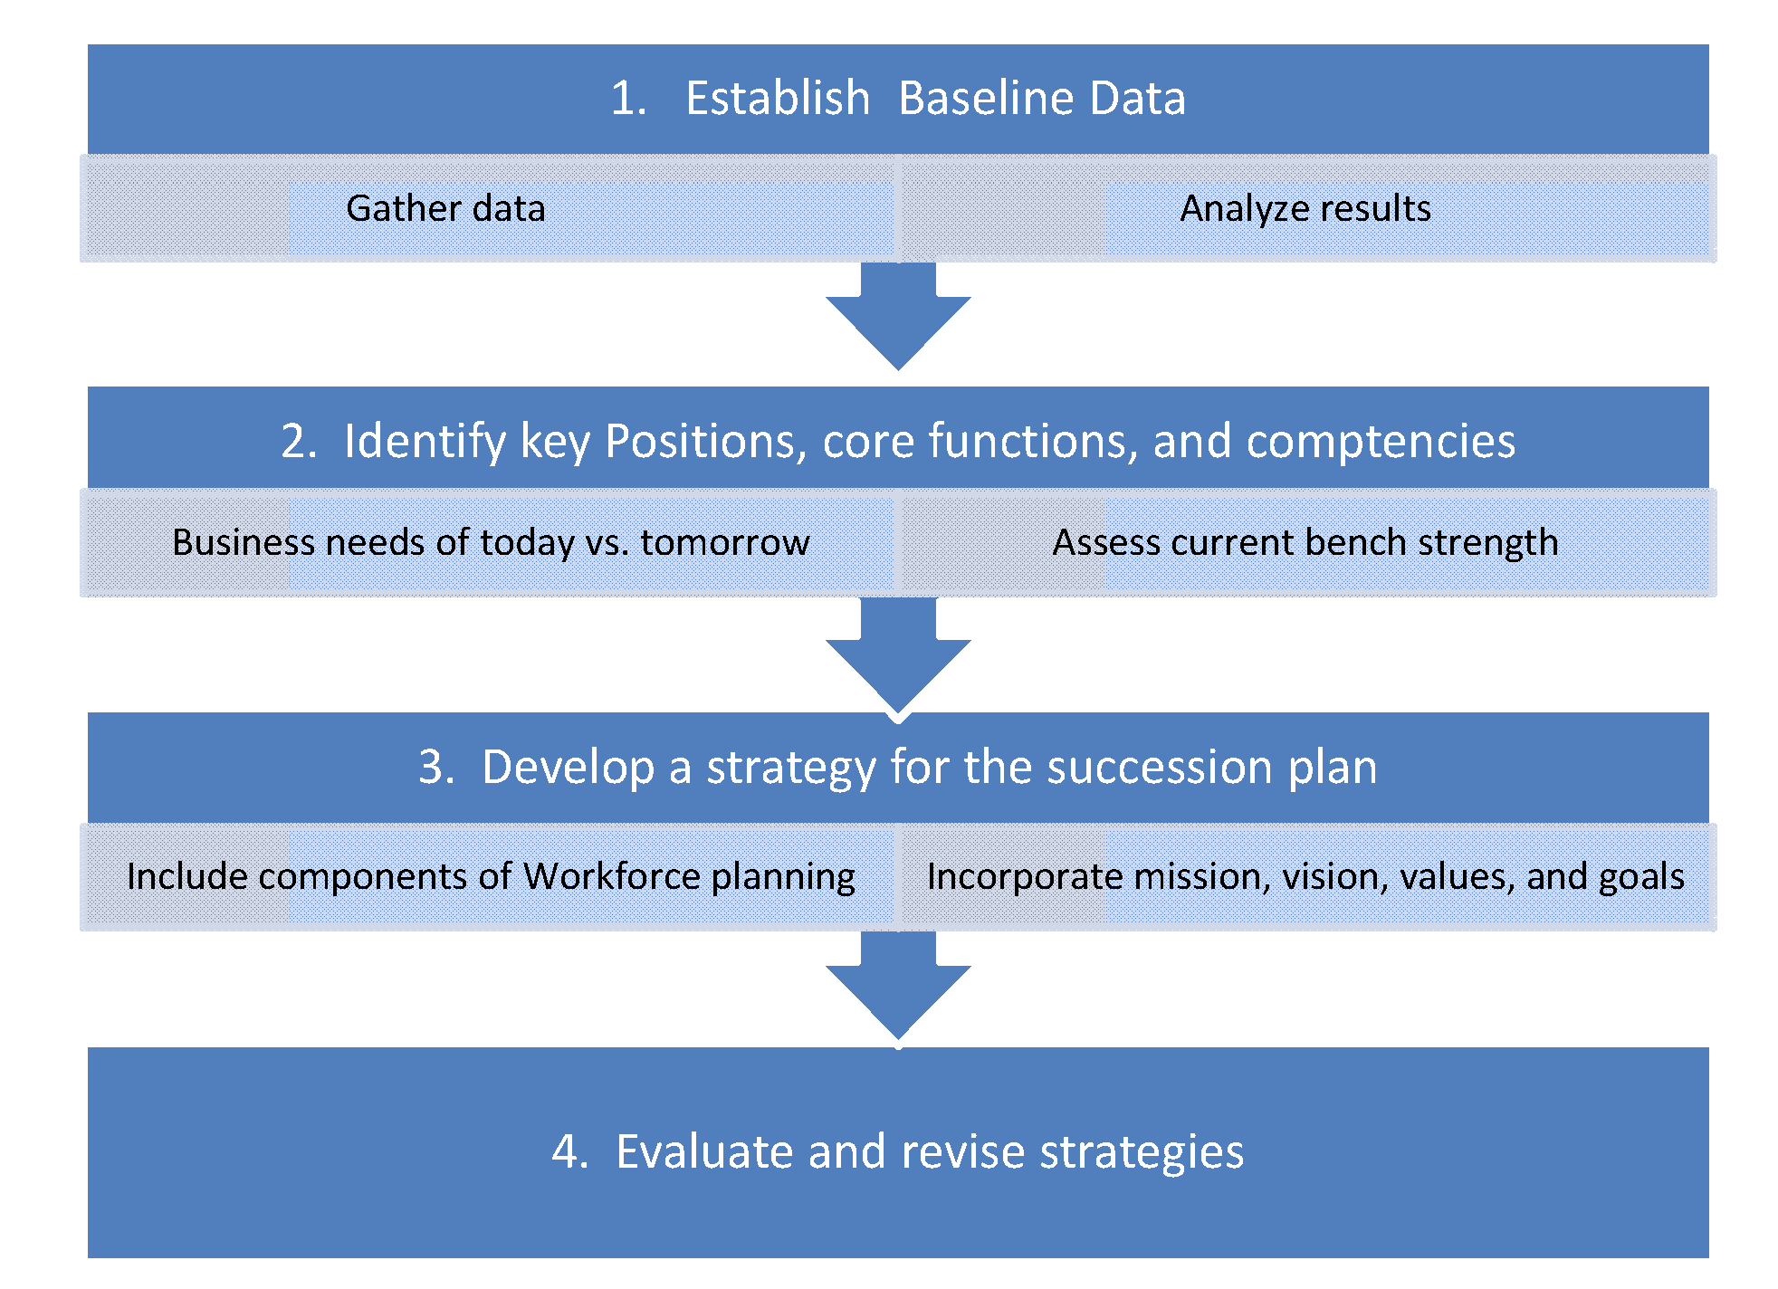
City of McMinnville, TN.
40

Slide 41
12. Ensuring Other Postemployment Benefits (OPEB) Sustainability
Prefund benefits (vs. pay-as-you-go) using a formal written policy.
Require employee contributions.
Consider impact on OPEB costs before offering early separation packages.
Do not issue OPEB bonds to fund liabilities.
Manage costs of offered benefits. Fourteen methods are provided for consideration, such as raising the eligibility age for OPEB.
41

Slide 42
12. Ensuring Other Postemployment Benefits (OPEB) Sustainability
Create a qualified trust fund for prefunding.
Communicate and educate stakeholders.
Treat OPEB as part of the total compensation package.
Avoid undue burden of benefit costs on employee in order to maintain employer competitiveness.
42

Slide 43
13. Sustainable Funding Practices for Defined Benefit Pensions and OPEB
Contribute the full amount of the actuarially determined contribution (ADC) each year.
Adopt a formal policy.
Fully funding liabilities
Stable amortization period over time
Employee/Employer contributions made at regular intervals
Select funding and amortization methods aligned with funding policy.
43

Slide 44
13. Sustainable Funding Practices for Defined Benefit Pensions and OPEB
Prepare actuarial valuation at least biennially.
Perform an actuarial experience study at least once every 5 years and update assumptions as needed.
Perform an independent audit of the actuarial evaluations at least once every 5 to 8 years.
Prepare and widely distribute a CAFR covering the retirement system, communicating plan status and activities.
44

Slide 45
13. Sustainable Funding Practices for Defined Benefit Pensions and OPEB
Reduce ADC volatility by:
Smoothing returns on assets, typically 5 years
Diversifying the investment portfolio to reduce volatility of investment returns
Managing investment returns long term
Managing growth in liabilities, including COLAs, benefit increases, benefit formula enhancements
45

Slide 46
14. Establishment of Strategic Plans
Every government should use some form of strategic planning
Essential steps of a sound process
Initiate the process
Prepare a mission statement
Assess environmental factors
Identify critical issues
Agree on a small number of broad goals
46
Notes:
46
46
46

Slide 47
14. Establishment of Strategic Plans
Develop strategies to achieve broad goals
Create an action plan
Develop measurable objectives
Incorporate performance measures
Review or adopt the plan
Implement the plan
Monitor progress
Reassess the plan
47
Notes:
47
47
47

Slide 48
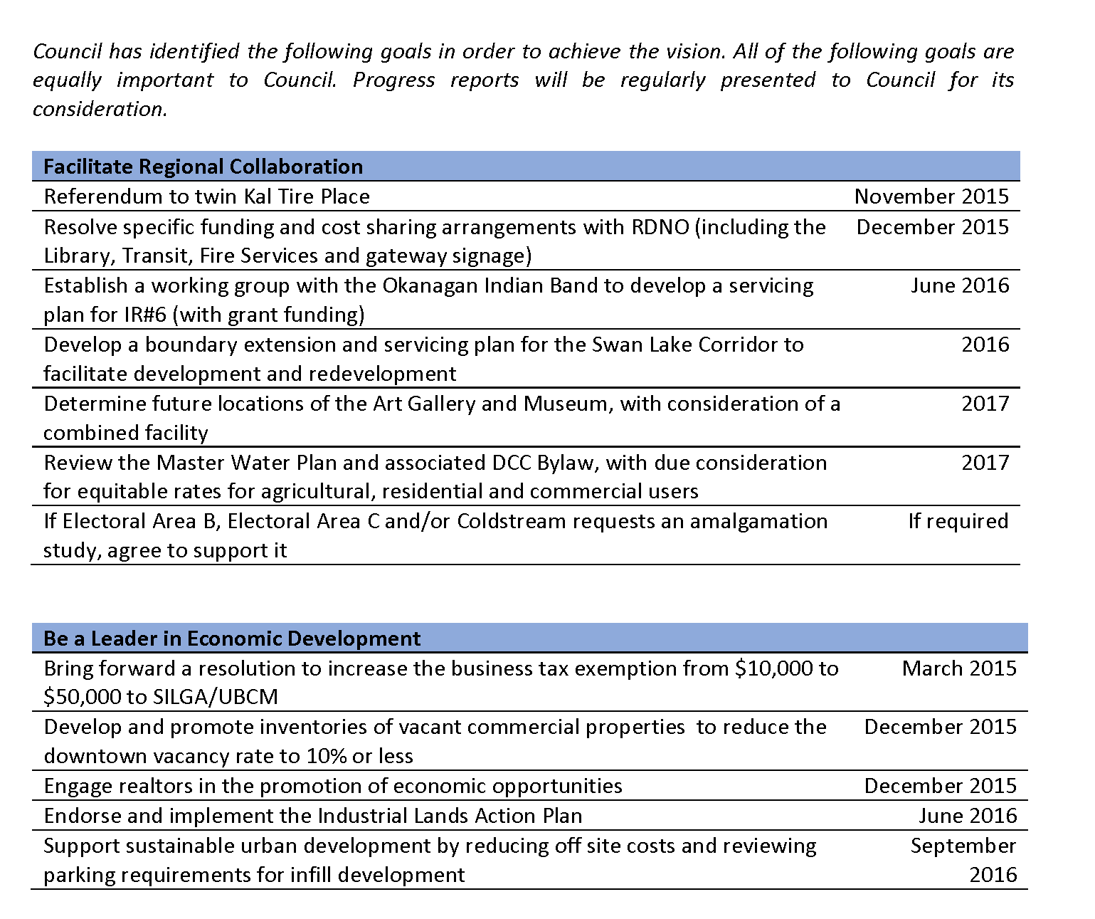
City of Vernon, ON.
48

Slide 49
15. National Advisory Council on State and Local Budgeting
NACSLB (1995-1997)
GFOA and 7 other SLG associations
Goal = set of recommended budget practices
Recommendation:
Adopt NACSLB Framework and practice statements
Blueprint rather than mandatory prescriptions
Incremental implementation foreseen
49
Notes:
49
49
49

Slide 50
16. Long-Term Financial Planning
Time horizon
Five to 10 years into the future
Scope
Consider all appropriated funds, but especially those that account for issues of top concern
Don’t just focus on the General Fund
Frequency
Update long-term planning activities as needed
Content
Financial environment
Revenue and expenditure forecasts
Debt position and affordability analysis
Strategies for achieving financial balance
Plan monitoring mechanisms
Visibility
Effective means to communicate information
50
Notes:
50
50
50

Slide 51
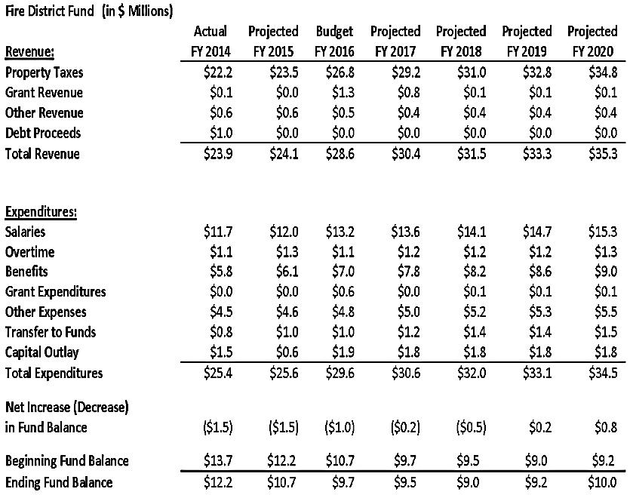
St. Johns County, FL
51

Slide 52
17. Budgeting for Results and Outcomes
Determine how much money is available.
Prioritize results.
Allocate resources among high priority results.
Conduct analysis to determine what strategies, programs, and activities will best achieve desired results.
52

Slide 53
17. Budgeting for Results and Outcomes
Budget available dollars to the most significant programs and activities.
Set measures of annual progress, monitor, and close the feedback loop.
Check what actually happened.
Communicate performance results.
53

Slide 54
City of Redmond, WA.
Budget
The City is using its Budgeting by Priorities (BP) for the fifth time in its 2017/2018 budget. By using lessons learned from each of the three previous efforts, the City strives to continue providing the highest priority services to the community.

Slide 55
18. Performance Management
Principles adopted by the National Performance Management Commission, in a 2010 report,
A Performance Management Framework for State and Local Government: From Measurement and Reporting to Management and Improving
Information, measures, goals, priorities, and activities are relevant to the priorities and wellbeing of the government and the community.
Information related to performance, decisions, regulations, and processes is transparent — easy to access, use, and understand.
55
Notes:
55
55
55

Slide 56
18. Performance Management
Principles continued . . .
Goals, programs, activities, and resources are aligned with priorities and desired results.
Decisions and processes are driven by timely, accurate, and meaningful data.
Practices are sustainable over time and across organizational changes.
Performance management helps to transform the organization, its management, and the policymaking process.
56
Notes:
56
56
56

Slide 57
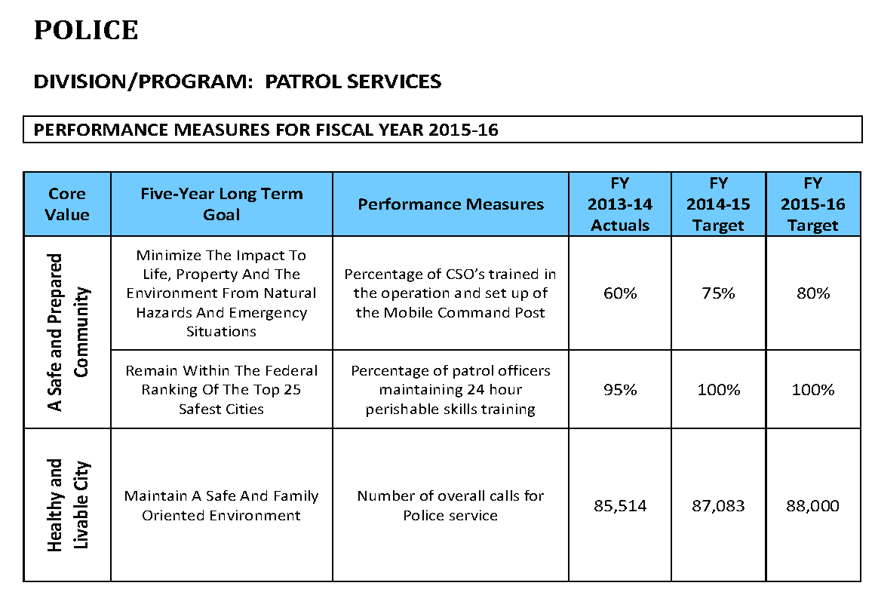
City of Temecula, CA.
57
Notes:
Mike – performance measures that connect the goals of the organization to the operational objectives is a compelling way to illustrate the relevance of the measures – and therefore the relevance of the programs themselves. This is done well by Temecula, CA.

Slide 58
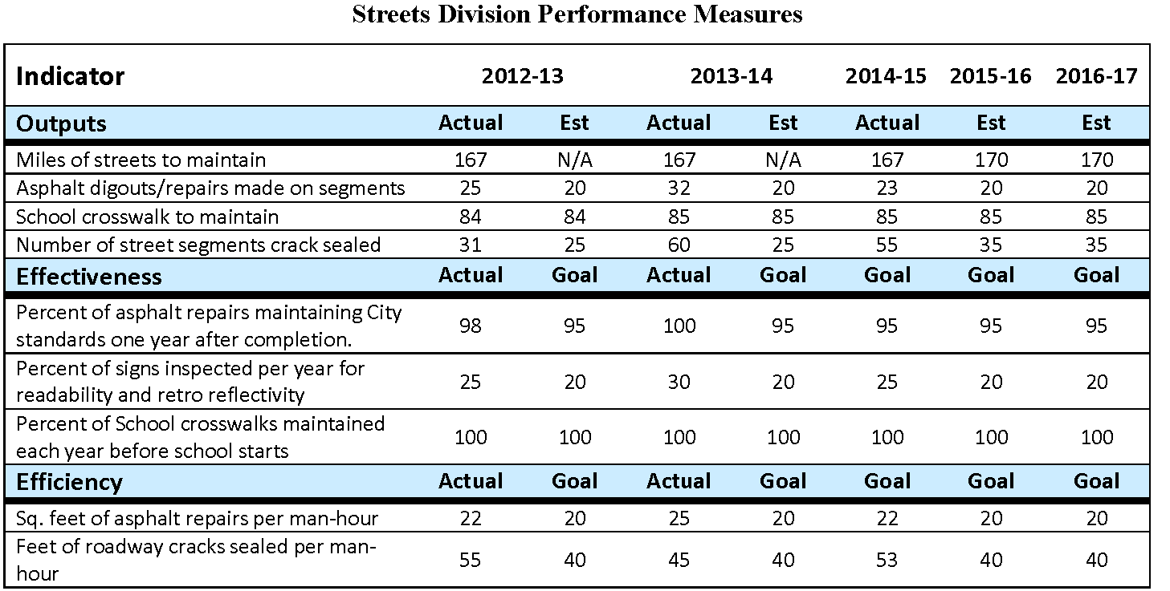
City of Grants Pass, Oregon
58
Notes:
Mike – a combination of activity measures and effectiveness measures can be a compelling way to communicate about the service as illustrated here by Grants Pass in Oregon
Also note that they set service level targets for future years.

Slide 59
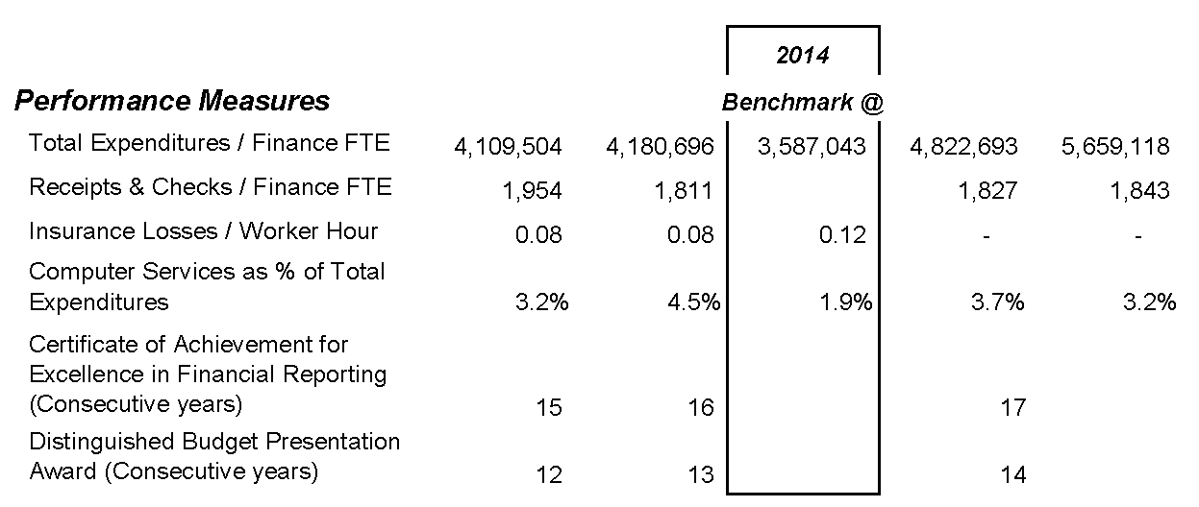
City of Maple Valley, WA.
59
Notes:
While it is useful to look at performance measure on an internal basis for trends, the idea of benchmarking or comparing yourself to other entities is useful as well. Maple Valley, Washington’s Finance Department performance measures are benchmarked against seven comparable cities.

Slide 60
19. Best Practices in School District Budgeting
GFOA has developed a series of Best Practices in School District Budgeting, which clearly outline steps to developing a budget that best aligns resources with student achievement goals. The budgeting process presented in these Best Practices is focused on optimizing student achievement within available resources. It encompasses a complete cycle for long-term financial planning and budgeting, including planning and preparing to undertake the budget process, developing a budget, evaluating how the budget process worked, and adjusting accordingly. Within this cycle, the district’s instructional priorities provide a guide for decision-making. GFOA recommends that all districts go through the defined steps as part of their planning and budgeting process.
60

Slide 61
20. Best Practices
in Community College Budgeting
GFOA has developed a series of Best Practices in Community College Budgeting, which outline steps to developing a budget that aligns resources with student achievement goals. The budgeting process advocated is focused on optimizing student achievement within available resources. It encompasses a complete cycle for long-term financial planning and budgeting, including planning the budget process, developing a budget, evaluating how the budget process worked and adjusting accordingly. Throughout this cycle, the community college’s institutional goals serve as the guide for decision-making and resource allocation. GFOA recommends that all community colleges go through the defined steps as part of their planning and budgeting process.
61

Slide 62
21. Public Participation in Planning, Budgeting, and Performance Management
Can improve accountability and responsiveness
Not only traditional, public participation, e.g. voting, running for office, attending public hearings, and reading the local newspaper
New forms of public involvement – surveys, focus groups, neighborhood councils, and Citizen Relationship Management systems -- as inputs to decisions about service levels, preferences, priorities, and organizational performance
62

Slide 63
21. Public Participation in Planning, Budgeting, and Performance Management
Identifying the Public’s Perspective - broader range collected through variety of ways and sources.
Collection information before a decision has been made
Should encourage all citizens to participate
Communicate how public involvement has specifically made a difference, and gather public feedback on how successful the process has been.
63

Slide 64
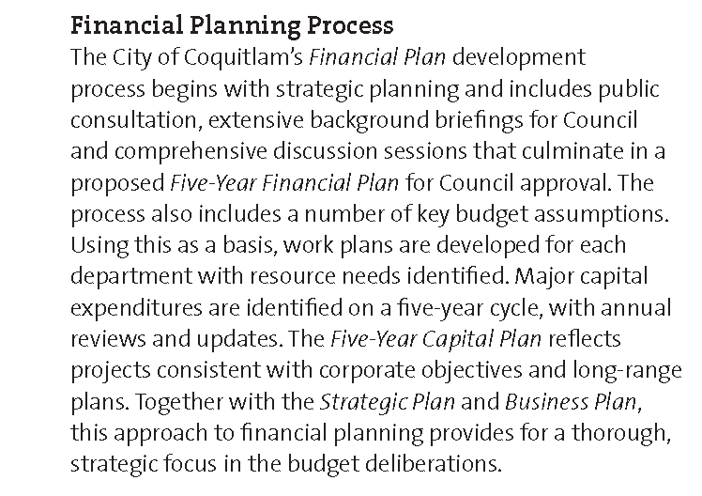
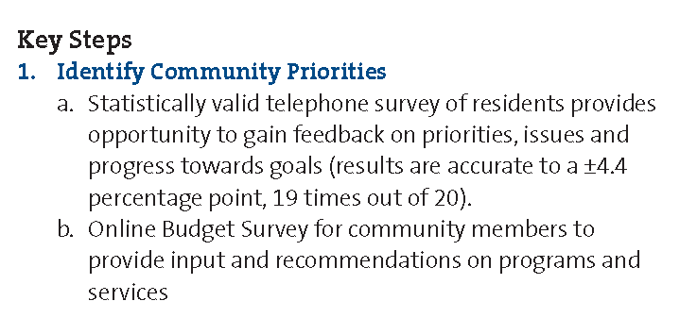
City of Coquitlam, BC.
64

Slide 65
22. Financial Forecasting in the Budget Preparation Process
Define assumptions – time horizon, objective, political/legal issues, major revenue and expenditure categories.
Gather information.
Preliminary/exploratory analysis
Business cycles
Demographic trends
Anomalies
Variables
65
Notes:
65
65
65

Slide 66
22. Financial Forecasting in the Budget Preparation Process
Select methods – extrapolation, regression, knowledge-based.
Implement methods, make the forecast, and forecast ranges.
Use the forecast.
Credibility of the forecaster
Presentation approach
Linking forecast to decision-making.
66
Notes:
66
66
66

Slide 67
City of Manhattan, KS.
67

Slide 68
23. Effective Budgeting of Salary and Wages
Personnel tracking system
Vacancy adjustments
Start dates
Trends, attrition
Frozen positions
Funded versus unfunded
Collective Bargaining Agreements
68
Notes:
68
68
68

Slide 69
23. Effective Budgeting of Salary and Wages
Impact of Inflation
Optimal Staffing Level
Comparison to other Governments
Staffing Guidelines
Classifying Position by Goal
Use of Volunteers/Temporary Positions
69
Notes:
69
69
69

Slide 70
23. Effective Budgeting of Salary and Wages
Compensation approaches
Step and grade systems
Pay for performance
Surveys
70
Notes:
70
70
70

Slide 71
23. Effective Budgeting of Salary and Wages
Personnel categorization
Capital versus operating
Cost allocation
Funding sources
Privatization or shared services
Monitoring
71
Notes:
71
71
71

Slide 72
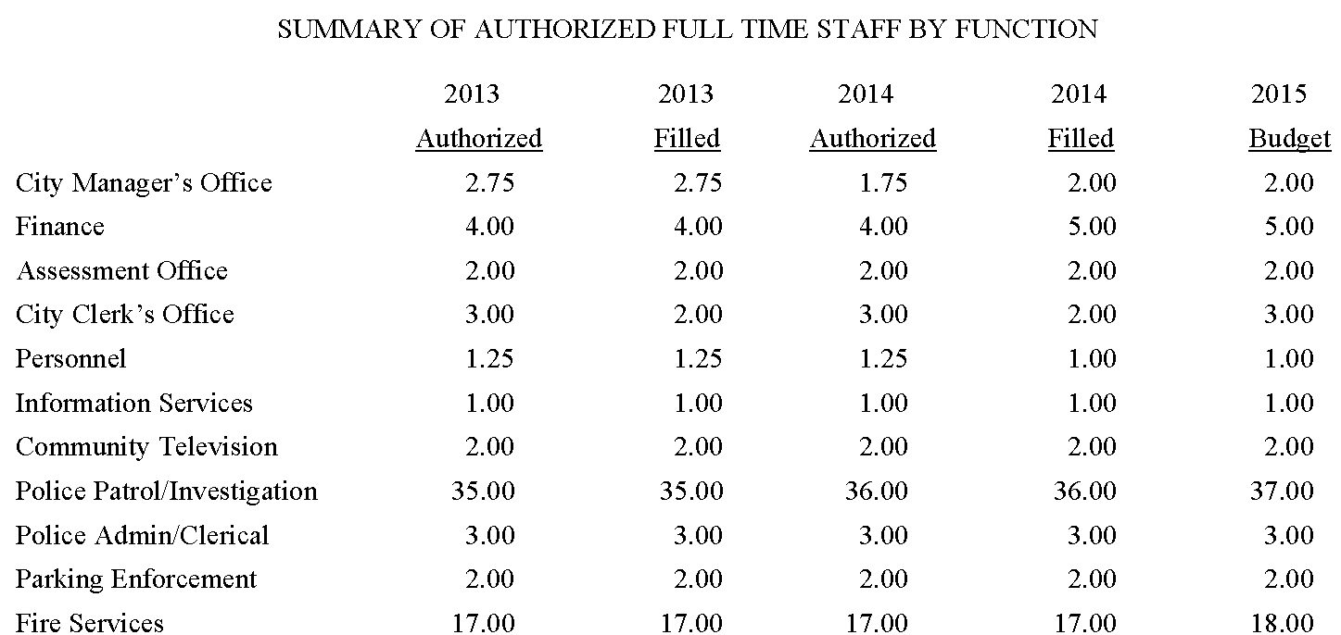
City of Rye, NY.
72
Notes:
Mike – mention whether you use full employment or hiring lag.

Slide 73
24. Inflationary Indices in Budgeting
Inflation indices
CPI (BLS)
GDP Deflator (BLS)
Construction Price Index (ENR)
Employment Cost Index (BLS)
Municipal Cost Index (American City & Co)
73
Notes:
73
73
73

Slide 74
24. Inflationary Indices in Budgeting
Alternatives to using indices
Economic consultants
Local universities
Peer governments
Vendor contacts
Industry specific journals
74
Notes:
74
74
74

Slide 75
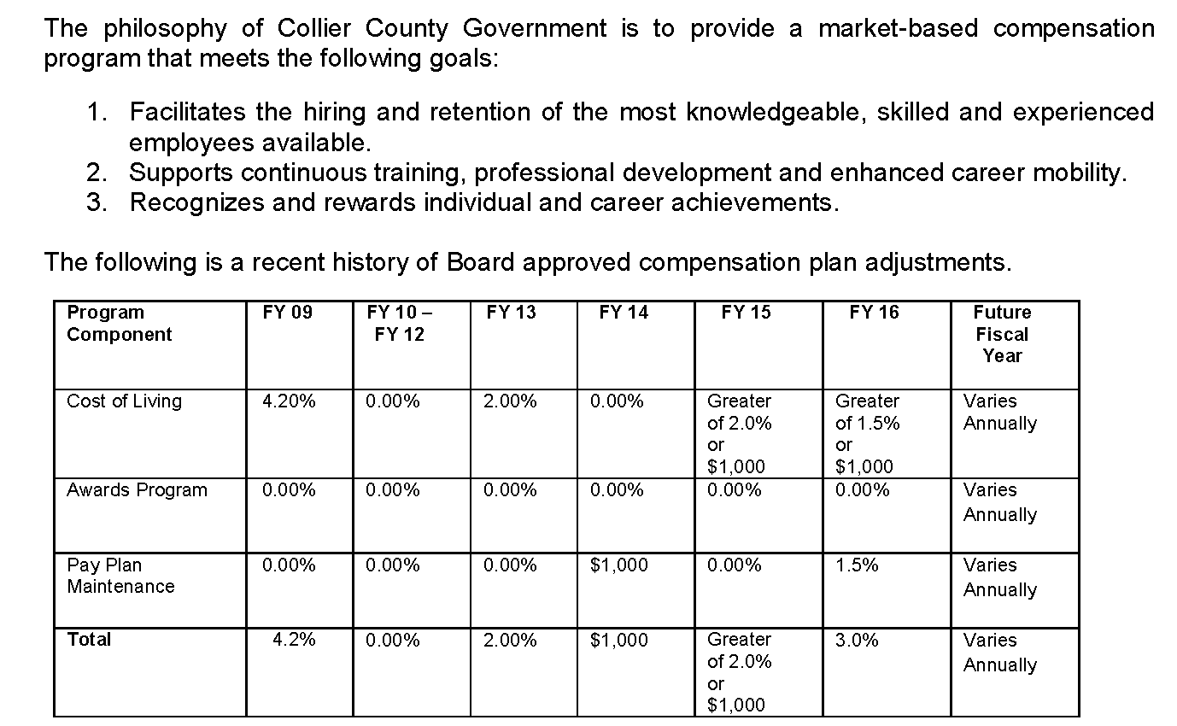
Collier County, FL.
75
Notes:
Collier County, Florida has many components to how it determines compensation for its employees. Cost of living is the major component.

Slide 76
25. Strategies for Managing Health-Care Costs
Monitor medical plan network and prescription drug discounts.
Set an appropriate level of employee cost sharing.
Encourage good consumer behaviors.
Analyze risks in self-insurance
Premiums, administrative fees
High-cost claims and high cost areas
Stop-loss insurance programs
Wellness programs
76
Notes:
76
76
76

Slide 77
25. Strategies for Managing Health-Care Costs
Measurements to assess plan performance
Medical loss ratio
Medical claim trends
Network discounts
Administrative fees
Prescription drug cost trend/generic drug substitution rate
77
Notes:
77
77
77

Slide 78
25. Strategies for Managing Health-Care Costs
Additional Strategies
Federal Requirements
Long-term Plan
Build Support
Educate Employees
Audit Plan Records
Rebid Periodically
78
Notes:
78
78
78

Slide 79
26. Evaluating Service Delivery Alternatives
Carefully analyze all aspects of a service delivery option before changing service delivery methods.
Current service – level of service, secondary functions
Required governmental control of service
Risks and benefits
Flexibility, reversibility of the arrangement
Public opinion
Specialized knowledge
79
Notes:
79
79
79

Slide 80
26. Evaluating Service Delivery Alternatives
Risks and benefits
Mgt capacity for alternative arrangement
Continuity of competitive forces
Financial risks – legal liability for performance and safety
Continuity
Risk mitigation
Transferring risk thru bonding/ insurance
Monitoring
Multiple vendors
80
Notes:
80
80
80

Slide 81
26. Evaluating Service Delivery Alternatives
Financial analysis
Focus on avoidable costs
Internal costing information accuracy
Present value analysis for multiple year contracts
Transitional financial impacts
Equipment, capital and infrastructure usage
Market input
Peer government comparisons
Communication and change mgt strategy
81
Notes:
81
81
81

Slide 82
Village of Bayside, WI.
82

Slide 83
27. Measuring the Full Costs of Government Service
Calculate the full cost of all services
Useful when considering alternative service-delivery options
Distinguish avoidable costs from unavoidable costs
Consider cost of transition
Consider offsetting revenues
83
Notes:
83
83
83

Slide 84
28. Pricing Internal Services
Identify Goals
Govern demand for a service
Develop enterprise rate models
Calculate indirect costs
Provide input for full costing
Discuss value of service
Promote competition in service delivery
Customize service levels for different customers
Decide Basis of Allocation
Cause and effect relationship
Benefit received
Fairness
Legal constraints
84
Notes:
84
84
84

Slide 85
Examples of Cost Allocation Bases
Internal Service | Basis
Payroll processing | No. of employees, No. of checks
Budgeting | Labor hours, size of budget
Insurance | No. of employees, experience
Legal services | Direct labor hours
Office space / rent | Square feet of space occupied
Procurement services | No. of POs, dollar volumes, direct labor
Vehicle costs | Miles driven, hours used
Information technology | No. of devices, server time, No. of help desk calls, direct labor hours
85
Notes:
85
85
85

Slide 86
29. Presenting Official Financial Documents on Your Government’s Website
Benefits
Heightened awareness
Universal accessibility (range of potential users)
Potential for interaction with users
Enhanced diversity (use of different languages)
Facilitated analysis (can extract data)
Increased efficiency (reduce redundant reports)
Lower costs
Broadened potential scope (use of hyperlinks)
86
Notes:
86
86
86

Slide 87
29. Presenting Official Financial Documents on Your Government’s Website
Specific guidelines:
Consistency with hardcopy version (if any)
Legibility (font size and page layout/direction) should be consistent
Pagination (numbers pages sequentially)
File size
Security (protect document from unauthorized changes)
87
Notes:
87
87
87

Slide 88
29. Presenting Official Financial Documents on Your Government’s Website
Specific guidelines:
Placement (predominately on homepage)
Software compatibility
Features such as zooming, bookmark, facing pages and search mechanism should be available
88
Notes:
88
88
88

Slide 89
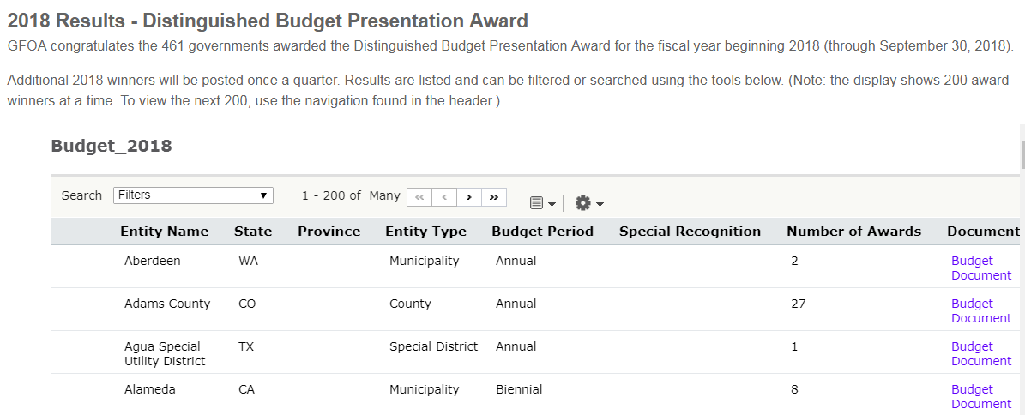

Slide 90
30. Making the Budget Document Easier to Understand
Organization – Consider Budget Awards criteria
Avoid excessive detail
Attractive, simple and easy to use design
Consistency – ex. department presentations
Highlights
- Consider a budget-in-brief
- Effective tables, charts, illustrations
Format
- PDF numbering matches document pages
- Hot links in table of contents
- All pages same direction
90
Notes:
90
90
90

Slide 91
City of Oceanside, CA.
91

Slide 92
City of Lenexa, KS.
92

Slide 93
31. Accurately Displaying Total Expenditures in Budget Presentations
Identification. Identify items that may be appropriated twice (e.g. interfund transfers, internal service funds). Determine how your organization uses internal service funds. Government-wide services may be provided by the organization versus externally (i.e. fleet, warehouse, and print/mail/graphics). Consider if different uses affect presentation preference for policy and other purposes. Look at the magnitude or size of the double-counted items and determine whether they are relevant or material to the overall budget. Consider any ramifications of the double-counting.
Requirements. Determine whether there are statutory requirements or state and provincial guidance for reporting the total budget, or any other legal rules, forms, and formats regarding presentation of budgets consistent with such statutory reporting.
Presentation. Determine the presentation preference for the organization. Consider how information may be interpreted by different audiences. Investigate how other peer governments report and present double-counting transactions in their budgets.
Transparency. Be transparent and consistent in presentation. Provide a written explanation in non-technical terms with the presentation. This may include presenting the total budget with the identified items and then net those items with an explanation.
93
Notes:
93
93

Slide 94
32. Department Presentation in the Operating Budget Document
Design. Enhances clarity, consistency, graphics
Brevity. Especially in financial schedules, text
Services. A description of services or functional responsibilities must be included.
Issues. Challenges, issues, opportunities
Revenues. May include any fees or charges that the department generates
Expenditures. Analysis in a broad manner
94
Notes:
94
94
94

Slide 95
32. Department Presentation in the Operating Budget Document
Staffing. Two options -- 1) organization chart as a supplement the overall organization chart of the government, or 2) brief schedule summary of headcount over a period of time (including the upcoming budget year
Prioritization/Goals and Objectives.
Performance Measures. Sometimes tied to government-wide strategic plan
95
Notes:
95
95
95

Slide 96
City of Cedar Rapids, IA.
96

Slide 97
33. Capital Budget Presentation
Directly link to, and flow from, the multi-year capital improvement plan.
Define capital expenditure.
Place in a distinct section of the document.
Focus presentation on financial sources and uses for both upcoming budget year and for multi-year plan.
97
Notes:
97
97

Slide 98
33. Capital Budget Presentation
Communicate the decision making process.
Calendar juxtaposed with operating budget schedule and statutory deadlines
Criteria for prioritization
Schedule for reporting status and completion dates
Identify projects as recurring or non-recurring
Greater detail for non-routine projects
98
Notes:
98
98

Slide 99
33. Capital Budget Presentation
Include detail for each major project.
Concise description - purpose, funding sources, total project cost and current budget year cost
Timetable, including phases
Graphic illustrations – photos, maps
Links to other organizational plans
Operating impacts, described and quantified
Additional info as links or references, avoiding excessive detail
99
Notes:
99
99

Slide 100
33. Capital Budget Presentation
A specific policy on operating impacts should be included under the capital section in the financial policies of the government. A rule might be established that the capital improvement program may not be submitted/approved until impacts are noted.
In order to accurately reflect and describe these impacts, assumptions should be noted. Staff involved with estimating operating impacts should be trained on how to set up the methodology.
100
Notes:
100
100

Slide 101
33. Capital Budget Presentation
Operating impacts can be classified into one of three elements or a combination of the three. These include increased revenues, increased expenditures or additional cost savings.
Long-range financial plans should include anticipated operating impacts from approved or anticipated capital projects.
101
Notes:
101
101

Slide 102
Town of Windsor, CO.
All improvements must by prioritized and ranked based on the following categories:
Priority I: IMPERATIVE (Must-Do) – Projects that cannot reasonably be postponed in order to avoid harmful or otherwise undesirable consequences.
A. Corrects a condition dangerous to public health or safety
B. Satisfies a legal obligation
C. Alleviates an emergency service disruption or deficiency
D. Prevents irreparable damage to a valuable public facility.
Priority II: ESSENTIAL (Should-Do) – Projects that address clearly demonstrated needs or objectives.
A. Rehabilitates or replaces an obsolete public facility or attachment B. Stimulates economic growth and private capital investment
C. Reduces future operating and maintenance costs
D. Leverages available state or federal funding.
Priority III: IMPORTANT (Could-Do) – Projects that benefit the community but may be delayed without detrimental effects to basic services.
A. Provides a new or expanded level of service
B. Promotes intergovernmental cooperation
C. Reduces energy consumption
D. Enhances cultural or natural resources.
Priority IV: DESIRABLE (Other Year) – Desirable projects that are not included within five-year program because of funding limitations.
102
Notes:
Mike – talk about how you prioritize.

Slide 103
City of Wichita, KS.
Significant Non-Routine Capital Expenditures Botanica Expansion
Council District: All
Type: New Construction
Category: Park
Start & Complete Date: 2012-2013
Cost (total): $2,650,000
Operational Costs (additional): $50,000
Operational Staff (additional): Minimal
Botanica continues to provide a premium attraction on the river that supports the Core Area and Neighborhood goal. The development of the gardens and infrastructure will strengthen the economic viability of the Botanica organization and support the City of Wichita in providing cultural arts programs for citizens and visitors.
The first phase of the Botanica Expansion Project included the development of a children’s garden comprised of approximately one acre located west of the current complex. New infrastructure for utilities and a road linking North Amidon to Sim Park Drive and Museum Boulevard were included. Additional improvements include more meeting and classroom space. Additional operating costs are estimated at $50,000 for maintenance and utilities.

Slide 104
34. The Statistical/Supplemental Section of Budget Document
Ensure relevance of data
Relate to rest of document
Fit to the specific type of government
Avoid excessive detail
Organize information by major category
Form of government
Geography
Community profile - demographics & economics
Provide explanations
104
Notes:
104
104
104

Slide 105
City of Markham, ON.
105

Slide 106
35. Basis of Accounting versus the Budgetary Basis
Clearly define the basis of budgeting.
State if the basis of budgeting and the basis of accounting are the same.
If not, note major differences and similarities.
Avoid technical terminology.
If use of technical terminology is unavoidable, define and explain terms.
106
Notes:
106
106
106

Slide 107
36. Budget Monitoring
Revenues. Governments need to carefully analyze sources of funds with particular attention to:
Seasonality, and whether comparable to prior observations
Any potential volatility and the resulting impacts
Trends and comparison to projections
Timing of receipts
Relationship to economic indicators and potential impacts
Changes in policy/practice of overarching governments involved in disbursement of revenues
Review of patterns at other similar/related governments
107
Notes:
107
107
107

Slide 108
36. Budget Monitoring
Expenditures. Governments need to carefully monitor all expenditures as well – including one-time uses and also examining key aspects of the following:
Personnel. Examine additional detail beyond just regular payroll expenses, including analysis related to hiring and vacancy information and also, depending on magnitude, analysis of part-time, overtime and special pay. In addition, conduct analysis of re-class/promotions to see if on-track with expectations. And whether fringe benefit costs are within budgeted expectations as well.
Non-personnel. Monitoring needs to include more than just current expenses. Governments need to analyze draw down of encumbrances, outstanding purchase orders, and its major contracts to develop a better picture of not only what was spent, but what remains to be spent.
108
Notes:
108
108
108

Slide 109
36. Budget Monitoring
How the elements should be analyzed
Root cause. Governments should move beyond just identifying deviations from budget versus actuals and work towards analyzing and articulating why deviations occurred in order to move towards resolution.
Time frame. Is it anticipated for any identified variance to continue or is there an underlying reason for the variance? How does the current spending pattern impact the subsequent year’s budget?
Requirements. Structure budget monitoring to meet any interim reporting requirements that the government may have, if possible.
109
Notes:
109
109
109

Slide 110
36. Budget Monitoring
At what level of detail should the analysis be conducted. This will vary depending on revenue/expenditure type. Organizations should discuss benefits of more versus less detail and its impacts on the timeliness, usefulness, and degree of difficulty to compile, among other factors. Potential levels at which to monitor the budget should mirror an organization’s chart of accounts, including the following:
Fund. Use for high level analysis and also may be the only monitoring needed for minor revenue/expenditure areas
Department. Analysis at this level can be used to establish budget accountability for department heads
Sub-department/division. Appropriate to analyze in particular if budget accountability resides at the sub-department head level.
Function. Use to track expenditures by major organizational responsibilities, i.e. public safety, public works, etc.
Object/account. Utilize for examining key types of expenditures at an organization-wide basis, such as overtime.
Project/program/grant/activity. Use to track revenue/expenditures of specific activities associated with areas that need additional scrutiny or for reporting requirements
110
Notes:
110
110
110

Slide 111
36. Budget Monitoring
Who is responsible and outlining roles
Production. Who produces the analysis, reports, etc. related to budget monitoring should be clearly articulated and disseminated.
Roles. Collaboration and ownership within the organization should be promoted to help provide context related to any potential issues.
Ownership. Identify who is responsible for resolving variances related to both spend and service delivery as well as any other problems identified that need attention.
111
Notes:
111
111
111

Slide 112
36. Budget Monitoring
Tools for conducting the analysis
Electronic system. An organization’s enterprise resource planning (ERP) system should drive data gathering and analysis related to budget monitoring. Use of the ERP system allows for real time information to be readily accessible for encumbrances and other time sensitive information as opposed to reliance on static, stand-alone reports.
Automation. Budget monitoring data and reports should be integrated into and generated by an organization’s ERP system to ensure efficient use of staff time and also consistency of information.
Overspend Protection. Governments should also ensure that mechanisms are in place in their ERP system to automatically prevent overspending of budget and notify the organization’s financial leadership.
Consistency. Off-system analysis should be consistently applied to all aspects of monitoring the budget and clearly articulated to both staff conducting the analysis and end users.
112
Notes:
112
112
112

Slide 113
36. Budget Monitoring
Communications
Frequency. The frequency of how often budget monitoring reports and information is generated should be agreed upon at all levels of the organization.
Delivery. How the information is communicated and to which stakeholders, both internally and externally, needs to be clearly structured.
Format. The format for how information related to budget monitoring needs to be clearly established as well.
Transparency. How can the information be shared on a wide spread basis to the community and include the proper context to best inform the public and minimize additional request for more information.
113
Notes:
113
113
113

