Slide 1
GFOASC Leadership: To Do List
Christy Todd and Jennifer Hairston

Slide 2
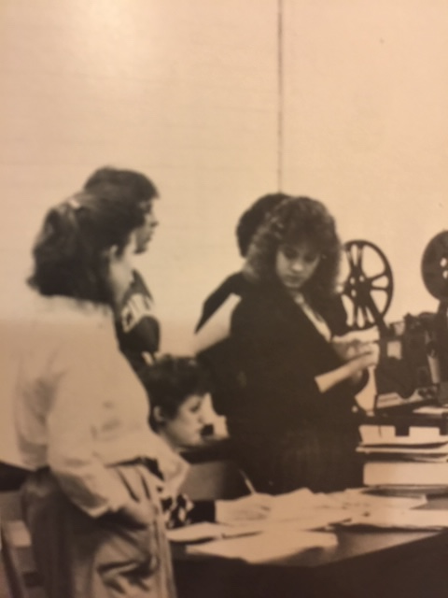
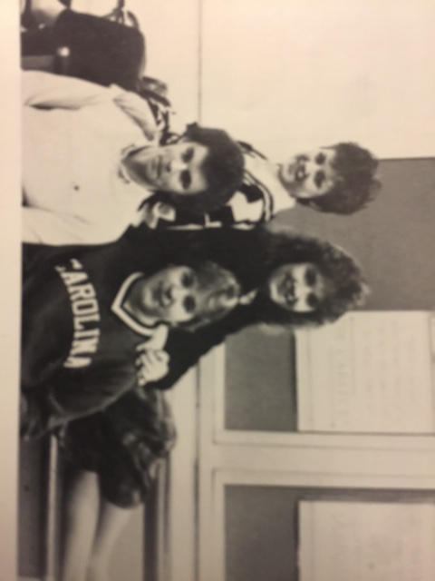
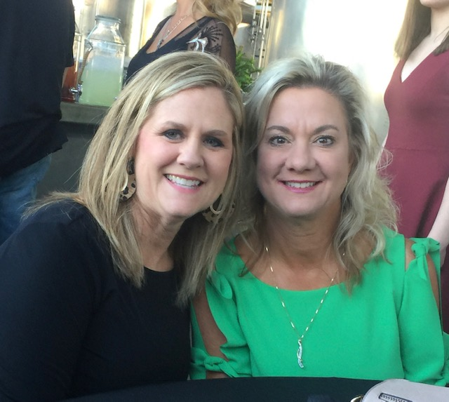
GFOASC Leadership: To Do List

Slide 3
GFOASC Leadership: To Do List
Jennifer and Christy – Where it all started!
Middle School
Became Friends, Did Student Council
High School –
Student Council, Conventions, Camps, Learning to be leaders
Where our leadership began to grow!

Slide 4
GFOASC Leadership: To Do List
“The first rule of leadership: everything is your fault.”
- A Bug’s Life

Slide 5
GFOASC Leadership: To Do List
“Life is like a dogsled team. If you ain’t the lead dog, the scenery never changes.”
-Lewis Grizzard

Slide 6
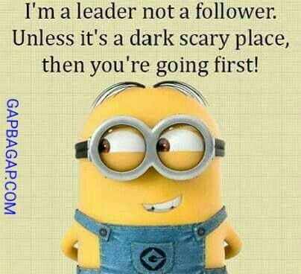
GFOASC Leadership: To Do List
“I’m a leader not a follower. Unless it’s a dark scary place, then you’re going first!"
- Minions from Despicable Me

Slide 7
GFOASC Leadership: To Do List
There are many leadership opportunities.
Community - examples
Work –examples
Today, the goal is for you to sharpen YOUR leadership skills!

Slide 8
GFOASC Leadership: To Do List
Group Activity
Traits of Best Boss
Traits of Not So Best Boss

Slide 9
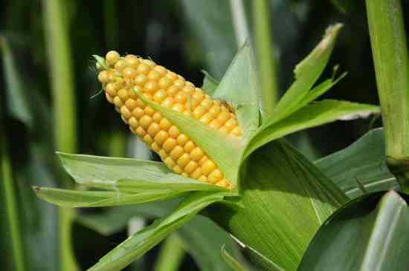
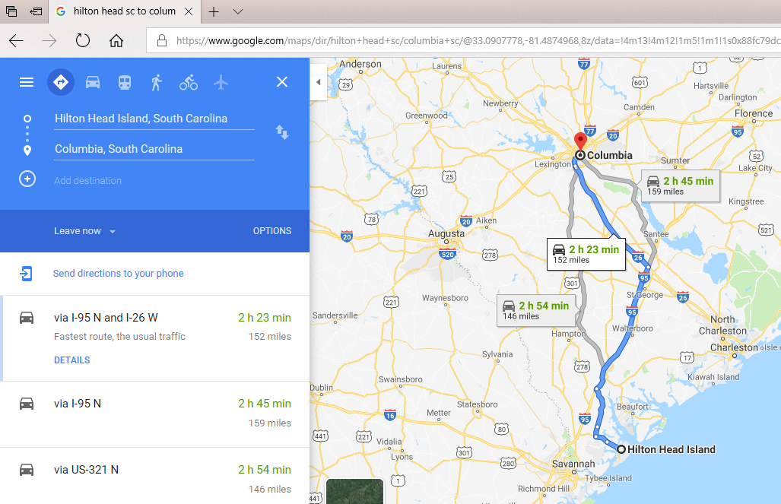
GFOASC Leadership: To Do List
Every Leader Needs a ……
TO DO LIST!
Keeps you productive
Makes you effective

Slide 10
GFOASC Leadership: To Do List
Now, we are going to talk about the top 5 things you need on your to do list.
1
2
3
4
5

Slide 11
GFOASC Leadership: To Do List
1. Develop Your Team
Doing vs. Developing
Doing gets the job done; developing gets the job done through the team.
Doing is transactional; developing is transformational.
Doing is focusses on performance; developing focuses on people.
Doing looks at what you are accomplishing; developing looks at whom you are cultivating.
Doing is about today; developing is about tomorrow.

Slide 12
GFOASC Leadership: To Do List
2. Create Accountability
Systems in place for yourself and your team
Necessary for growth
Gets results
Eliminates dysfunction within the team
Allows for personal growth

Slide 13
GFOASC Leadership: To Do List
3. Be A Clear Communicator
Concise and articulate
Listens well and seek to understand before reacting
Maintain poise in stressful situations to draw out clear thinking
Provide candid, timely feedback
The most important thing in communication is to hear what isn’t being said. - Peter F. Drucker
Wise men speak because they have something to say; Fools because they have to say something. - Plato

Slide 14
GFOASC Leadership: To Do List
4. Coach Your Team
Morning/Daily check-ins with your team
Team provides status updates without being asked
Open communication – they feel comfortable enough to talk with you
Have conversations with your team – not monologues

Slide 15
GFOASC Leadership: To Do List
Coach Your Team (Continued…)
Intentional one-on-ones with them
Schedule them – not just review times
Informal meetings
About work/what they do/accomplishments
Personal – but keep to a minimum
Stakeholders and employees

Slide 16
GFOASC Leadership: To Do List
Coach Your Team (Continued…)
Protect & Intercede
Protect – how you talk about them to others
Intercede – how you talk to them about what happened
Alone, we can do so little; together we can do so much. - Helen Keller

Slide 17
GFOASC Leadership: To Do List
5. Set the Tone
Remember – you set the tone for the team
Keep a positive attitude – even in the hard times
Take charge when you need to
Create a healthy culture
Healthy vs. toxic
To effectively communicate, we must realize that we are all different in the way we perceive the world and use this understanding as a guide to our communication with others. - Anthony Robbins

Slide 18
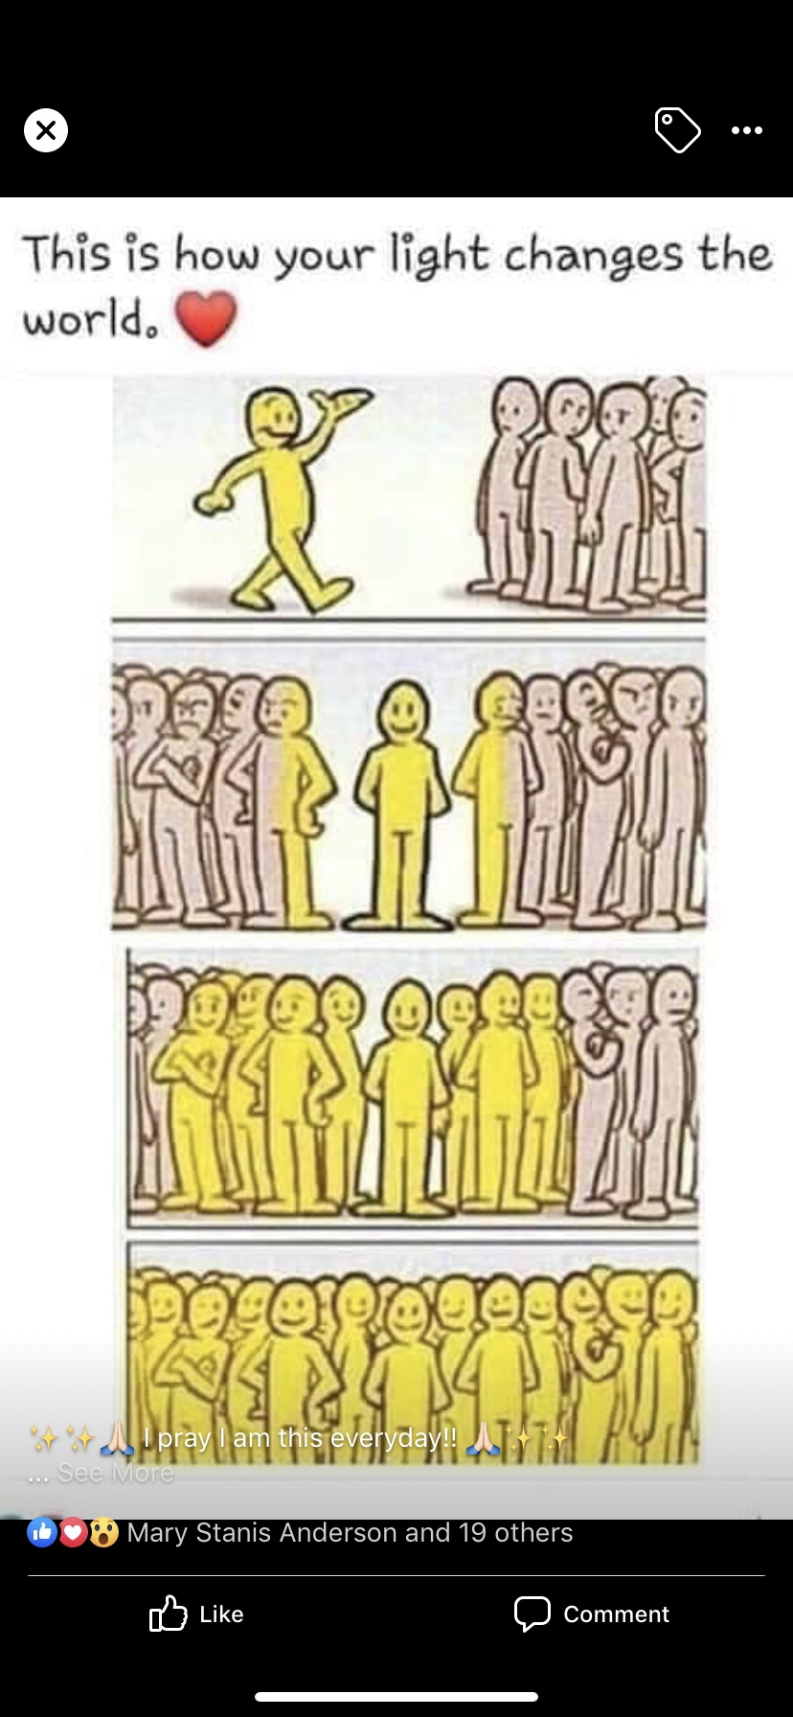
GFOASC Leadership: To Do List

Slide 19
GFOASC Leadership: To Do List
Activity
Recreate your to list to be a “sharper” leader
1
2
3
4
5

Slide 20
GFOASC Leadership: To Do List
The weak can never forgive. Forgiveness is the attribute of the strong.” -Gandhi
“The only real training for leadership is leadership.” - Anthony Jay
“Remember the difference between a boss and a leader; a boss says ‘Go!’- a leader says ‘Let’s go!” - E.M. Kelly

Slide 21
GFOASC Leadership: To Do List

