Slide 1
Automating for the Future: The Payments Evolution
Presented to:
October 15, 2019

Slide 2
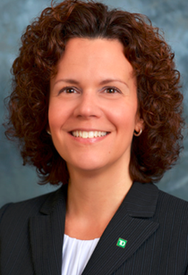
Adrienne Terpak, CTP
VP, Segment Manager Treasury Management Technical Marketing
Kris Kowal, CSPO
VP, Digital Innovation
& Transformation
Treasury Management Product

Slide 3
Overview
Introduction
Treasury Perspectives Survey
Evolving Customer Experience
Future-proof Your Payments
PSA: Fraud & Security Controls
Continuing your Journey: Engage Your Partners

Slide 4
Audience Question
Considering all your operations, what area do you spend the most of your time working on?
Payment Management
Cash Forecasting
Cash Positioning & Reporting
Reconciliations & Accounting

Slide 5
Treasury Perspectives Survey – Key Findings
Less optimism than in 2018
Limited impact from tax reform
Trade conflict NOT a top concern
Plans to spend despite uncertainty
Manual processes continue to bog down operations
Payments & forecasting are time consuming
Over 1/3 cannot perform all duties
TD Bank, N.A. | Bank Deposits FDIC Insured

Slide 6
Treasury Perspectives Survey – Key Findings
Regulatory pressure is high and expected to increase
KYC remains a top concern
Excited about emerging new tech
Slow to apply new technology
TD Bank, N.A. | Bank Deposits FDIC Insured

Slide 7
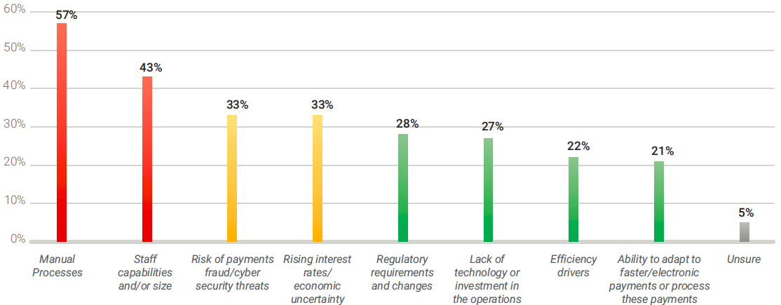
Treasury Perspectives Survey: What Are Your Top Operational Challenges?
TD Bank, N.A. | Bank Deposits FDIC Insured

Slide 8
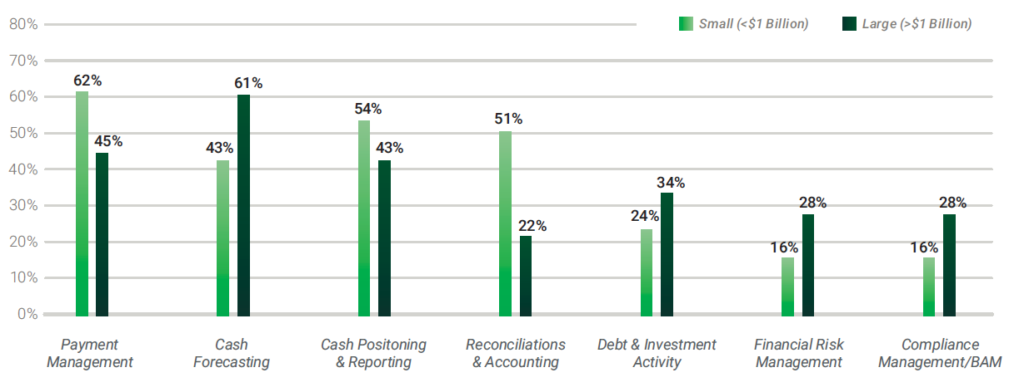
Treasury Perspectives Survey: What Activities Take the Most Time?
TD Bank, N.A. | Bank Deposits FDIC Insured

Slide 9
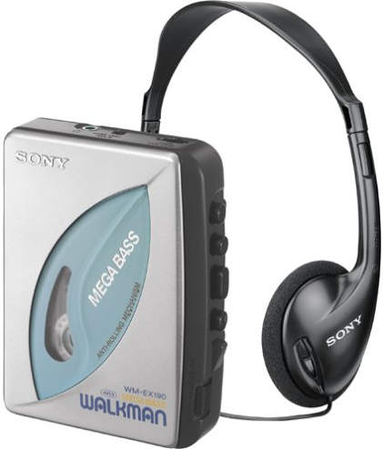
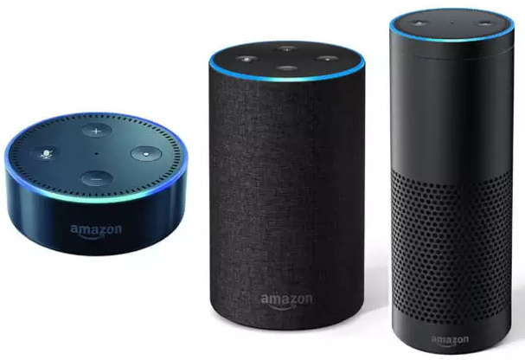
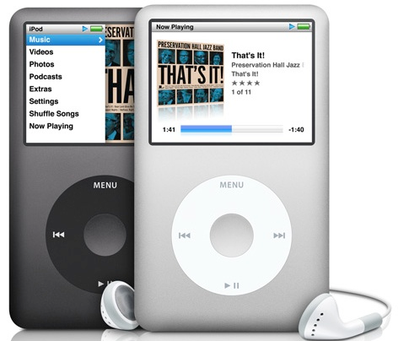
Where does your organization fit in?
Transactional
Strategic
Products/Service:
Manual deposits
Excel based schedules and reconciliation
Paper based invoices
Credit card terminal on site
Checks issued for payments
Products/Services:
Treasury Management Solution
File based information exchange
Lockbox services
Remote check deposit
ACH Originations
Basic website
Armored car services
Products/Services
ERP – Banking – CRM APIs
Consolidated Receivables & Payables
Workflow solutions
Customer Portals with electronic billing and payments
Alternative payment acceptance
Contextual AI insights
TD Bank, N.A. | Bank Deposits FDIC Insured

Slide 10
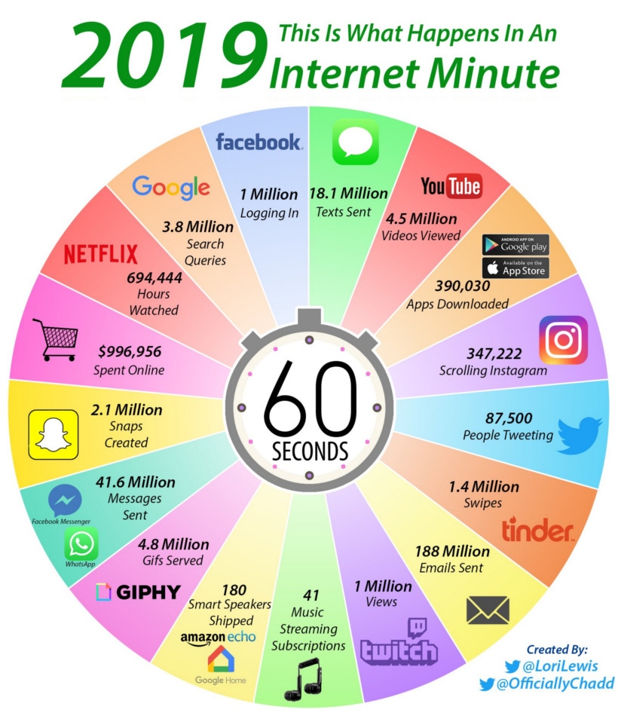
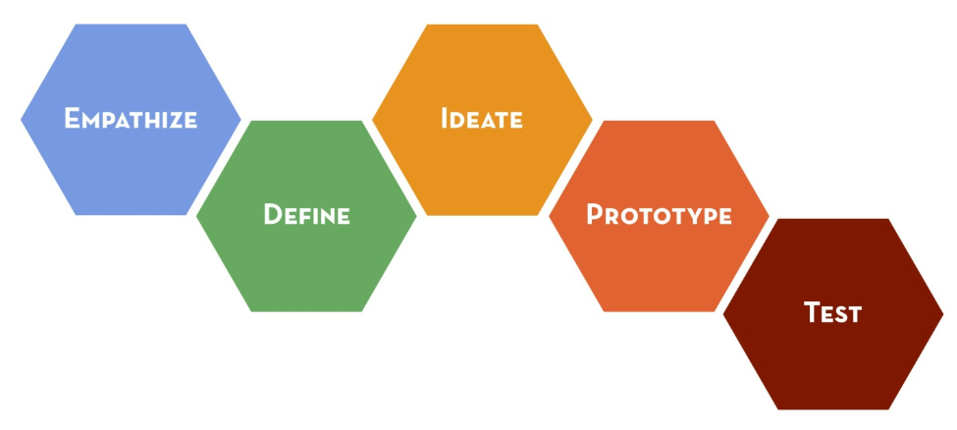
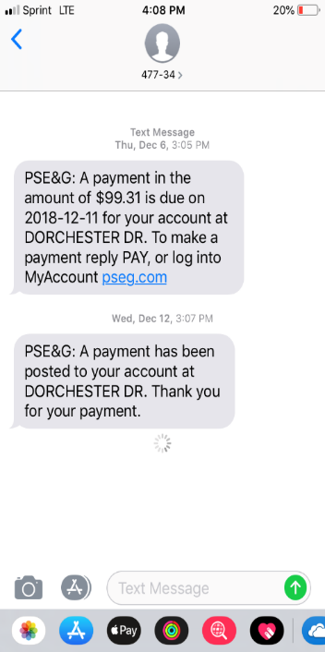
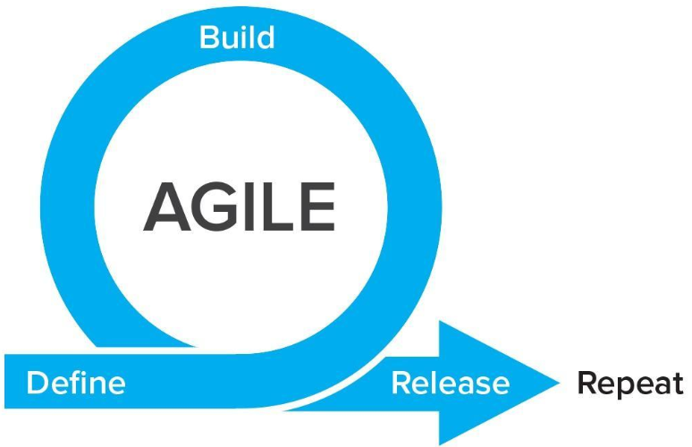
Evolving the Customer Experience
Customer Preferences
Change Drivers
TD Bank, N.A. | Bank Deposits FDIC Insured

Slide 11
Future-proof your payables Automate Payments, Improve Working Capital, and Leverage Electronic Methods

Slide 12
The State of B2B Payments: The Paper Problem
30%
79%
47%
Less than 30% of businesses make more than 70% of their payments electronically¹
of organizations experienced BEC fraud in the past year, 8% suffered a loss
of businesses say eliminating paper or implementing AP automation is a top priority for 2019 and beyond.³
¹ B2B Payments & Working Capital Management Survey 2018, Strategic Treasurer, Bottomline Technologies & Bank of America Merrill Lynch
² 2019 Strategic Treasurer Payment Fraud & Controls Survey
3 2019 Ardent Partners State of ePayables
TD Bank, N.A. | Bank Deposits FDIC Insured

Slide 13
Payment Networks
¹RPMG Electronic Accounts Payable Benchmark Survey (2015)
TD Bank, N.A. | Bank Deposits FDIC Insured

Slide 14
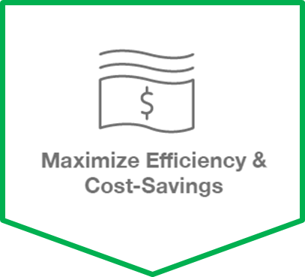
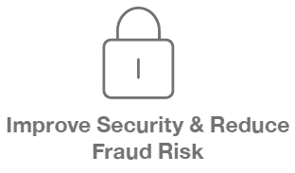
Payment Networks – why use them?
Reduce the time AP staff spends on manual activities; free them up for value-add activities
Cut down on overall AP payment processing costs and ensure optimal payment methods are used
Gather, authenticate, and store vendor payment information in a central, secure location
Reduce exposure to check fraud with conversion to secure electronic payments.
Monetize a greater portion of AP spend with rebate opportunity on virtual card and ACH.
Greater control over payment timing.
Transform AP to a revenue driver
TD Bank, N.A. | Bank Deposits FDIC Insured

Slide 15
Audience Question
To what extent have you automated your payment processes?

Slide 16
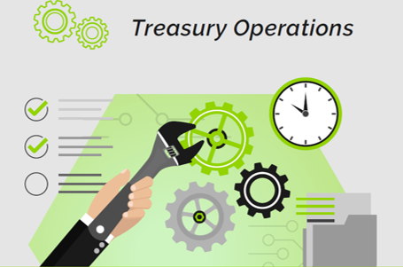
Treasury is Overworked
Treasury is Overworked and Strained by Manual Processes
Source: 2019 Treasury Perspectives Survey
TD Bank, N.A. | Bank Deposits FDIC Insured

Slide 17
Future-proof your receivables Automate Payments, Improve Working Capital, and Leverage Electronic Methods

Slide 18
Five Steps to Receivables Automation
Analyze Current Payments Mix
1
Be Proactive about Electronic Receivables
2
Plan for Partial Payments
3
Strengthen Data Matching
4
Consolidate Data Streams
5
SOURCE: AFP Five Steps to Receivables Automation
TD Bank, N.A. | Bank Deposits FDIC Insured

Slide 19
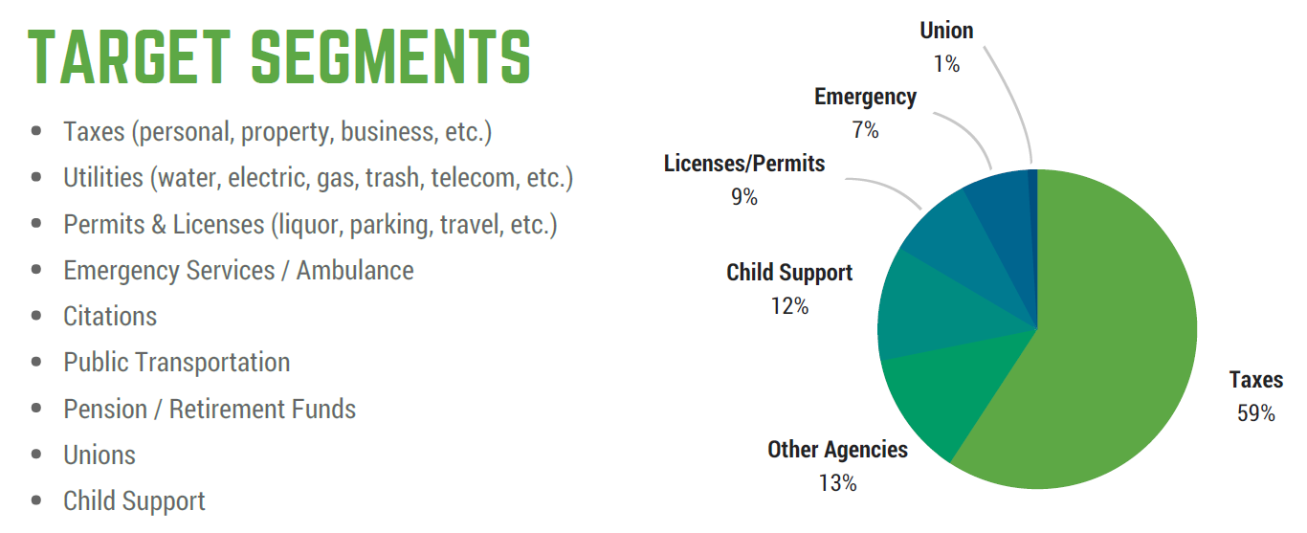
Receivables Automation
TD Bank, N.A. | Bank Deposits FDIC Insured

Slide 20
Receivables – Online Billing & Payment
Business Value
PDF Bill Presentment
Hierarchies (Agencies/Departments)
Secure hand-off via front-end website
Convenience and service fee model
Customer Value
Recurring payments
Multiple payment channels
Single sign-on
TD Bank, N.A. | Bank Deposits FDIC Insured

Slide 21
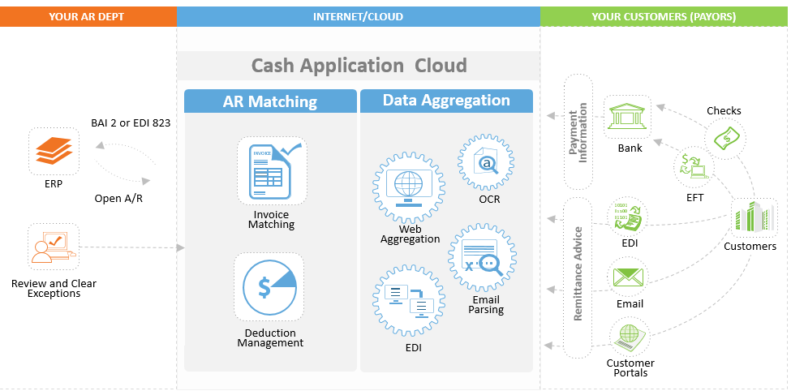
Receivables – Consolidated Automation Workflow
TD Bank, N.A. | Bank Deposits FDIC Insured

Slide 22
Contextual AI Capabilities
Today
Wire? ACH? Check?
Check or Credit?
Near Future
AI: Who do you want to pay?
AI: When do you want the payment to arrive?
AI: Who do you want to pay?
AI: When do you want the payment to arrive?
TD Bank, N.A. | Bank Deposits FDIC Insured

Slide 23
PSA: Payment Fraud & Security Controls

Slide 24
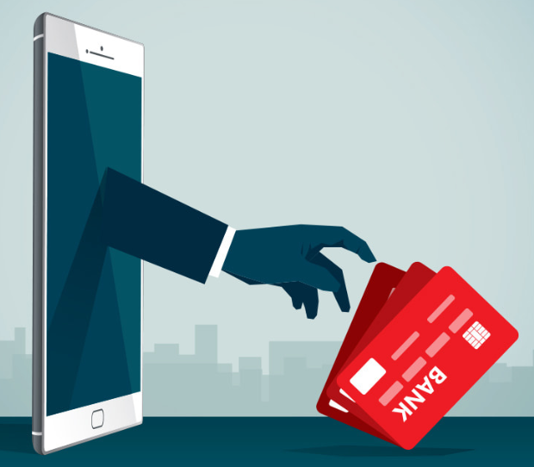
Audience question
Has your organization experienced more than one type of fraud in the last 12 months?
TD Bank, N.A. | Bank Deposits FDIC Insured

Slide 25
Treasury Fraud & Controls Survey – Quick Stats
of corporates believe the threat of fraud has increased in the past year.
73%
of corporates train their employees on security at least annually.
64%
TD Bank, N.A. | Bank Deposits FDIC Insured

Slide 26
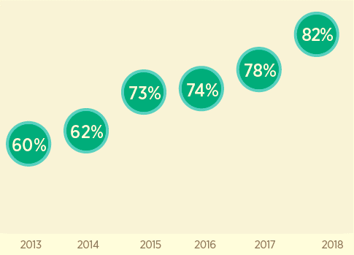
Payments Fraud – Still on the Rise!
Dramatic increase in payments fraud activity over last 4 years
A record-setting 82 percent of financial professionals report that their organizations experienced attempted and/ or actual payments fraud in 2018
Source: 2019 AFP Payments Fraud and Control Survey
TD Bank, N.A. | Bank Deposits FDIC Insured

Slide 27
Payments Fraud – Still on the Rise!
2017 data: 74% 48% 30% 28% 13%
Source: 2019 AFP Payments Fraud and Control Survey
TD Bank, N.A. | Bank Deposits FDIC Insured

Slide 28
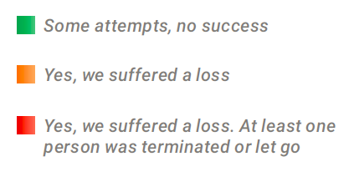
Prominent Types of Fraud
TD Bank, N.A. | Bank Deposits FDIC Insured

Slide 29
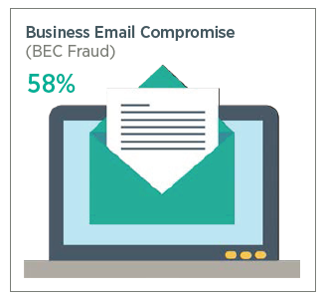
Prominent Types of Payments Fraud
>$12.5 Billion
Global losses due to BEC in the last 5 years
(FBI Internet Crime Center, 2013-18)
Source: 2019 AFP Payments Fraud and Control Survey
TD Bank, N.A. | Bank Deposits FDIC Insured

Slide 30
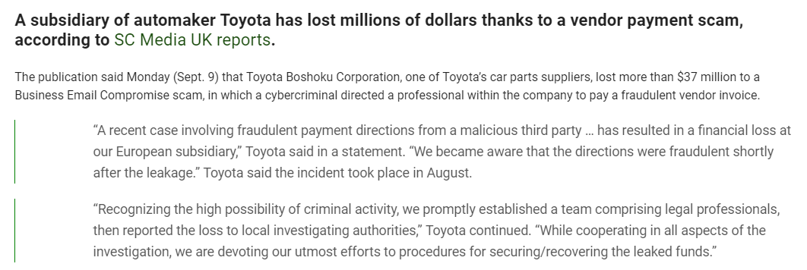
Fraud and Headline Risk
Source: pymnts.com (September 10, 2019)
TD Bank, N.A. | Bank Deposits FDIC Insured

Slide 31
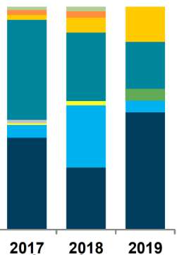
Government Data Breaches
Q2 2019 – 55% increase in reported breaches v. Q1
The education sector accounted for 71% of breaches
Phishing was the most prolific vector, accounting for 33% of reported breaches
SOURCE: www.CIsecurity.org MS-ISAC Identified SLTT Government Data Breach Vector Yearly Breakdown
TD Bank, N.A. | Bank Deposits FDIC Insured
31

Slide 32
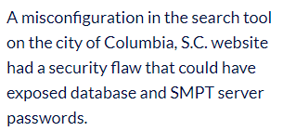
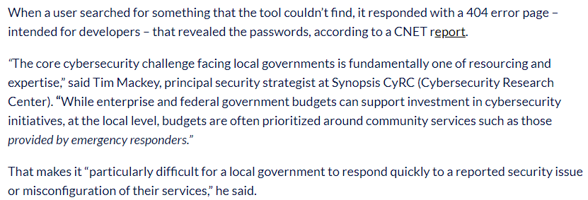
Source: scmagazine.com (April 26, 2019)
TD Bank, N.A. | Bank Deposits FDIC Insured

Slide 33
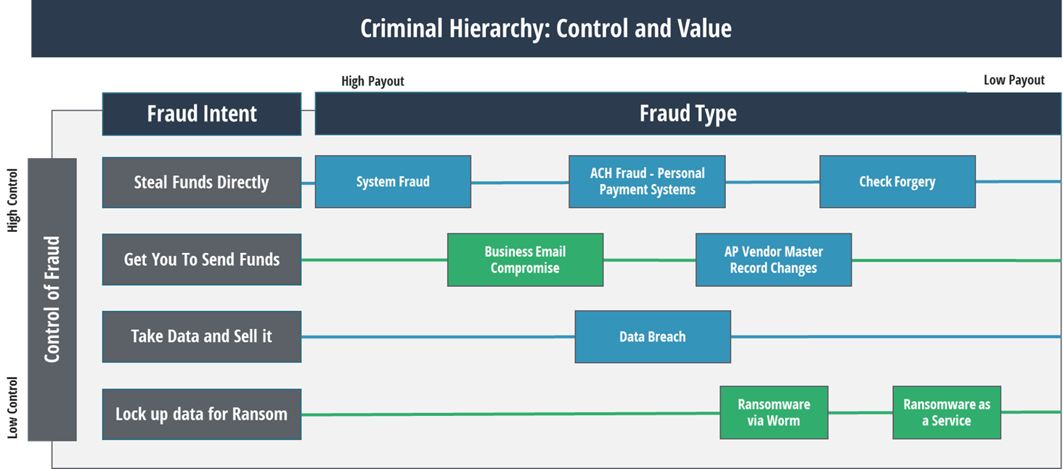
Threat Actor Playbook
TD Bank, N.A. | Bank Deposits FDIC Insured

Slide 34
Fight Back with Security Layers
No “magic bullet” to stop fraud
Principle of
Least Privilege
LAYERING your defenses is the best approach
Multi-factor authentication
Segregation of Duties
Policies, Procedures
Encrypt / Protect Sensitive Data
at rest and in transit
Network Security
Firewall / Antivirus / Antispyware
TD Bank, N.A. | Bank Deposits FDIC Insured

Slide 35
Prevention Tips for Prominent Fraud Types
BEC Fraud
Use multi-factor authentication on all email/messaging systems
Train employees how to identify and respond to suspicious emails or requests
Cyber/Data Theft
Encrypt data, both at rest and in transit
Install and maintain latest antivirus and firewall software
Employ tools to monitor cloud environments
TD Bank, N.A. | Bank Deposits FDIC Insured

Slide 36
Prevention Tips for Prominent Fraud Types
Check Forgery
Stop using checks, convert to e-pay methods
Utilize positive pay and debit filters/blocks for electronic and paper-based payments
Reconcile accounts daily
Emerging Technologies
Biometrics
Tokenization
Monitoring Software
TD Bank, N.A. | Bank Deposits FDIC Insured

Slide 37
10 Common Risk Management Practices
Cultivate a Risk Management Culture within the organization
Mandate Process Controls including dual control and segregation of duties
Isolate a Computer / Avoid Public Wi-Fi for banking and payment initiation
Pick up the Phone to authenticate ALL payment requests (internal & vendor)
Inspect Bank Accounts Daily and reconcile frequently
Structure Bank Accounts to isolate activities and leverage inherent controls
Use Fraud Deterrent Banking Services like Positive Pay, ACH Blocks/Filters, etc.
Monitor Information with credit reporting agencies and state record databases
Initiate Background Checks on ALL employees and contractors
Notify the Bank & Law Enforcement if you are under attack
TD Bank, N.A. | Bank Deposits FDIC Insured

Slide 38
Helpful Resources
Resource | Link¹
FBI Cyber Crime FBI Internet Crime Complaint Center InfraGard | https://www.fbi.gov/investigate/cyber http://www.ic3.gov/default.aspx https://www.infragard.org
National Cyber Security Alliance (NCSA) | https://staysafeonline.org
TD Bank Security Center Fraud Prevention Tips | http://www.tdbank.com/popup/cm_secure_notify.html https://www.tdbank.com/exc/pdf/tms/fraudprotection.pdf
TD Bank and Strategic Treasurer Treasury Perspectives 2019 Survey Report | https://strategictreasurer.com/2019-treasury-perspectives/
Strategic Treasurer 2019 Treasury Fraud & Controls Global Survey Report | https://strategictreasurer.com/2019-treasury-fraud-controls/
NACHA Current Fraud Threats Protecting Against Fraud: How to Spot and Prevent Fraud Schemes Threats | https://www.nacha.org/content/current-fraud-threats https://www.nacha.org/sites/default/files/2019-06/2019%20Fraud%20Fact%20Sheet%20FINAL.pdf
¹ TD Bank does not control the content or privacy policies associated with any third party websites provided.
TD Bank, N.A. | Bank Deposits FDIC Insured

Slide 39
Next Steps: Bringing It All Together

Slide 40
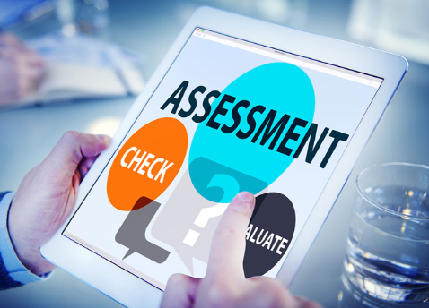
Strategy and Planning
Self Assessment
What gaps exist in your current process?
How many manually processes do you have?
Are there further opportunities for automation?
Do you have the visibility into key operations and financial data?
Develop a Roadmap
Where do you want to be in one, two, three years?
Remember it will take time "Rome wasn't built in one day"
Continue your journey, engage your partners!
TD Bank, N.A. | Bank Deposits FDIC Insured

Slide 41
Thank You
Adrienne D. Terpak, CTP
TD Bank, America's Most Convenient Bank®
VP, Treasury Management Services
Segment Manager, Technical Marketing
M: (551) 777-0563
Email: Adrienne.Terpak@td.com
Mary Suddeth
TD Bank, America's Most Convenient Bank®
VP, Treasury Management Officer
O: (864) 421-1303
M: (864) 444-8678
Email: Mary.Suddeth@td.com
Kris Kowal, CSPO
TD Bank, America's Most Convenient Bank®
VP, Digital Innovation & Transformation
Treasury Management Services Product
O: (856) 533-6861
Email: Kris.Kowal@td.com
TD Bank, N.A. | Bank Deposits FDIC Insured

