Slide 1
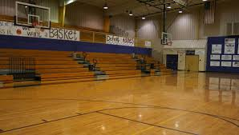
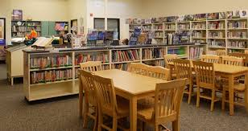

Certificates of Insurance,
Facility Use Agreements,
& Contracts
Derek Slate, CIC, CSRM
Vice President of Sales
Randy Cranfill, MESH, CPSI, CSRM
Director of Safety and Loss Prevention
October 15, 2019

Slide 2
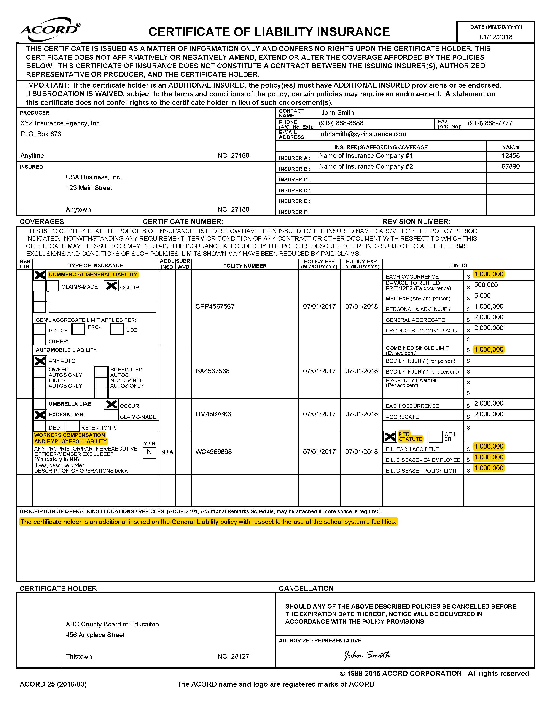
What are Certificates of Insurance?

Slide 3
What are Facility Use Agreements?

Slide 4
What are Facility Use Agreements?

Slide 5
Why does your Public Entity need to require one or both of these documents?
Requiring these documents provides some of the BEST ways to transfer liability back to parties that benefit from doing business with your entity or benefit from the use of your facilities.
It is not 100% guaranteed to shield your Entity from all claims, but they are especially effective in preventing claims that result from the negligence of the User from coming back on you.
Protects the insurance policies from being used- avoid premium increases, avoid uninsured individuals or businesses from being included on your Workers’ Compensation audit because COIs cannot be presented to the auditor.
FYI most general liability policies written for school systems are not on audit.

Slide 6
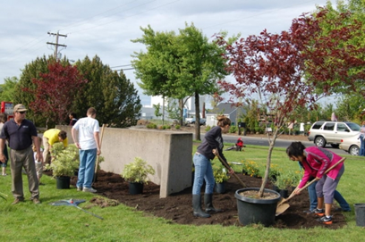
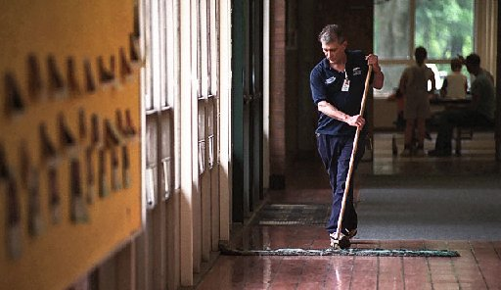
Some examples that would require only a certificate of insurance:
Landscaping contracts
Janitorial contracts
Food vendor contracts
Service contractor agreements
- plumbing
- roofing
- heating & air conditioning

Slide 7
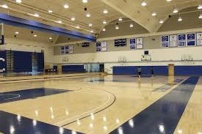
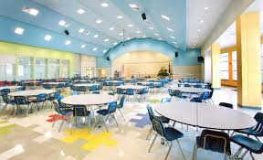
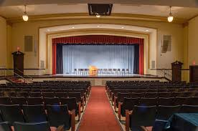
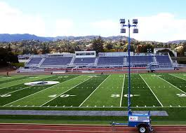
Examples where both a certificate of insurance and a facility use agreement are needed:
Gym rentals
Cafeteria rentals
Auditorium rentals
Athletic fields and grounds

Slide 8
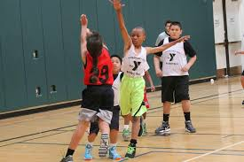
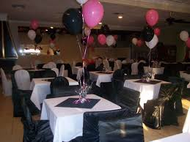
Any concerns with Certificates and Facility Use Agreements?
You must be willing to evenly enforce the requirements for Certificates of Insurance and the insurance requirements under the Facility Use Agreements.
It is difficult to allow the YMCA to use the gymnasium for basketball (usually no problem because they have insurance) and not allow the Smith Family reunion to use the gym because they won’t purchase the insurance for a one day event.

Slide 9
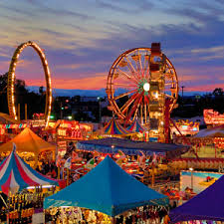


Any concerns with Certificates and Facility Use Agreements?
What can the Smith Family do?
  Obtain a Special Events Insurance Policy
    - Family Reunions
    - Children’s birthday parties
    - Wedding/baby showers
    - Other examples?
What does a Special Events Policy do?
Is it expensive?
Where can you purchase one?

Slide 10
Any concerns with Certificates and Facility Use Agreements?
Administrators need to be informed - only use vendors that will provide certificates of insurance. Examples include painters, landscapers, and sheriff’s deputies that may be hired by principals or directors to perform tasks at their individual locations or sites as opposed to a central office contract.
These folks can “slip through” the cracks.

Slide 11
Rules of Workers’ Compensation
The North Carolina Workers’ Compensation Act states corporations, sole proprietors, limited liability companies, partnerships, and any other business ventures must obtain workers’ compensation insurance.
People who are sole proprietors, members of LLCs, committee members, and partners are not automatically included as employees, even if the business is non-profit and meet specific requirements under the NC General Statutes. Corporate officers may elect to be excluded from coverage; however, they are still counted when determing if a business has three or more employees.
Independent contractors may be found by the Industrial Commission as employees due to the amount of control used by the employer.
Employers may still be held liable for subcontractors with no workers’ compensation insurance regardless of the number of employees you or the subcontractor employs.

Slide 12
Rules of Workers’ Compensation
Failure to carry workers’ compensation insurance may result in:
    Financial penalties
    Misdemeanor charges
    Felony charges
    Imprisonment
Exceptions to these rule include:
    Employees of specific railroads
    Casual employees
    Domestic servants directly employed by a household
    Farm laborers with less than ten full-time (non-seasonal) employees
    Federal government employees
    Sellers of agricultural products for the producers on commission or for other compensation, paid by the producers, provided the product is prepared for sale by the producers.

Slide 13
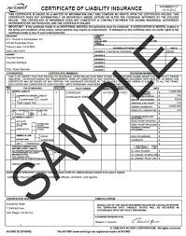
Any concerns with Certificates and Facility Use Agreements?
The limits required or requested by the public entity should at least match their limits which are usually $1,000,000 for general liability. It is a good idea to request auto liability and employer’s liability (part of the workers’ compensation policy) to be the same as the general liability ($1,000,000.) Some public entities require umbrella policies which provide limits higher than $1,000,000.

Slide 14
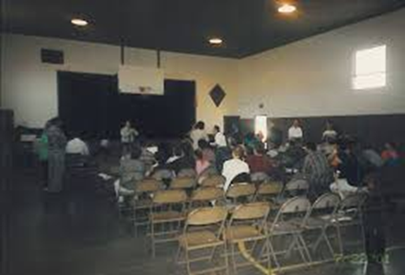
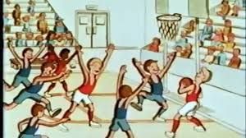
Any concerns with Certificates and Facility Use Agreements?
The individual(s) / group(s) / organization(s) must comply with the terms and conditions of the agreements
Church example
Holiday sports tournament example
Others?

Slide 15

How about Additional Insureds?
What does it mean to be an additional insured?
Which policies can we ask to be an additional insured from our vendors or groups that use our facilities?
Why do we want to do this?
    Primary vs. Secondary

Slide 16

Additional Insured Status in Reverse?
Are BOEs asked to name other people / organizations / entities as additional insureds onto the BOE’s policy?
Examples:
  High School Graduations
  Swim meets
  Other events?

Slide 17
Any concerns with Certificates and Facility Use Agreements?
An effective program will establish a system to request and track the expiration dates of the contractors and vendors that work on behalf of the BOE on an ongoing basis. Requests for updated certificates need to be made at least 30 days ahead of the expiration date.
Make sure your PTOs and/or PTAs purchase general liability coverage for their programs and events. Someone at the school system needs to keep track of their insurance too.

Slide 18
For all the good that certificates can do, they do have their limitations:
The COI does not address the financial ratings of the insurance providers.
The COI does not address the financial solvency of the vendor.
The COI cannot guarantee that the vendor will continue to pay and keep their policy in force.
However, certificates are currently the best option to manage the insurance process.

Slide 19




14
Common Examples Where
Things Can Go Wrong

Slide 20
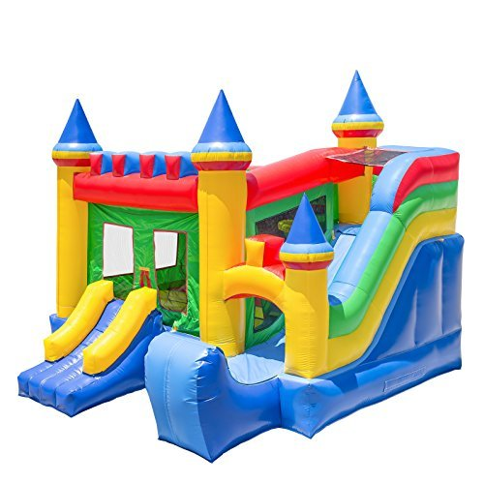
Inflatables
Why?
Fix this?

Slide 21

Law Enforcement
Why?
Fix this?

Slide 22

Little League/Parks & Recreation
Why?
  Cobblestone walk example
Fix this?

Slide 23

Volunteers
Why?
Fix this?

Slide 24

Painters/ Landscapers
Why?
  Is free or cheaper always better?
  Tree trimmer examples
Fix this?

Slide 25

Continuing Education Instructors for Teachers
Why?
Fix this?

Slide 26

Referees and Game Officials
Why?
Fix this?

Slide 27

Before & After School Care Programs
Why?
Fix this?

Slide 28

High School Athletics & Summer Camps
Why?
  Helicopter example
  Gator example
Fix this?

Slide 29

High School Athletics & Band Boosters
Why?
Fix this?

Slide 30

Church Groups/Civic Groups/ & Others
Why?
Fix this?

Slide 31

County Employee Nurses
Why?
Fix this?

Slide 32




Outside IT Vendors?
Problems?
Why?
Fix this?

Slide 33
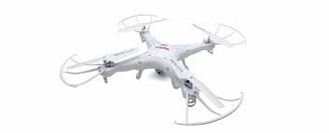
One for the Road…
Drone Vendors
Why?
Fix this?

Slide 34



